Slide 1
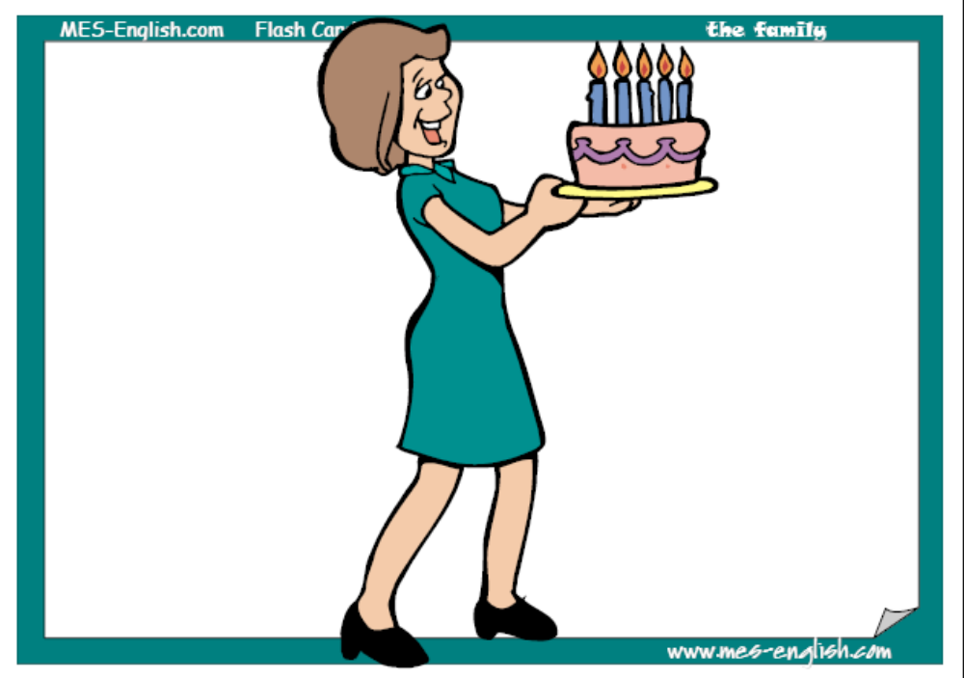
Mother

Slide 2
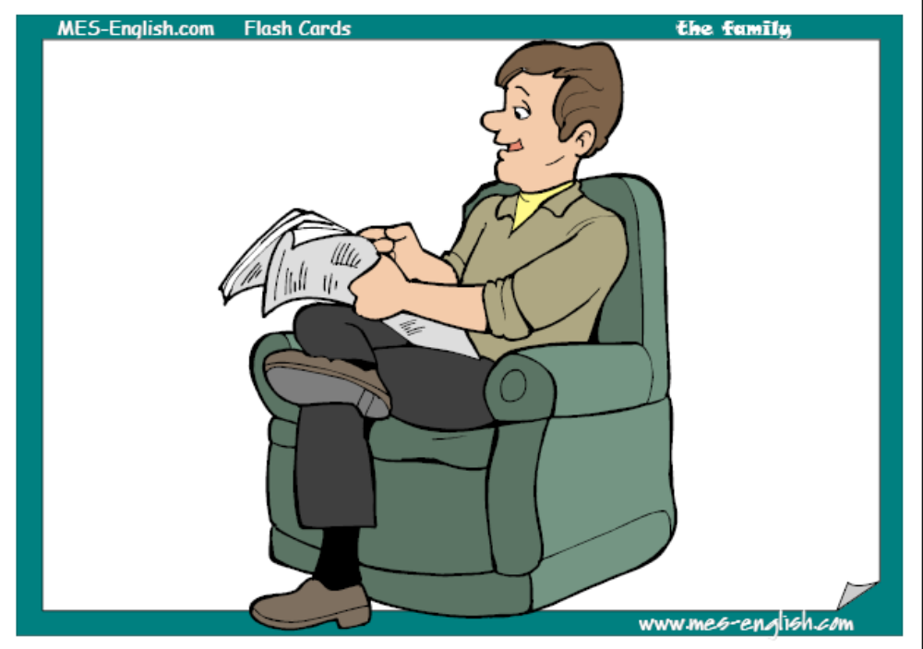
Father

Slide 3
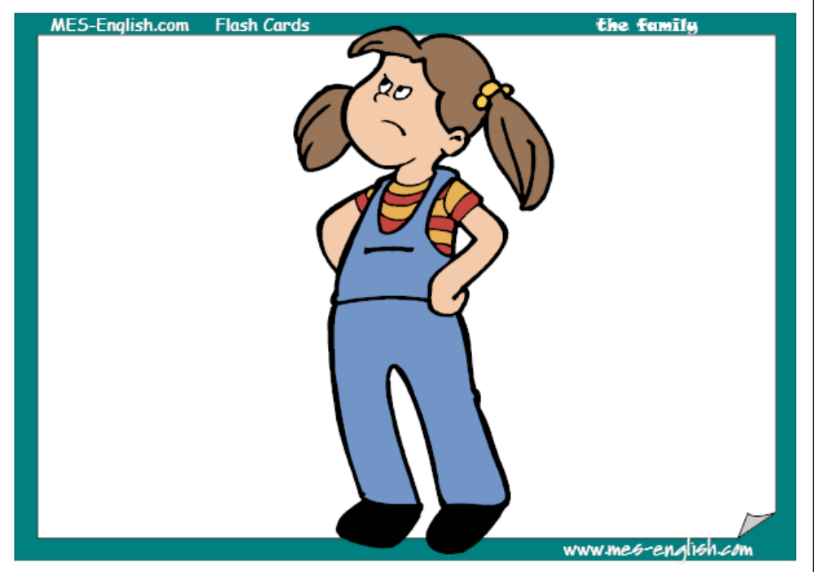
Daughter

Slide 4
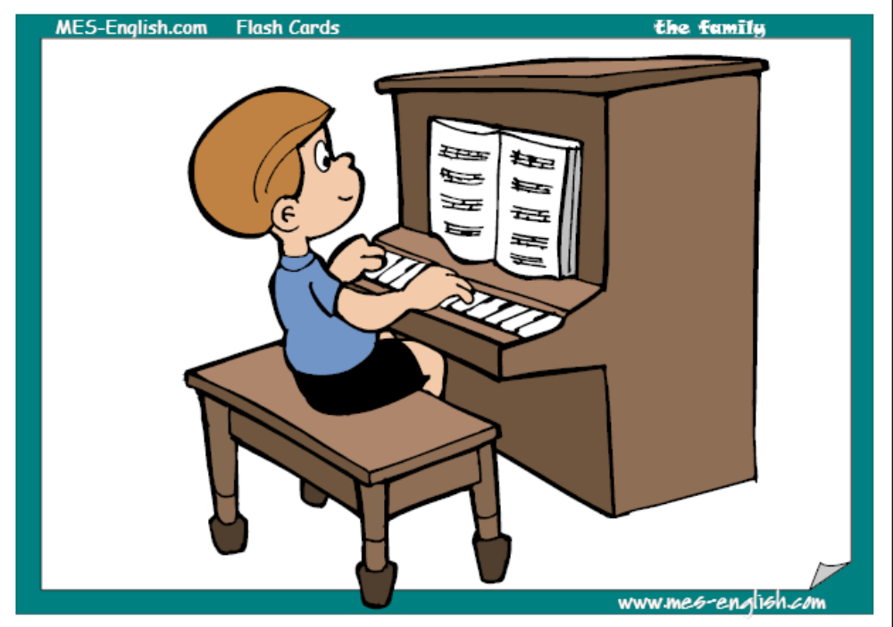
Son

Slide 5
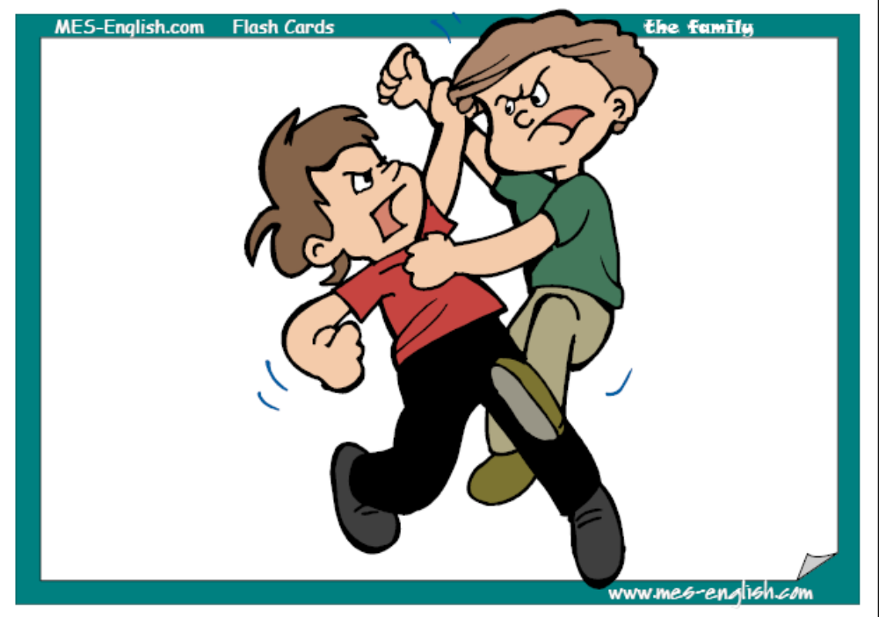
Brothers

Slide 6
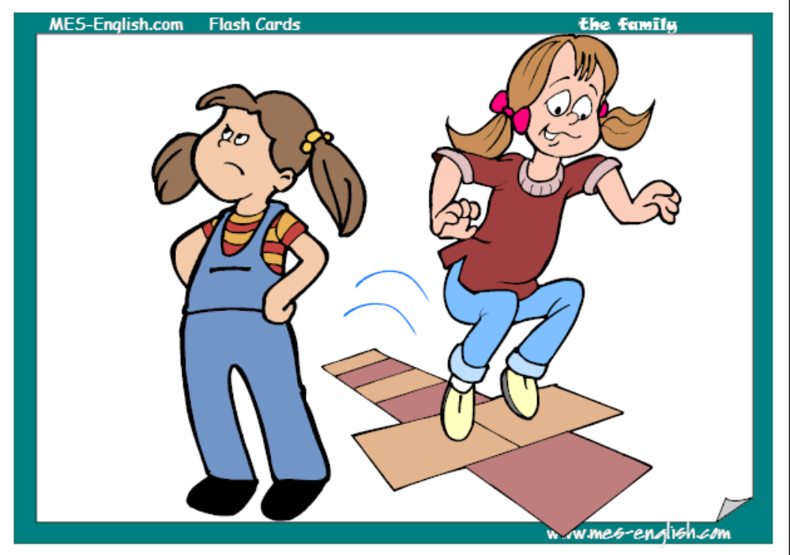
Sisters

Slide 7
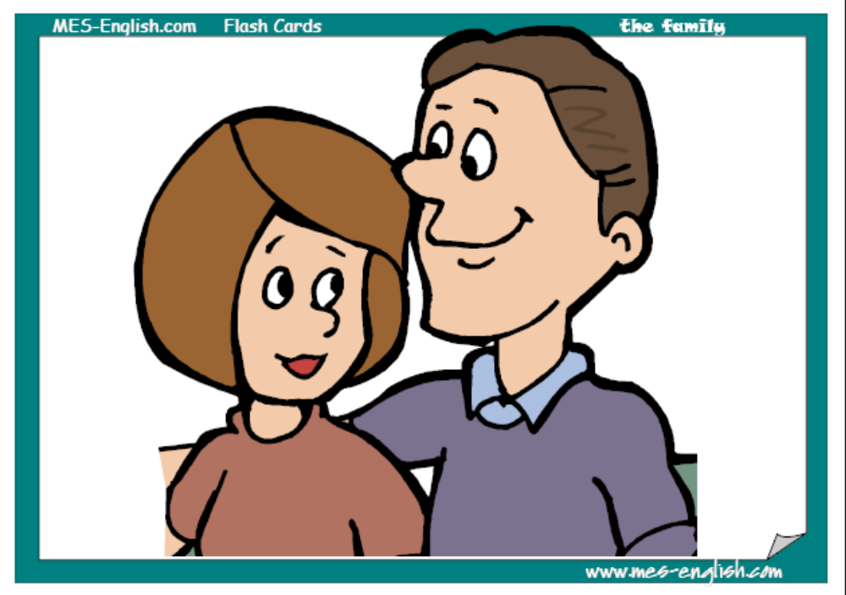
Mother and
Father

Slide 8
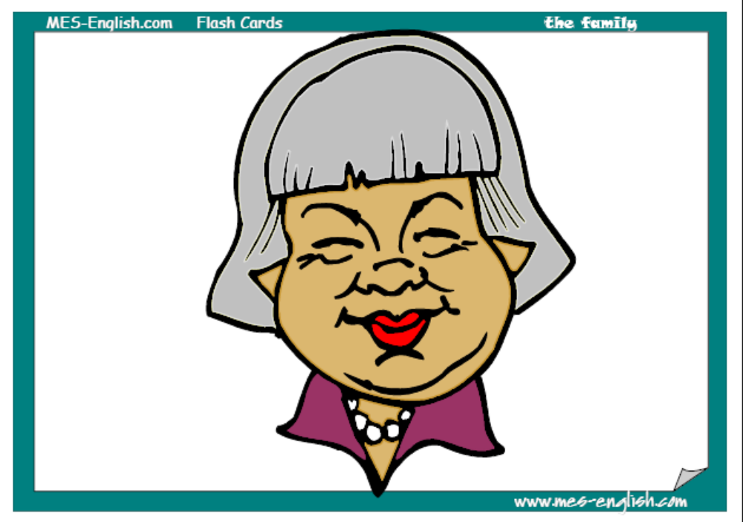
Grand- mother

Slide 9
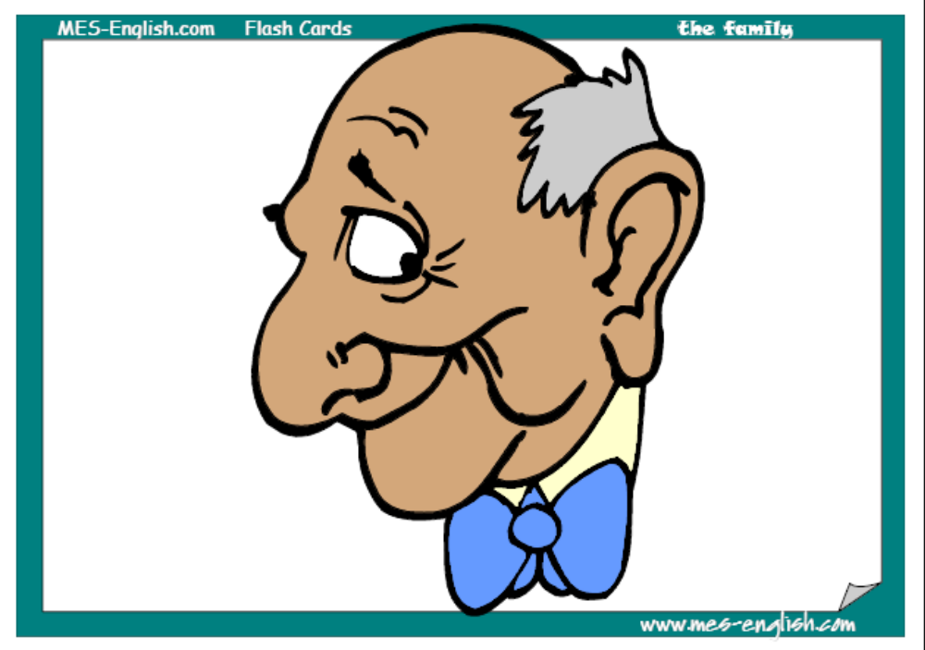
Grand- father

Slide 10
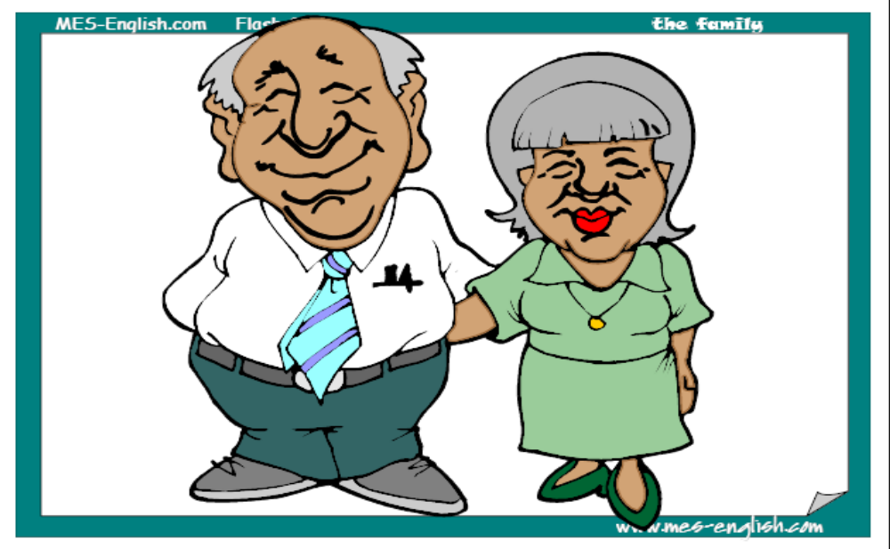
Grandfather and grandmother

Slide 11
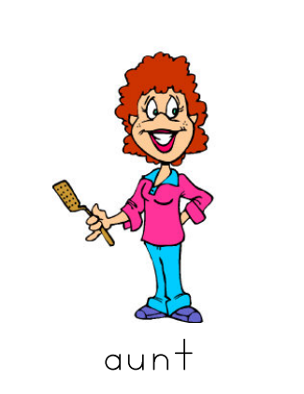

Slide 12
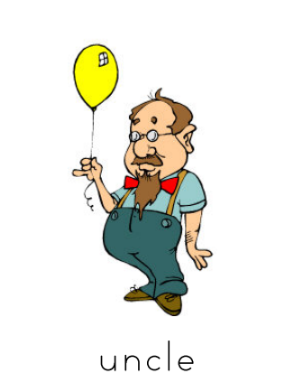

Slide 13

Read the transcriptions of thе words and translate them
[a:nt]
[‘fa:ðə]
[‘mʌðə]
[‘grænpa:]
[‘brʌðə]
[ʌŋkl]
брат
[‘grænmʌðə]
бабушка
мама
тётя
папа
дедушка
дядя

Slide 14


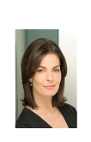

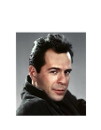
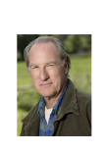




Match the pairs
a grandmother
a son
a mother
a sister
an uncle
a grandfather
a daughter
a father
a brother
an aunt

Slide 15
Find the odd one out
Grandmother, brother, sister, cat
Mother, grandfather, black, father
Father, school, mother, sister
Brother, pet, family, grandmother
Aunt, grandmother, son, café
Uncle, park, grandfather, brother

Slide 16
Read the descriptions of people and say what they are…
mother’s or father’s brother is …
mother’s or father’s sister is …
mother’s father is …
father’s mother is …
mother and father are …
aunt
uncle
grandfather
parents
grandmother

Slide 17
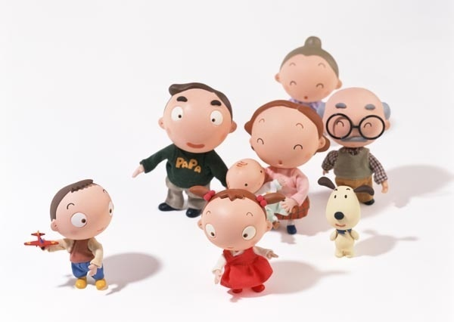
Game «Guess»

Slide 18
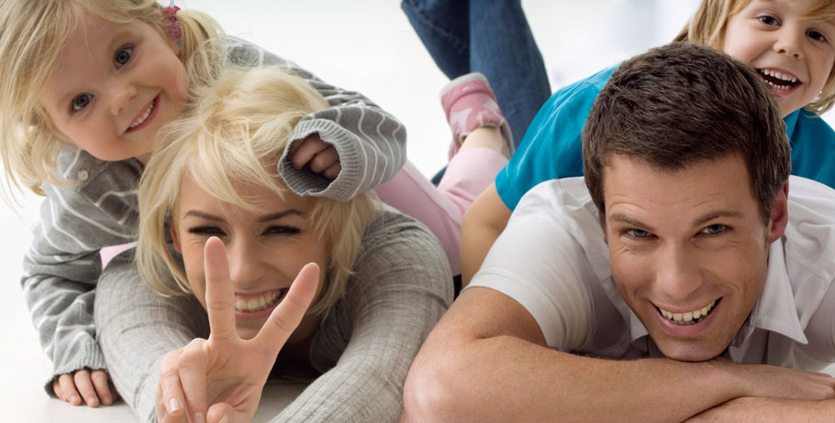
Let’s have a rest!

Slide 19
New words
nephew ['nefju:]племянник
niece [ni:s]племянница
cousin ['kʌz(ə)n]
двоюродный брат, сестра

Slide 20
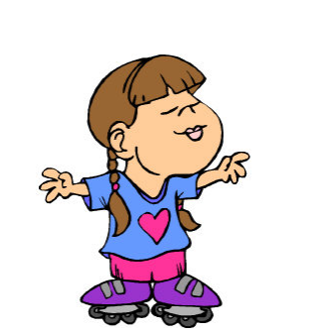
niece

Slide 21

nephew

Slide 22
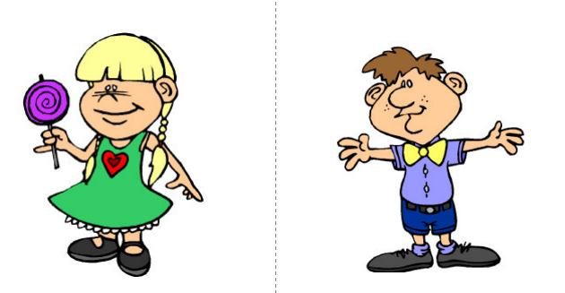
cousins

Slide 23
Translate the sentences:
1. My nephew has a small dog.
2. His niece is a very beautiful girl.
3. Our cousins live in Moscow.

Slide 24
New words
nephew ['nefju:]племянник
niece [ni:s]племянница
cousin ['kʌz(ə)n]двоюродный брат, сестра

Slide 25
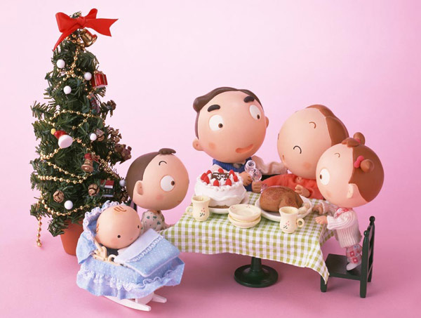
Talk about your family

Slide 26
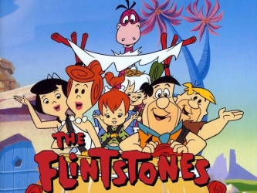

Slide 27
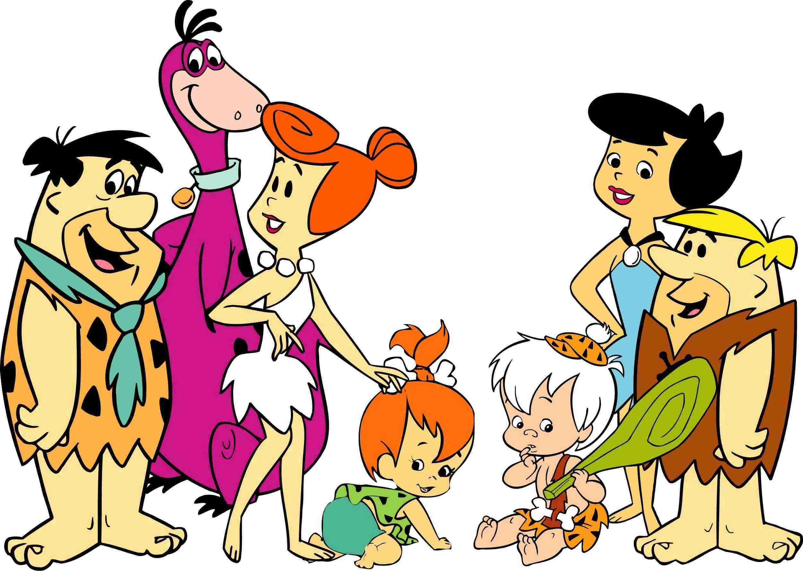
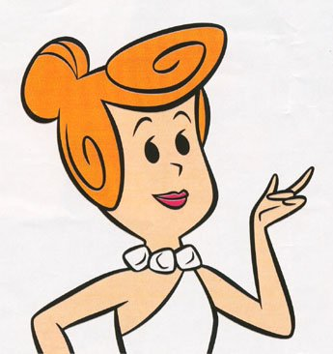
Hi! My name is Wilma Flintsone. This is my family. I have a daughter, a husband, a sister, a nephew, a brother-in-law and a pet.

Slide 28
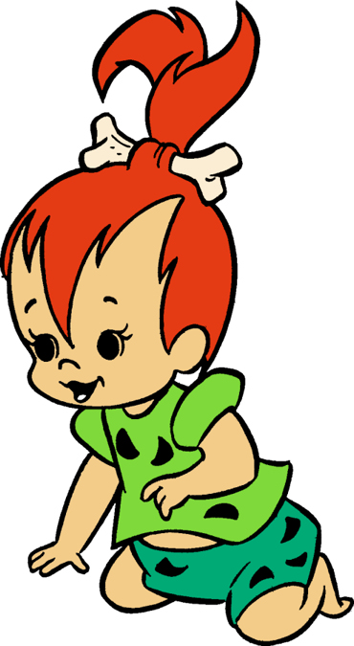
Look! This is my daughter. Her name is Pebbles Flintsones. Her eyes are black and her hair is red.

Slide 29
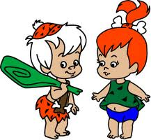
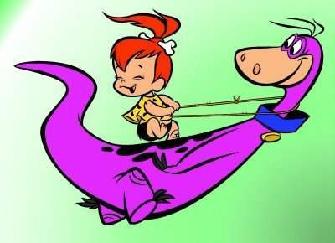
Pebbles likes to ride Dino and to play with her cousin Bambam.

Slide 30
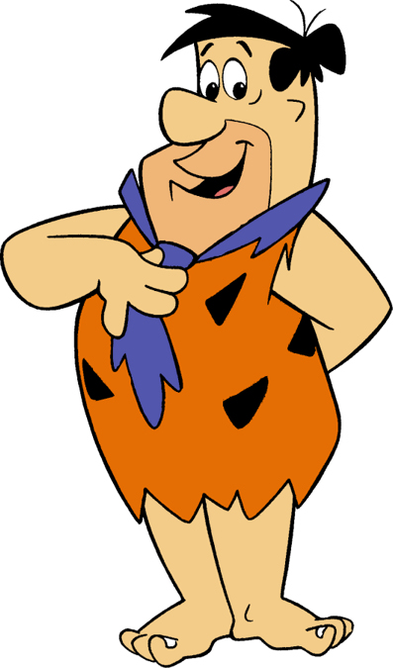
Here is my husband and Pebbles’ father, Fred Flintstone. He has got black eyes and black hair.

Slide 31
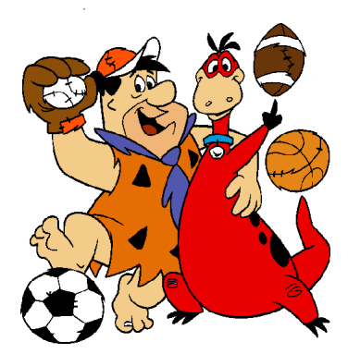
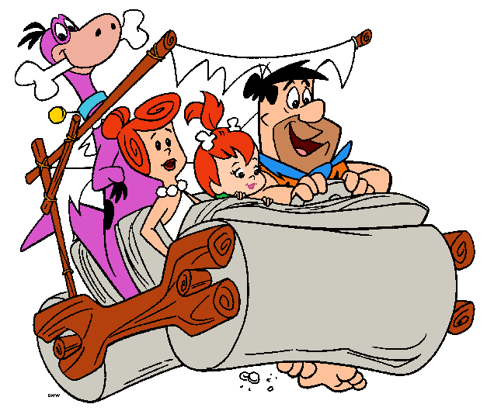
Fred likes to play football with Dino. My husband can drive a car.

Slide 32
6. What can Fred Flintstone do?
6. What can Fred Flintstone do?
a) paint pictures;
b) ride a dinosaur;
c) drive a car;
d) play computer.

Slide 33
7. Who plays football with Fred?
a) Wilma;
b) Bambam;
c) Barney;
d) Dino.

Slide 34
8. What colour are Fred’s eyes?
a) black;
b) blue;
c) red;
d) green.

Slide 35
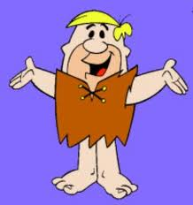
9. Who is Pebbles’ uncle?
a) Fred;
b) Bambam;
c) Dino;
d) Barney.

Slide 36
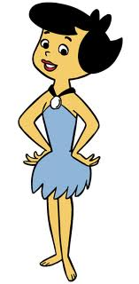
10. Who is Betty?
a) Pebbles’ Mum;
b) Bambam’s Mum;
c) Fred’s aunt;
d) Wilma’s aunt.

Slide 37
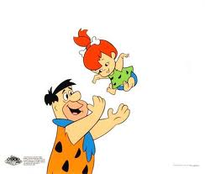
5. Who is Fred Flintstone?
a) Pebbles’ Dad;
b) Pebbles’ cousin;
c) Pebbles’ brother;
d) Pebbles’ uncle.

Slide 38
6. What can Fred Flintstone do?
6. What can Fred Flintstone do?
a) paint pictures;
b) ride a dinosaur;
c) drive a car;
d) play computer.

