Slide 1





Slide 2



ANIMALS
10
20
30
40
50
HOUSE
10
20
30
40
50
CLOTHES
10
20
30
40
50
WEATHER
10
20
30
40
50
FOOD
10
20
30
40
50

Slide 3
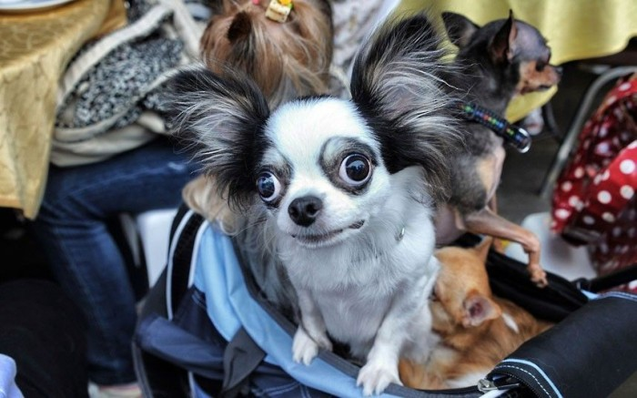


Animals
10
Who is it?
A dog.

Slide 4
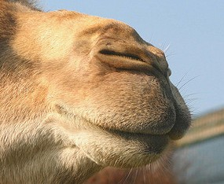
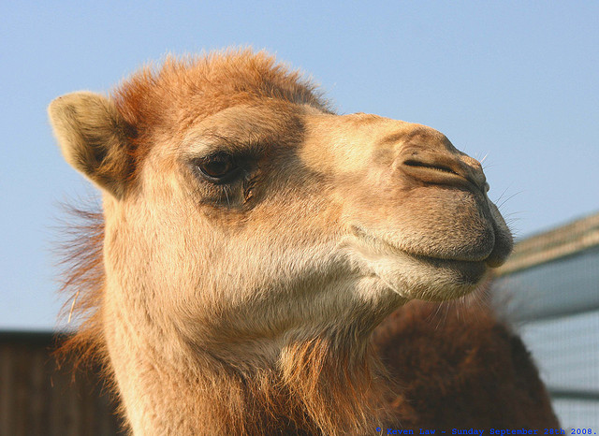
Animals
20
Guess who am I?
A camel.

Slide 5
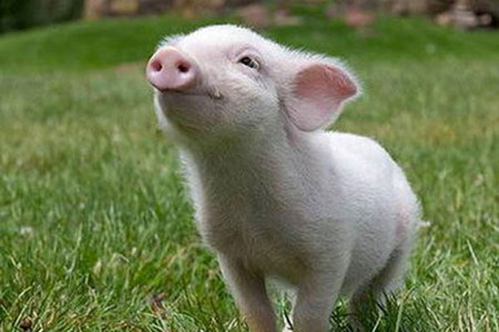
НОМИНАЦИЯ
30
Guess the riddle:
I live on a farm.
I am pink.
I have a little tail.
My nose is called a snout.
And I say “Oink, oink”.
I am ….
A pig.

Slide 6
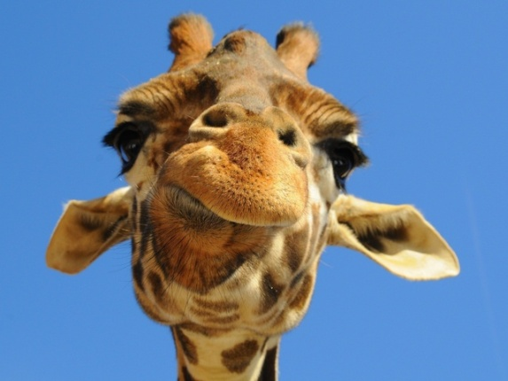
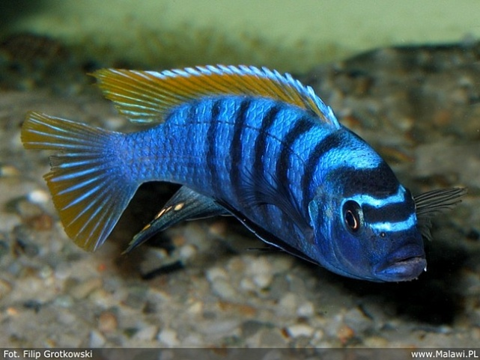
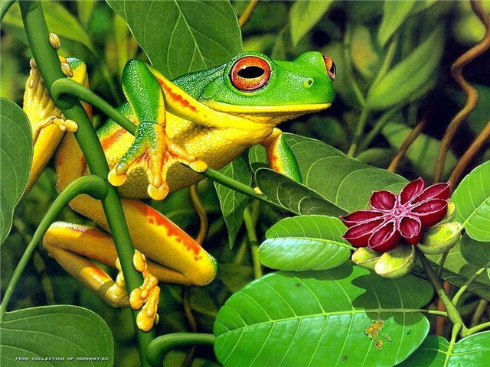
Animals
40
Find the odd words in each line:
A horse, a cow, a giraffe, a goat.
A cat, a mouse, a frog, a dog.
3. A goat, a cow, a fish, a sheep.
A giraffe
2. A frog
3. A fish

Slide 7

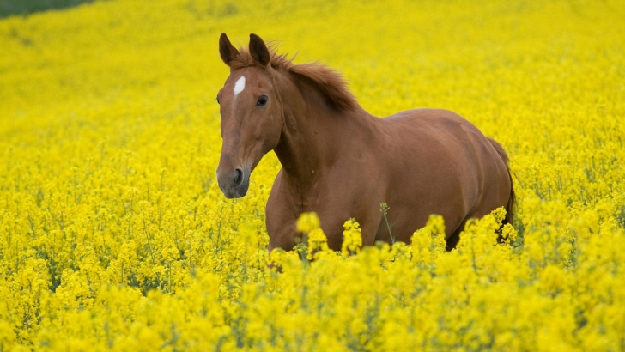
Animals
50
What animal is? u = r
A horse.

Slide 8



House
10
What is it?
A room.

Slide 9


House
20
Guess what is it.
A sofa.

Slide 10
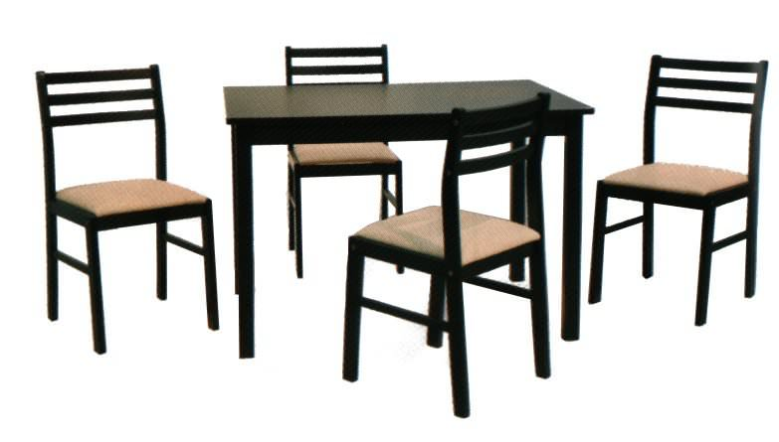
House
30
Guess the riddle:
We have legs but cannot walk.
Tables and chairs.

Slide 11



House
40
Find the odd word in each line:
A wall, a hall, a window, a door.
2. A fridge, a table, a bath, a stove.
3. A kitchen, a bedroom, a living – room, children’ s room.
1. a hall
2. a bath
3. a kitchen

Slide 12
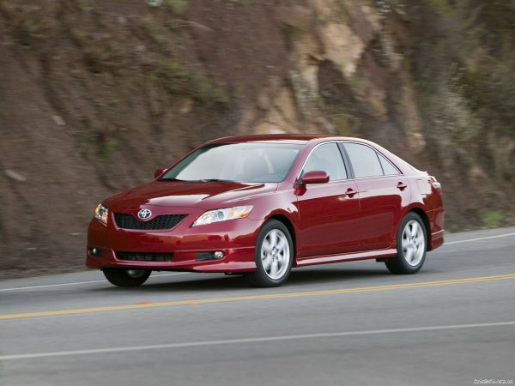
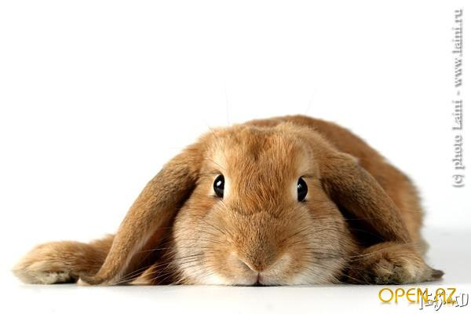
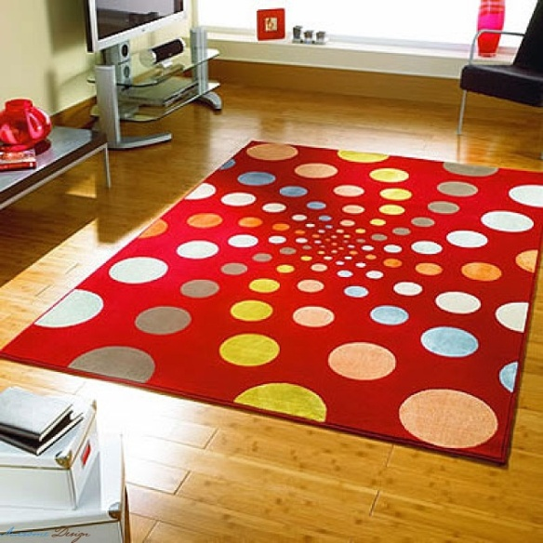
House
50
What is it? +
A carpet.

Slide 13

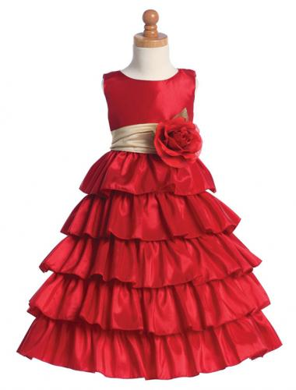


Clothes
10
What is it?
A dress.

Slide 14

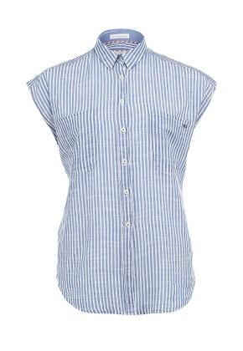
Clothes
20
What is it?
A shirt.

Slide 15
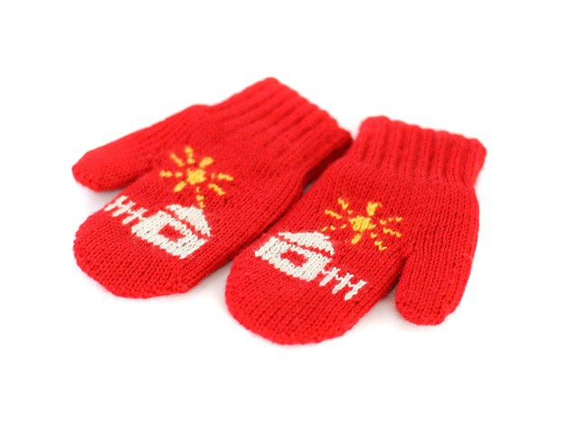
Clothes
30
Guess the riddle.
We protect your hands from snow and ice.
Fingers think we’re very nice.
What are we?
Mittens.

Slide 16
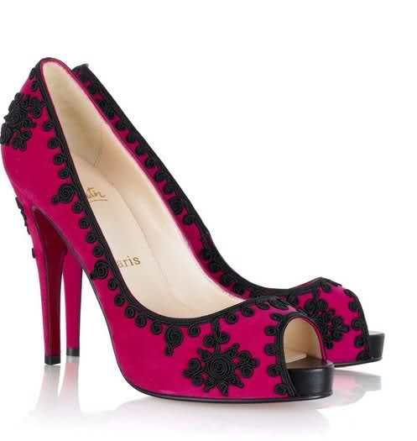

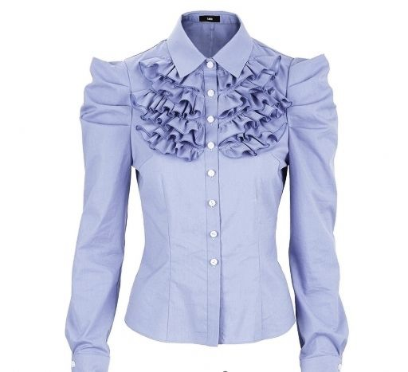
Clothes
40
Find the odd word in each line:
Shoes, a skirt, jeans, a scarf.
Mittens, a scarf, a coat, a blouse.
A shirt, a sweater, trousers, a T - shirt.
1. Shoes.
2. A blouse.
3. Trousers.

Slide 17

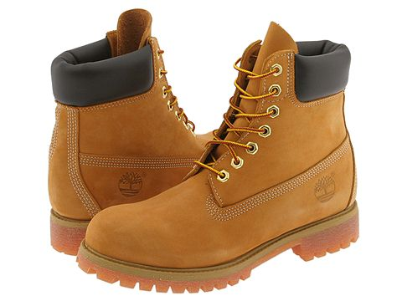
Clothes
50
What are they? K=T
Boots

Slide 18




Weather
10
What is the weather like?
It is cloudy.

Slide 19

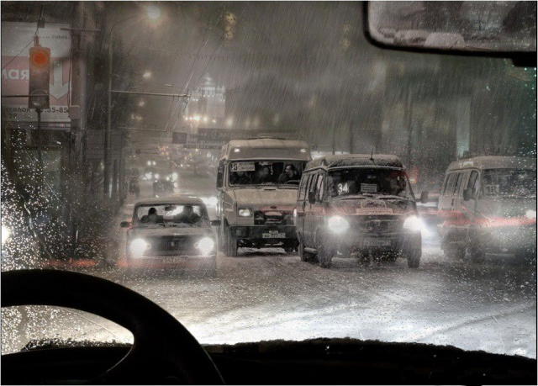
Weather
20
What is it?
It rains.

Slide 20
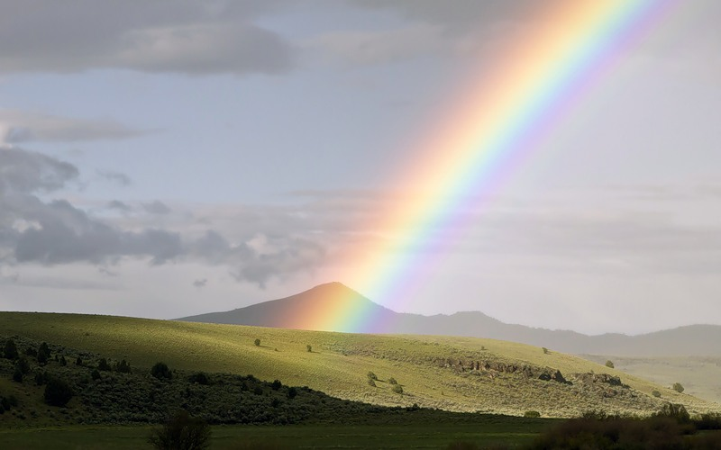
Weather
30
Guess the riddle:
Red and green and delicate blue,
Orange, yellow, and violet, too.
Indigo’s there,
a deep, dark, hue.
I see, but can’t touch it, and
neither can you!
What is it?
A rainbow

Slide 21
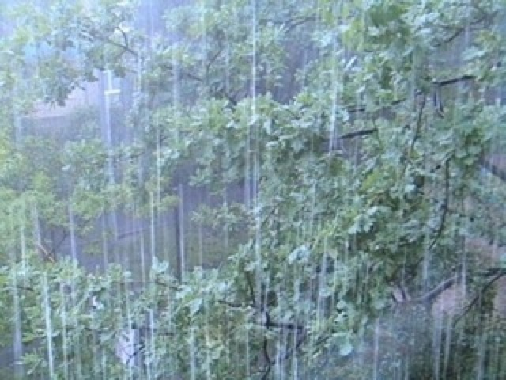


Weather
40
Find the odd word in each line:
1. Windy, cloudy, rain, snowy.
2. Hot, snowy, sunny, warm.
3. Rain, wind, cloud, a star.
Rain.
2. Snowy.
3. A star.

Slide 22
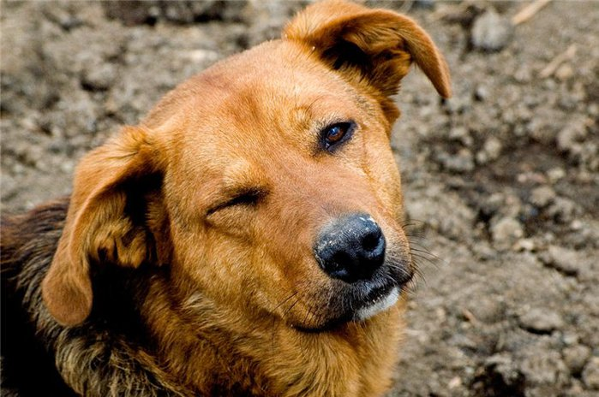
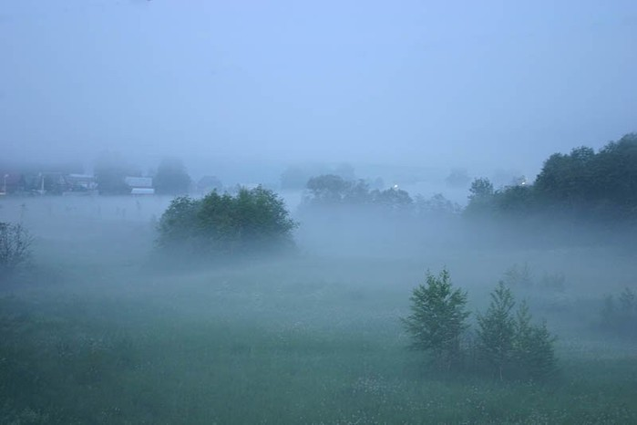
Weather
50
What is the weather like?
F+’ + gy
It’s foggy

Slide 23

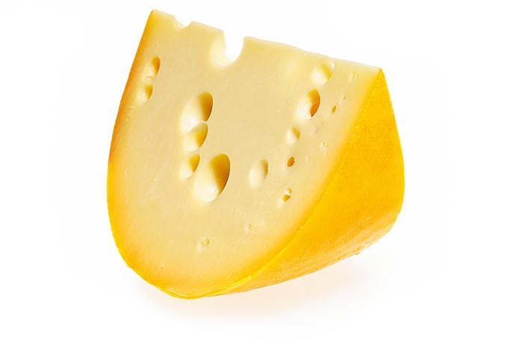


Food
10
What is it?
Cheese

Slide 24
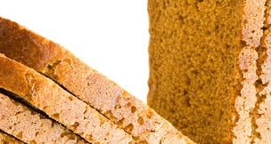
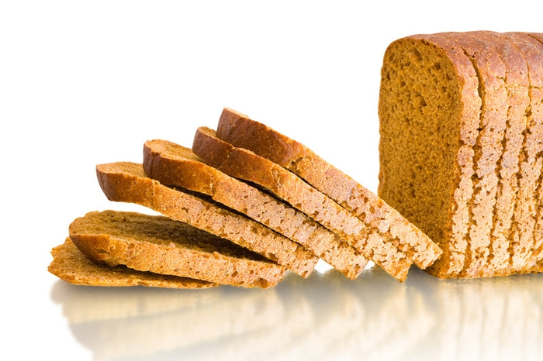
Food
20
Guess!
Bread.

Slide 25
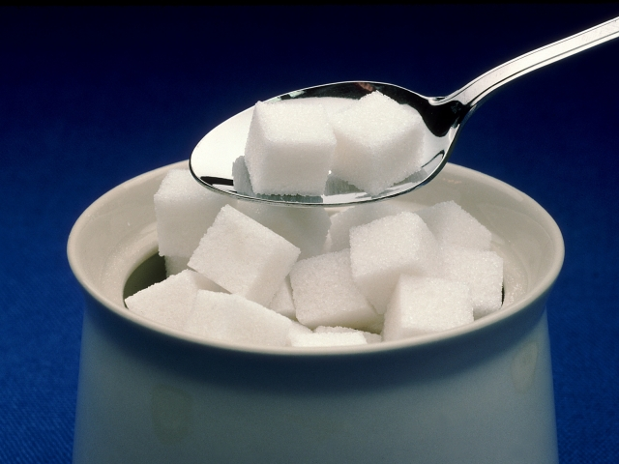
Food
30
Guess the riddle:
Clean, but not water,
White, but not snow,
Sweet, but not ice-cream,
What is it?
Sugar

Slide 26
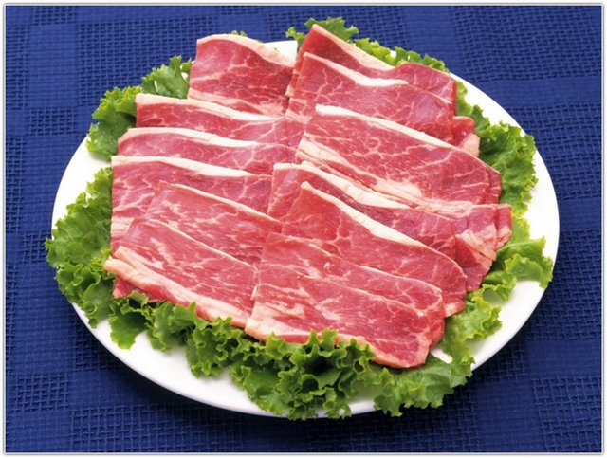


Food
40
Find the odd word in each line:
Sugar, jam, meat, sweets.
Potatoes, fish, meat, water.
Cheese, a cake, biscuits, bread.
Meat.
Water.
Cheese.

Slide 27


Food
50
What is it?
But + ‘ + r
Butter

Slide 28
http://www.hereisfree.com/content1//pic/zip/201122421113324977801.jpg идея кнопки «домик»
http://gatet.files.wordpress.com/2010/06/me.jpg знак вопроса с человечком
http://www.design-web.com.ua/wp-content/uploads/2012/11/owl.jpg мудрая сова

Slide 29
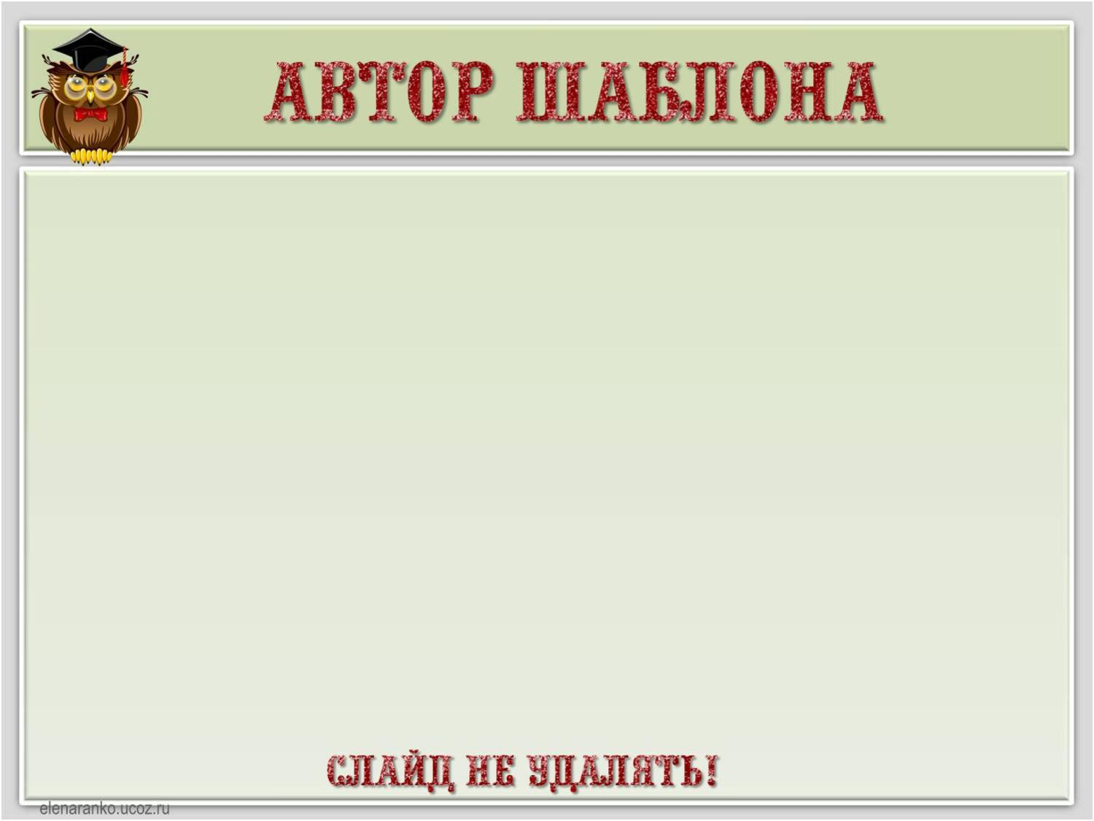
Ранько Елена Алексеевна
учитель начальных классов
МАОУ лицей №21
г. Иваново
Сайт: http://elenaranko.ucoz.ru/

