Slide 1
SPORT IN OUR LIVES

Slide 2
Purpose: to get acquainted with sports, and to identify the impact of sports on the human lifestyle.

Slide 3
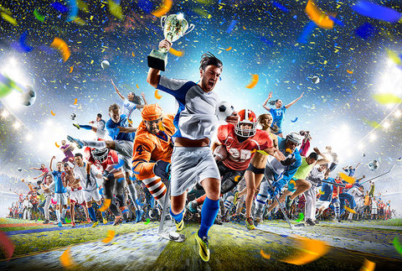
In sports successfully combined outdoor games, to which a person experiences a natural desire, with systematic physical exercise.
The stimulus of sport is the joy that gives a person the consciousness of his physical development, and the desire to improve their sports achievements, mainly - in competitions.
Types of outdoor games and there was an infinite number.

Slide 4
Sport is an integral part of physical culture, means and method of physical education, the system of organization of competitions in various physical exercises.
There is Amateur sport and professional. Amateur sports existed in the Ancient world, and professional basically began to appear at the turn of the nineteenth and twentieth centuries.
In ancient times, primitive people were engaged in hunting, waged various wars and just trying to survive. To return from hunting, with prey, it was necessary to be physically strong and agile. Nature itself was then the head coach of people.
To survive, it was necessary to run quickly, accurately throwing a spear to throw stones, to navigate on the site, shoot with a bow, etc. With the development of civilization began to appear ritual events in honor of the gods.
Amateur Rugby
Professional Rugby

Slide 5
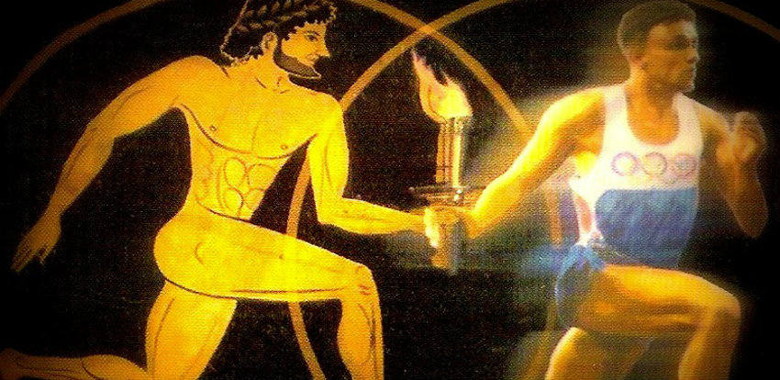
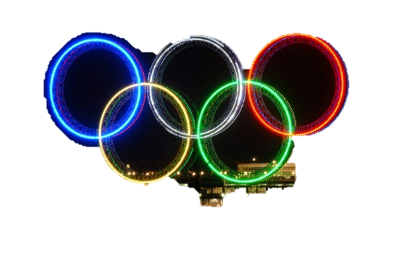
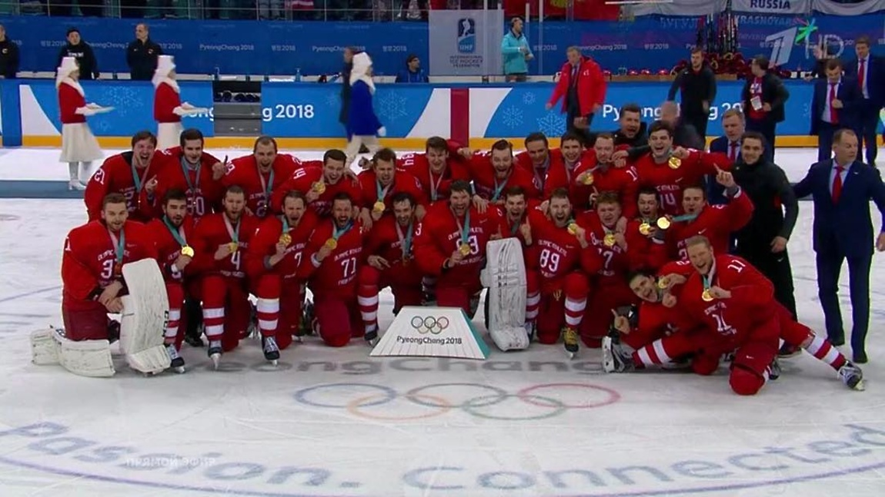
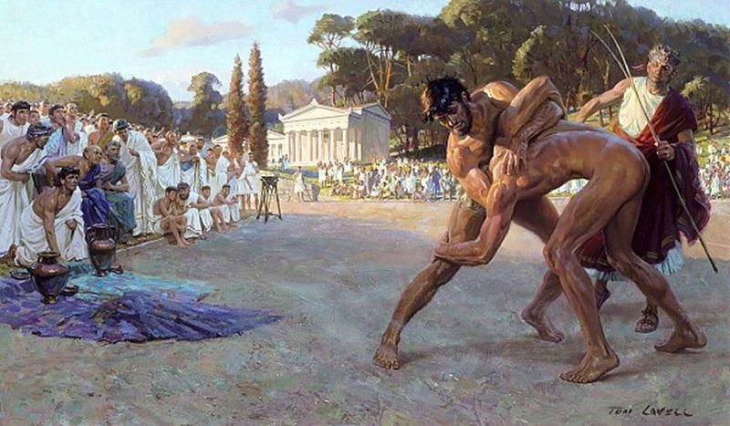
We all know the Olympic games. They, too, were ritual games in honor of the gods.
It is believed that the first games took place in 776 BC and were organized in honor of the God Zeus in the Greek-revered sanctuary of Olympia, located in the Western part of the Peloponnese Peninsula.
The revival of the Olympic games began in the 19th century.
The first world competitions, similar to the ancient Greek Olympic games, were held in 1896 in Athens. There were 9 sports in the program of The games of the I Olympiad. It was decided to hold competitions in athletics, gymnastics, swimming, weight lifting, wrestling, shooting,fencing, Cycling and tennis. Since then, the Olympic games have become a major international sporting event.

Slide 6
The most popular are game sports. Such as football, volleyball, basketball, hockey, handball. These sports are particularly spectacular.
The essence of team sports is the competition of teams or athletes in the form of a game (match, meeting, tournament). During the game, direct contact is prohibited or has significant restrictions. Game sports are active competitions with the main goal of defeating the enemy. As a rule, game sports are team competitions. The main goal of the game is to set the maximum number of points (points, goals, balls) in the allotted time or before the first hit.

Slide 7
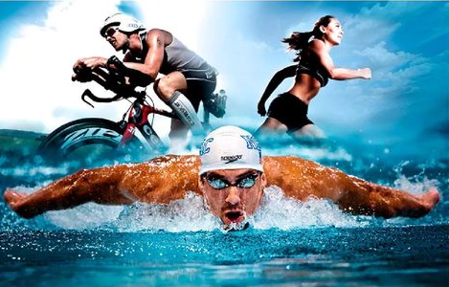
Cyclic repetition of movements to move your own body in space-the essence of cyclic sports. The speed of movement plays a crucial role in determining the winner. In such sports, athletes try to move very cyclically with a certain periodicity in order to achieve maximum productivity of physical strength and show the best results. And though few people know about cyclic sports, yet there are quite a lot of them and many of us have seen at least one of them, we just do not know that this is a cyclic sport. The most important and decisive role on which all bets are placed is nothing but the speed of movement in the implementation of those same cyclic movements. As a rule, such sports are called high-speed, because most of them and, accordingly, the results are determined by the speed. These sports include: athletics, swimming, skating, biathlon, cross-country skiing and others.

Slide 8
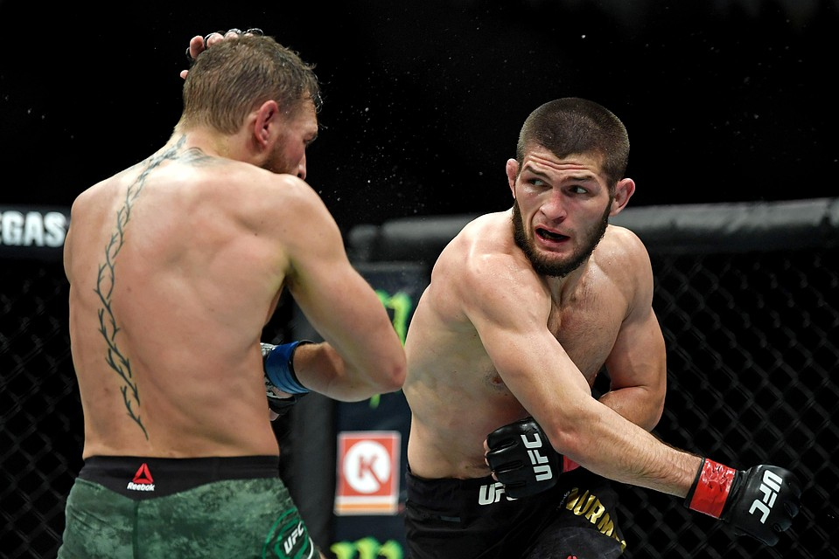
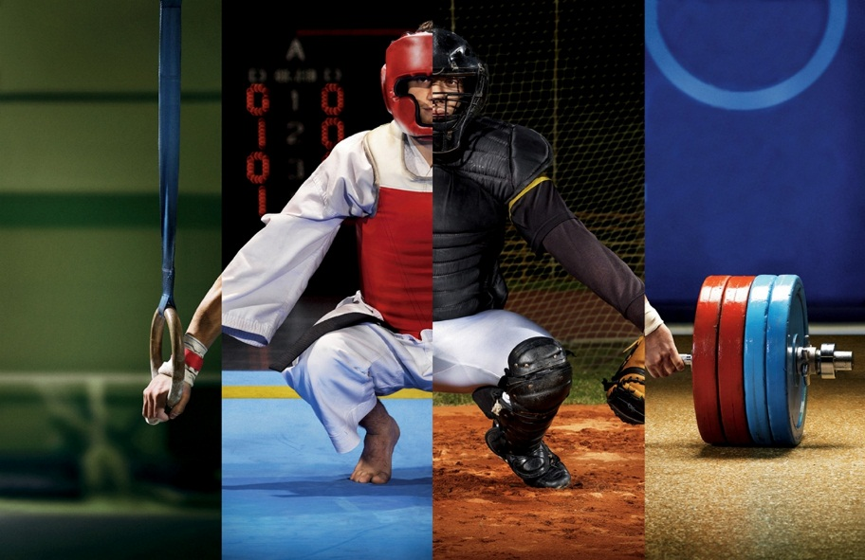
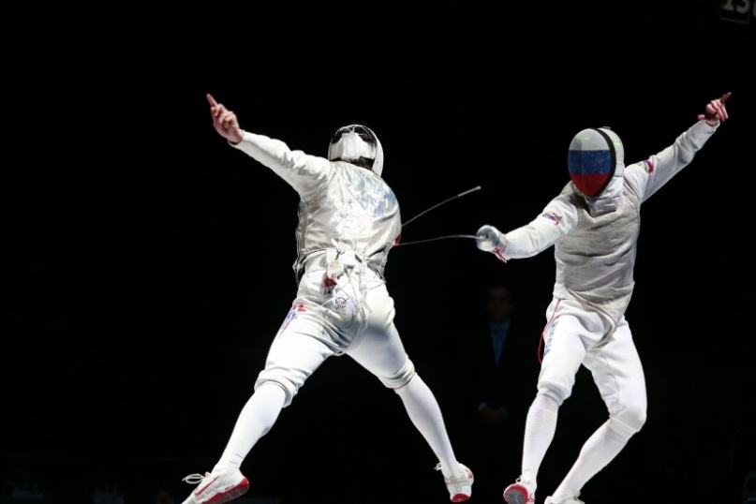
Combat sports are the complete opposite of cyclical sports, as in them physical contacts between rivals are the main actions by which athletes and achieve victories. These types include: Boxing, Sambo, kickboxing, freestyle wrestling, judo, fencing and others.

Slide 9
Sports-competition, the desire for maximum results allows a person to adapt to difficult living conditions. Of course, sport is a phenomenon of cultural life. In it, a person seeks to expand the boundaries of their capabilities, born of successes and failures. Sport is a competitive activity and special preparation for it. A healthy sports lifestyle has a wide range of positive effects on various aspects of the human body and personality.
Донченко Мария
11 «А»

