Slide 1

Определительные придаточные
(relative clauses)
ГОКУ АО ОШ при УИН
2016 год

Slide 2

Определительные придаточные предложения выполняют функцию определения и отвечают на вопросы
what?- какой?
which? - который?

Slide 3
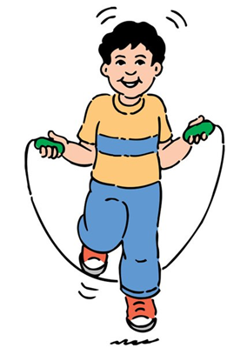
Они следуют непосредственно за тем существительным в главном предложении, которое они определяют .
For example:
I know who can help us.
I know a man who can help us.
Я знаю человека, который помогает нам.

Slide 4
Относительные местоимения
who - который
which - который
that - который

Slide 5
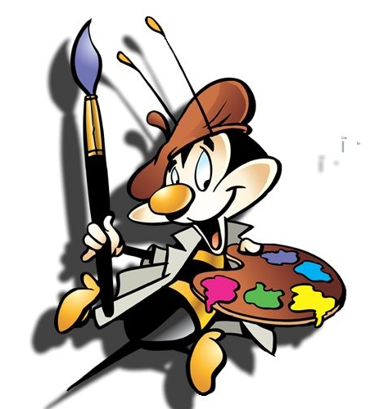
И как же их отличить???

Slide 6
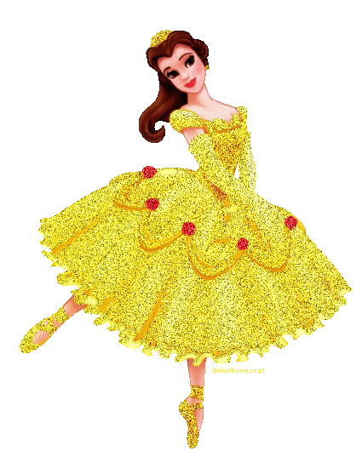
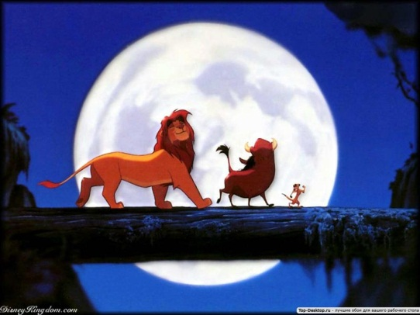
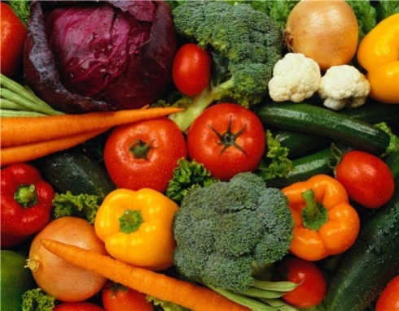
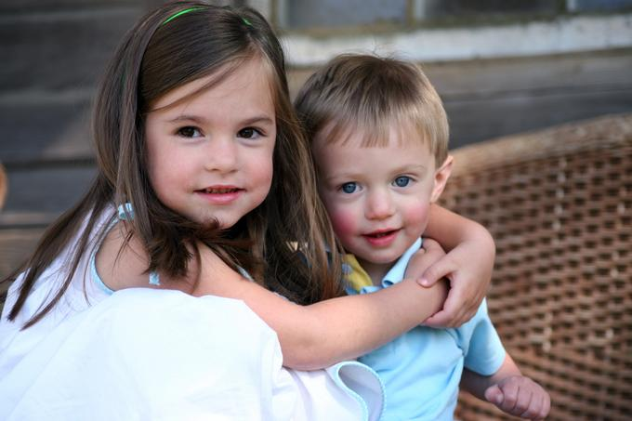



Отличие
That, Which и Who
Who
Which

Slide 7
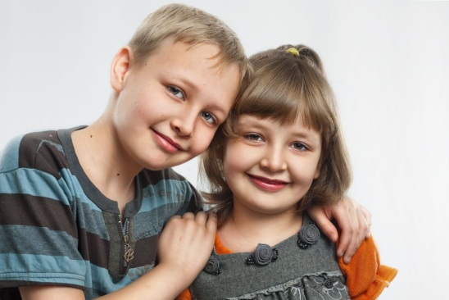
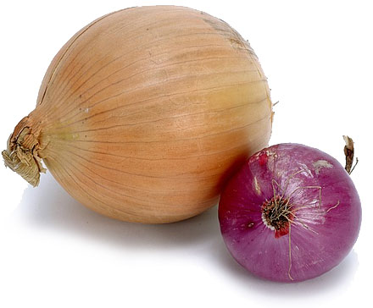


That

Slide 8
Относительными местоимениями:
who - который
(для людей)
which - который
(для неодушевленных предметов и животных)
that - который
(общее)

Slide 9
Попробуй решить !
Тебе нужно выбрать правильное местоимение!

Slide 10
The man … is sitting there is my brother.
Человек, который сидит там, мой брат.
The picture … hangs on the wall was painted by Repin.
Картина, которая висит на стене, была написана Репиным.
who
which

Slide 11
Самостоятельная работа
Who/Which
1.Where is the letter …I gave you to read?
2.Here is the book …. we have spoken about.
3.Give me the book ……I gave you yesterday.
4.There is the student … was at the theatre yesterday.
5. He posted the letter …he had written.
6.The man … had called on you left a message.

Slide 12
WHO/ WHICH/ WHOSE
1.Do you know the man …. house we saw yesterday? 3.This is the picture…..I bought yesterday. Это картина, которую я купил вчера. 4.I wonder ….. house that is. Интересно, чей это дом. 5.He ordered coffee…. was promptly brought. Он заказал кофе, который сразу же и принесли. 6.I’m looking for jeans,…. are less expensive. Я ищу джинсы, которые были бы дешевле (менее дорогие). | 7.Do you know ….. book it is? 8.I see a boy … is drawing. 9.He returned the book …..he had borrowed. Он вернул книгу, которую брал. 10.The girl …. gave me the book has gone. Девочка, которая дала мне книгу, ушла. 11.That’s the man …. car has been stolen. Вот тот человек, чью машину украли. 12.The pen ….you took is mine.

Slide 13
Look at the sentences and fill the gaps with the necessary relative pronoun – who, whose, which.
1. Do you know ___ cup of tea it is?
2. She is looking at the aquarium ___ we bought last week.
3. I don’t know the girl ___ is speaking with my brother.
4. Where is the pie ___ our mother made yesterday?
5. Do you know ___ dog is in our garden?
6. We know ___ broke your vase.
7. I don’t see the boy ___ won the competition.
8. Have you found the dog ___ bit you?
9. I wonder ___ car it is.
10. The apple ___ I bought is worm-eaten.

Slide 14
Look at the sentences and fill the gaps with the necessary relative pronoun – who, whose, which.
1. Do you know ___ cup of tea it is? → whose
2. She is looking at the aquarium ___ we bought last week. → which
3. I don’t know the girl ___ is speaking with my brother. → who
4. Where is the pie ___ our mother made yesterday? → which
5. Do you know ___ dog is in our garden? → whose
6. We know ___ broke your vase. → who
7. I don’t see the boy ___ won the competition. → who
8. Have you found the dog ___ bit you? → which
9. I wonder ___ car it is. → whose
10. The apple ___ I bought is worm-eaten. → which

Slide 15
Вставьте местоимения who, whose или which.
He didn’t know ___ sheet of paper it was.
We are talking about the book ___ we bought yesterday.
I don’t know the man ___ is looking at me.
Where is the pizza ___ she cooked yesterday?
Do you know ___ cat it is?
I know ___ broke your smartphone.
We are discussing the boy ___ won the competition.
Do you see the elephant ___ has a big red bow?
He wonders ___ house it is.
The apple-pie ___ I bought is in the fridge.

