Slide 1
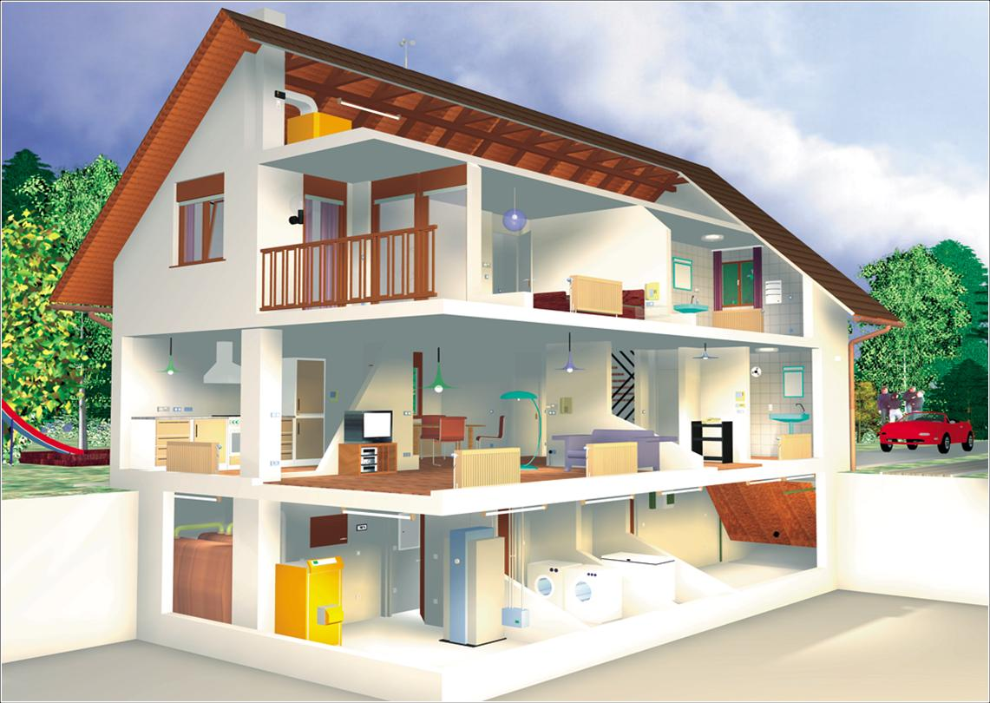
Человек и его дом

Slide 2
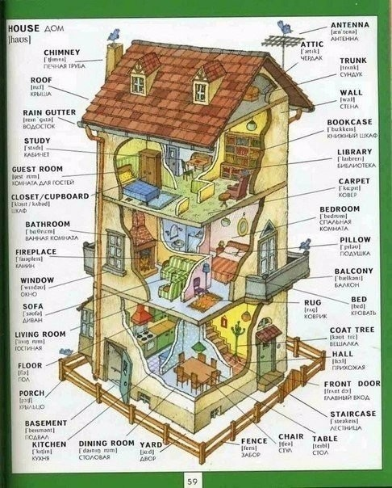

Slide 3
Мy house
Let's go to my house.
Let's go today.
I'll show you all the rooms
Where we work and play.
Here is the kitchen
Where Mother cooks for me.
Here is the living room
Where I watch TV.
Here is the dining room.
We eat here every day.
And this room is my room
Where I sleep and play.

Slide 4
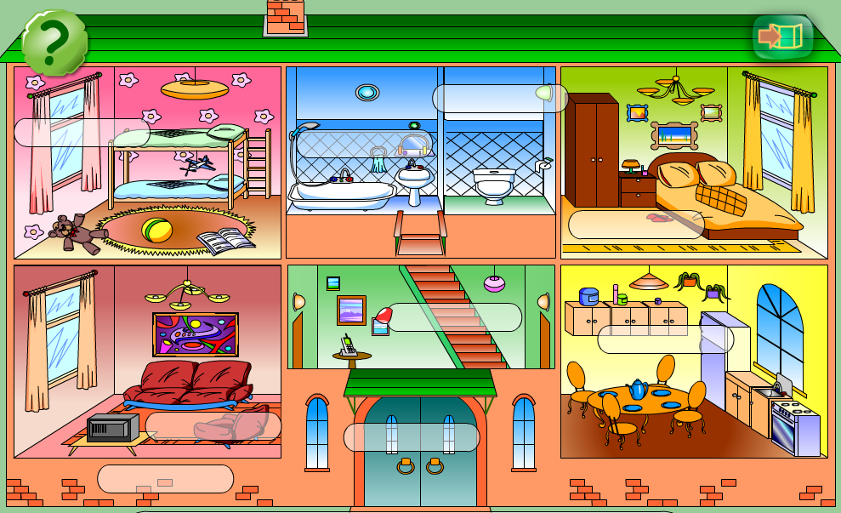
7
6
5
2
4
3
1

Slide 5
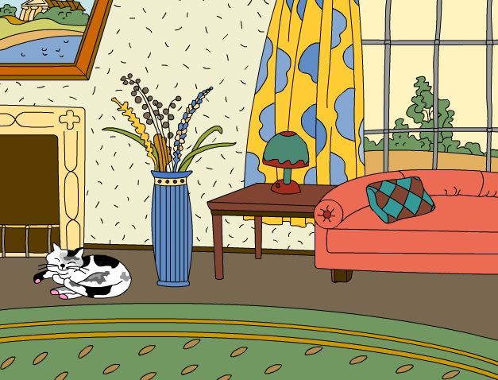
Look at the picture and say
what there is in the room.

Slide 6
PROVERBS:
Home sweet home.
My home is my castle.
East or West home is best.
There is no place like home.

Slide 7
architect [aʼ:kitekt] архитектор
design [diʼzain] план, проект, чертеж
designer [diʼzainƏ] конструктор, проектировщик, модельер
interior [inʼtiƏriƏ] внутренняя часть дома, интерьер
semi-detached (house) [ʼsemidiʼtætʃt] –один из двух домов, имеющих общую стену.

Slide 8
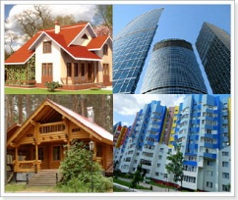
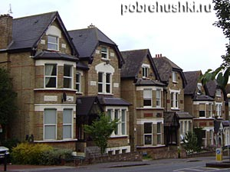
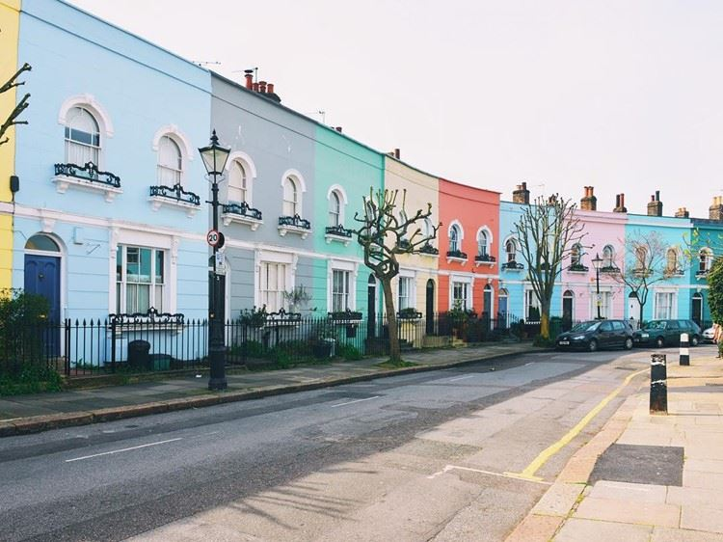
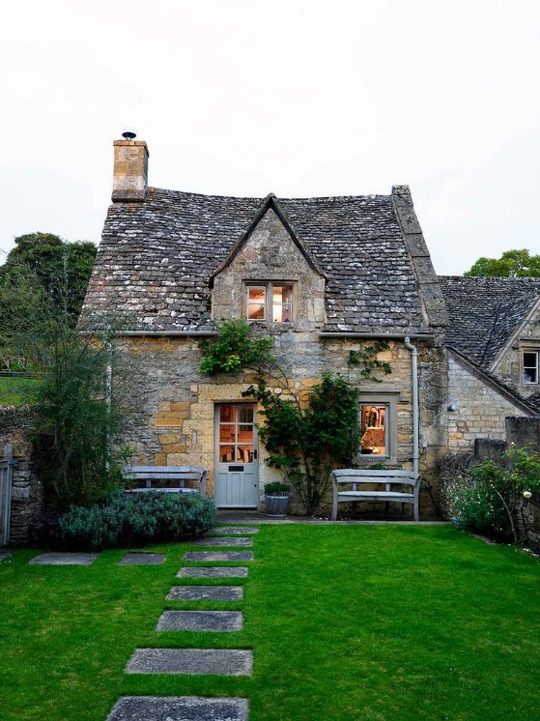
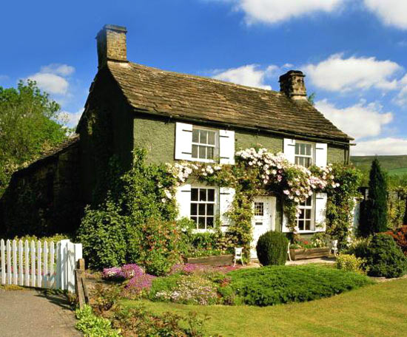
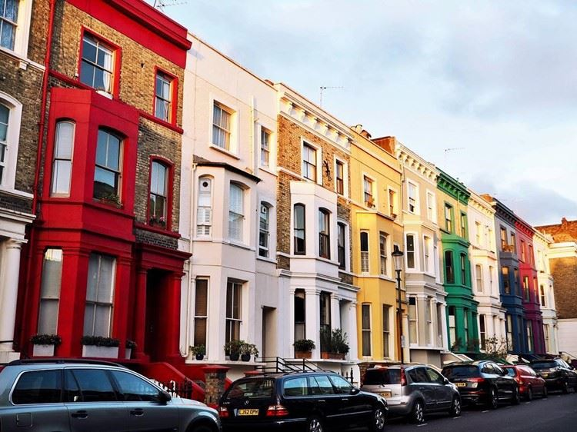

Slide 9
Основные СТИЛи ДИЗАЙНА ИНТЕРЬЕРА.
Основные СТИЛи ДИЗАЙНА ИНТЕРЬЕРА
Лофт
Минимализм
Прованс
Хай-тек
Эко-стиль
Авангард
Ампир
Арт-деко
Барокко
Кантри

Slide 10
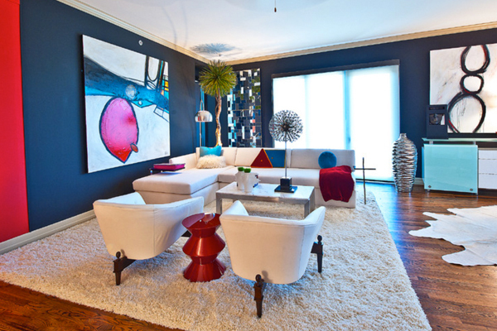
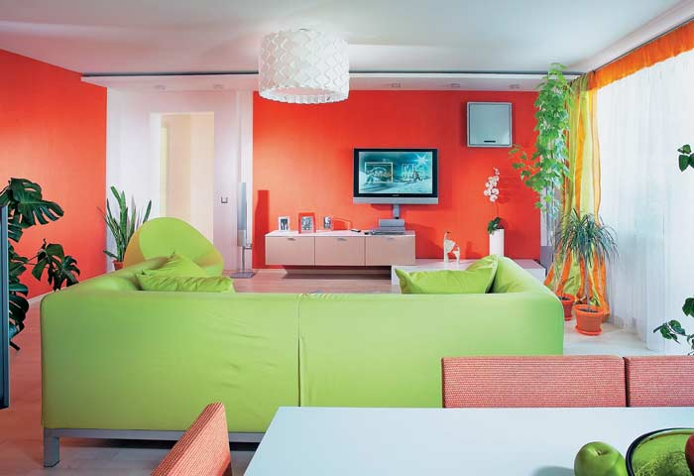
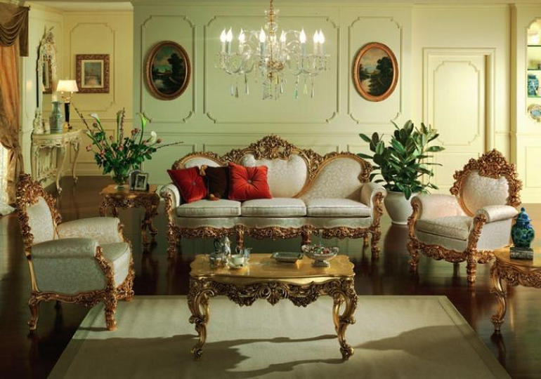
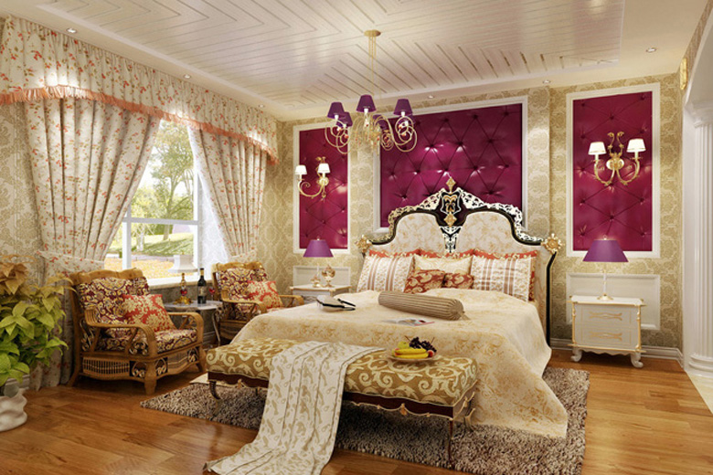
АВАНГАРД
АМПИР

Slide 11
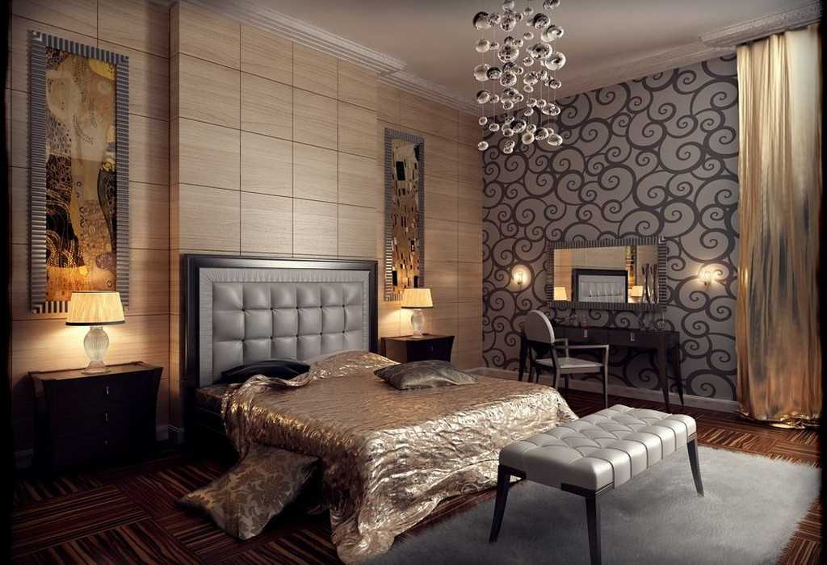
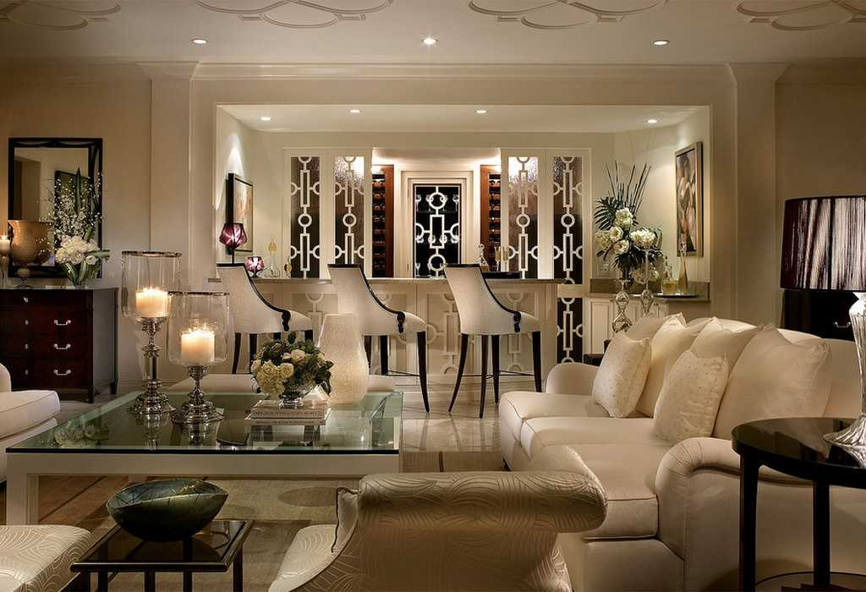
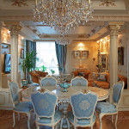
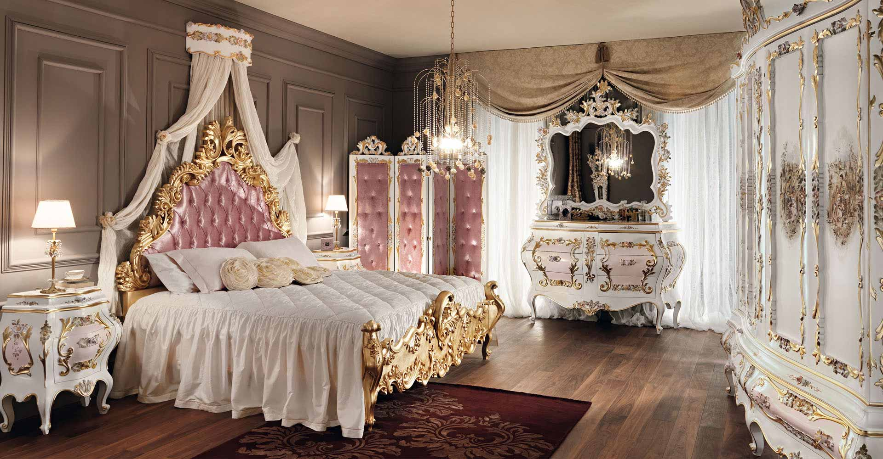
АРТ-ДЕКО
БАРОККО

Slide 12
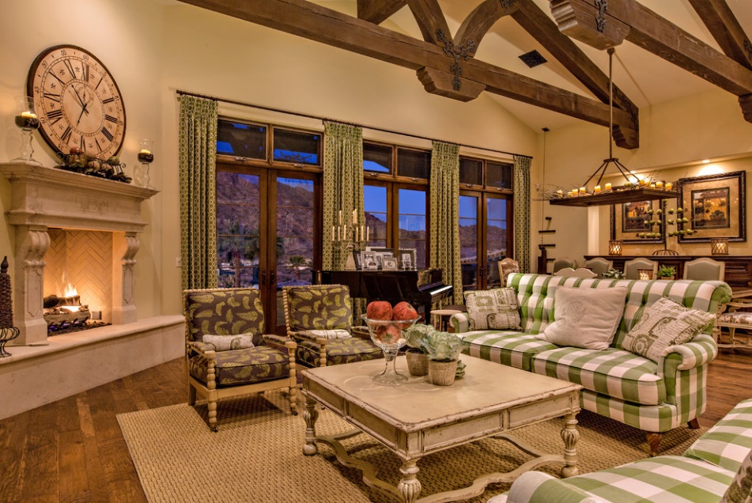
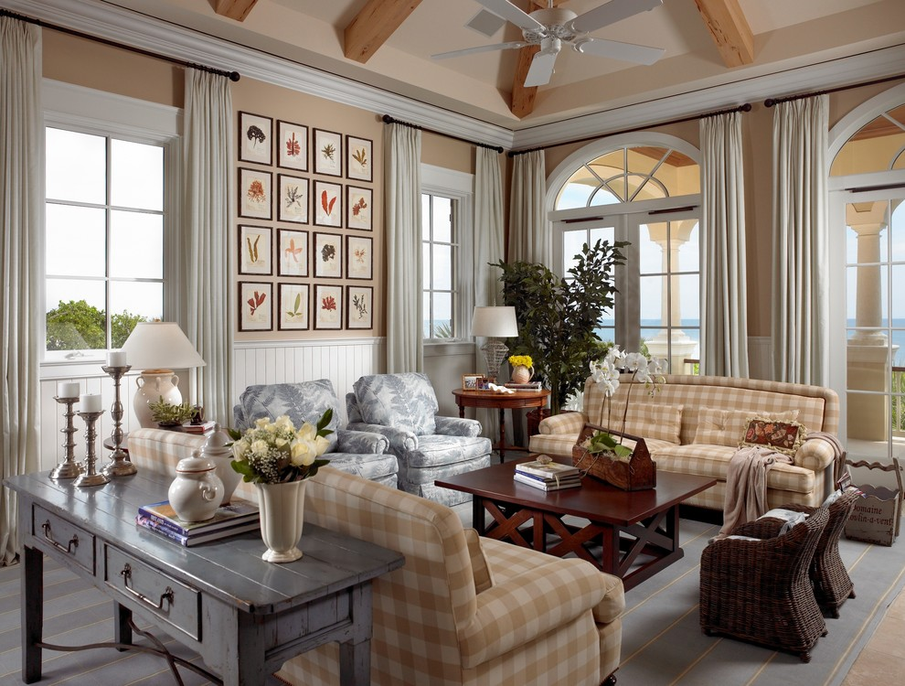
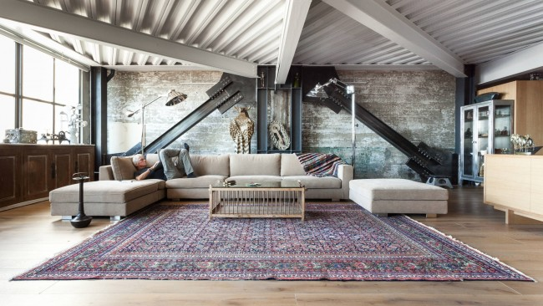
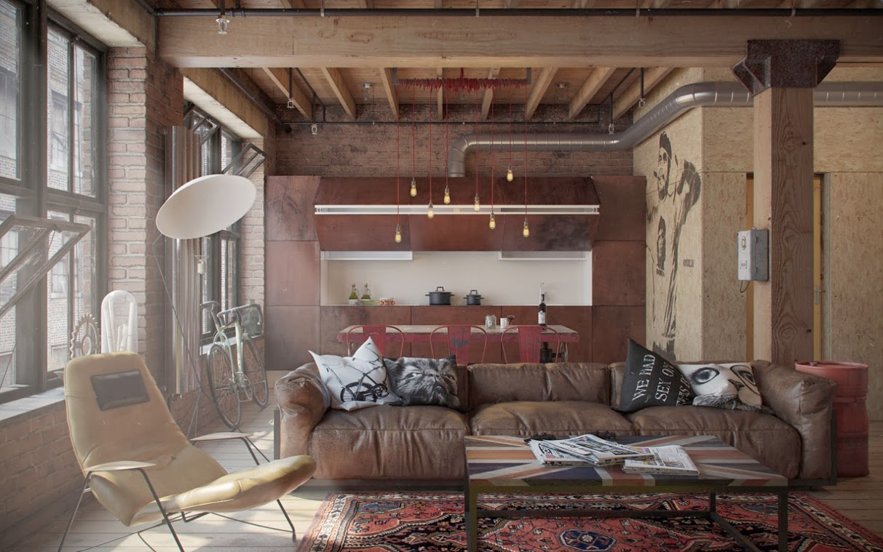
КАНТРИ
ЛОФТ

Slide 13
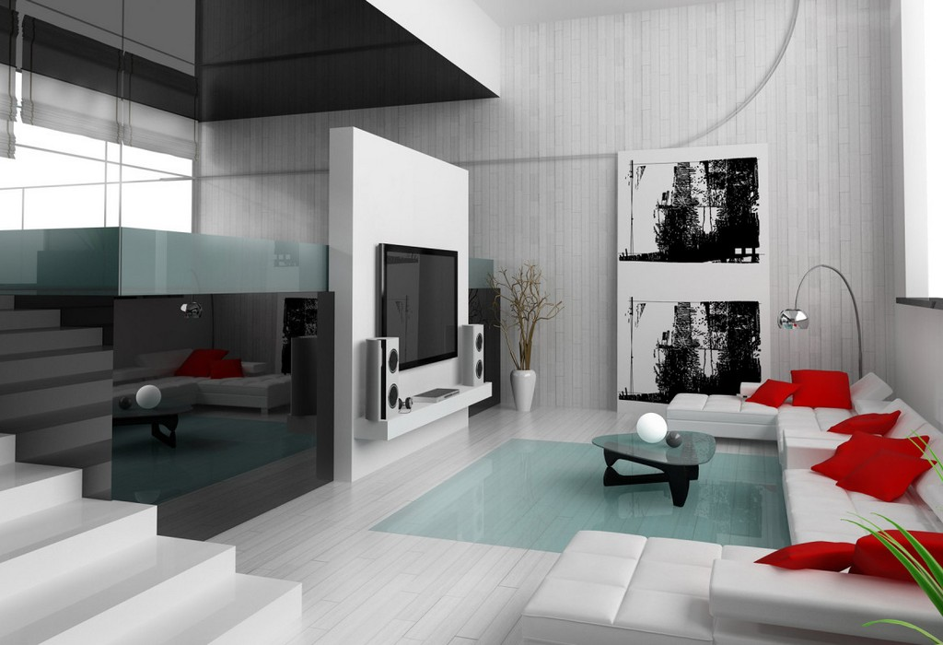
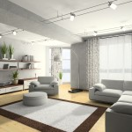
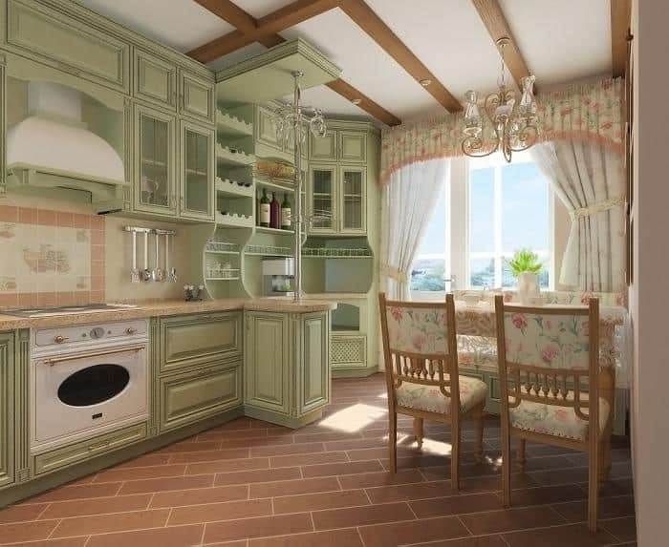
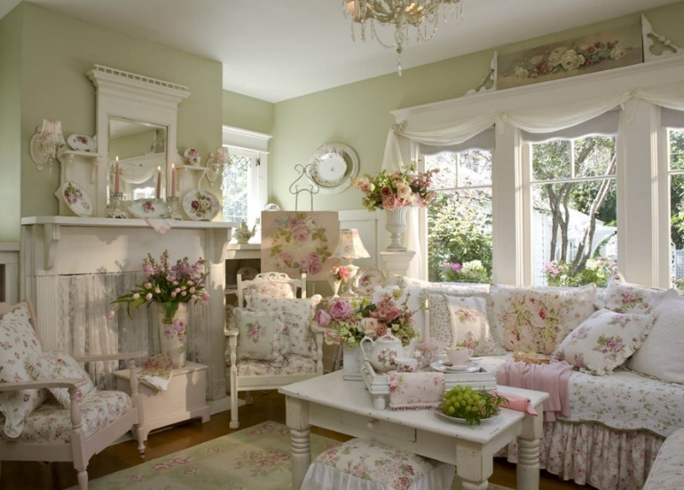
МИНИМАЛИЗМ
ПРОВАНС

Slide 14
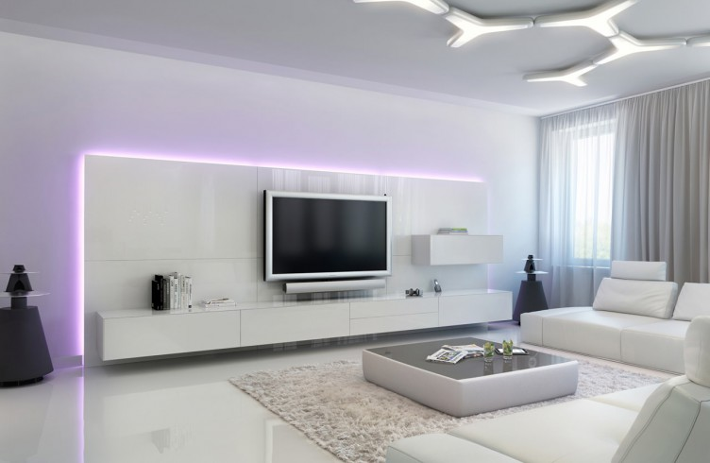
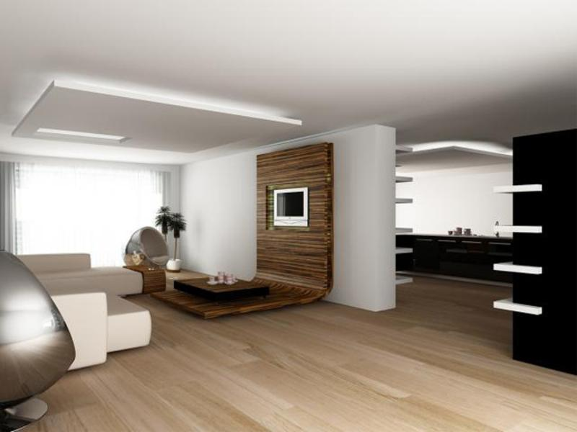
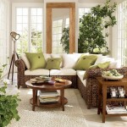
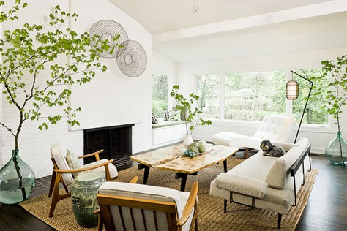
ХАЙ-ТЕК
ЭКО-СТИЛЬ

Slide 15
1) Complete the sentences:
There are …… in the living room.
There aren’t……. in the living room.
There is …….in the bedroom.
There isn’t ……..in the bedroom.
2) Впиши обороты There is или There are.
………….a vase on the table
………….. some flowers in the vase
……………a cat under the table
…………….some cups on the table

Slide 16
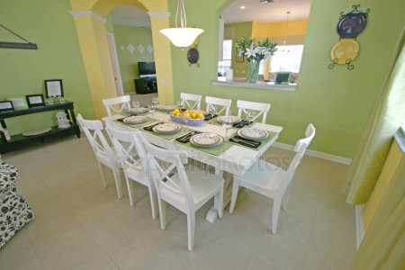
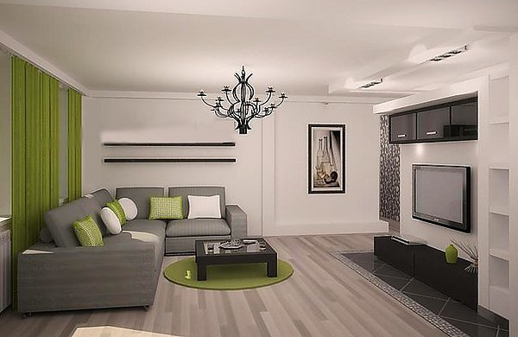
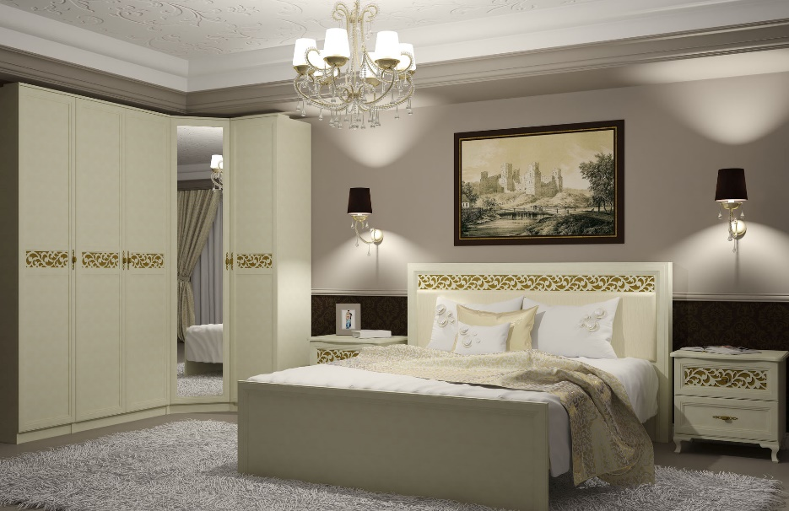
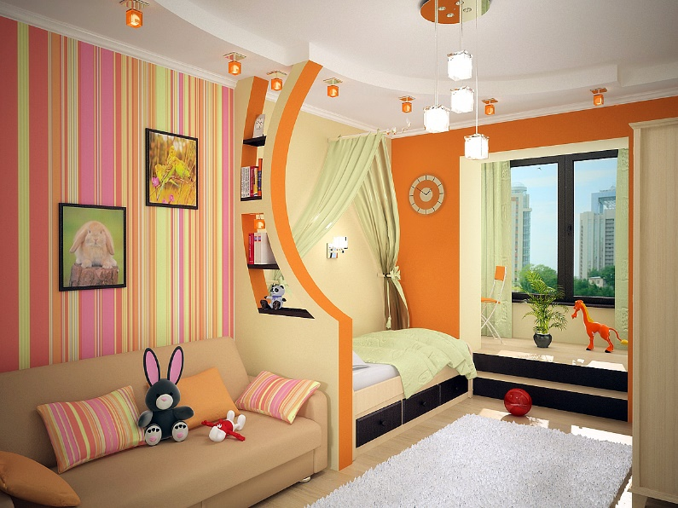
a dining room
a living room
a bedroom
a children’s room

Slide 17
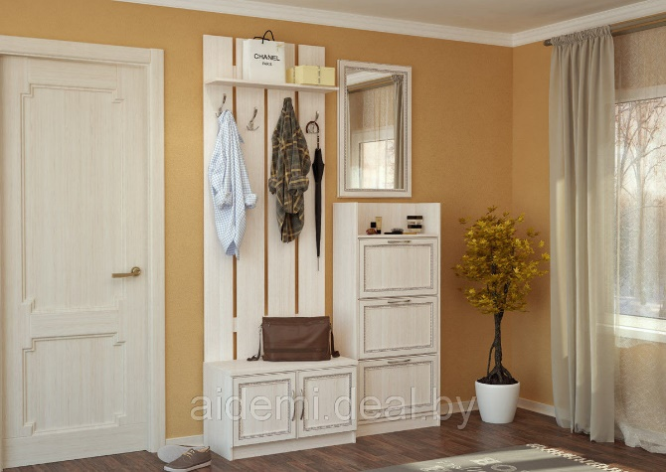
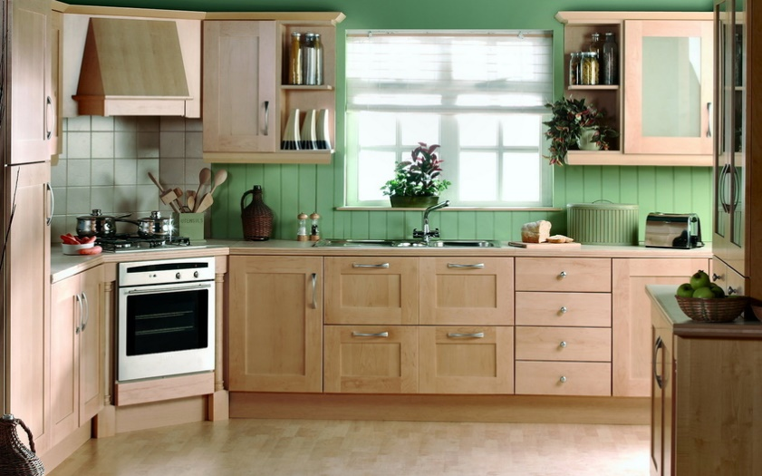
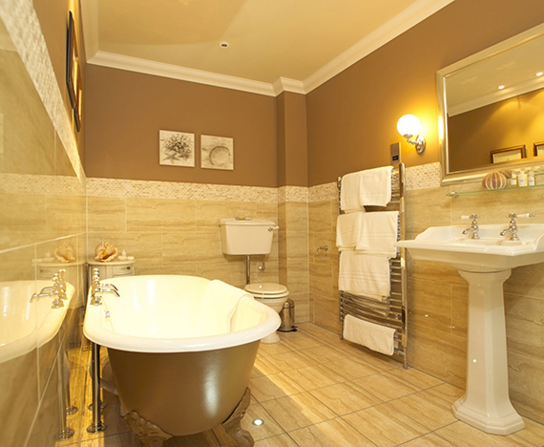
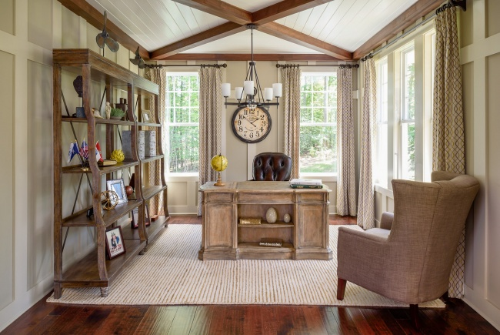
a hall
a kitchen
a bathroom
a study room

Slide 18
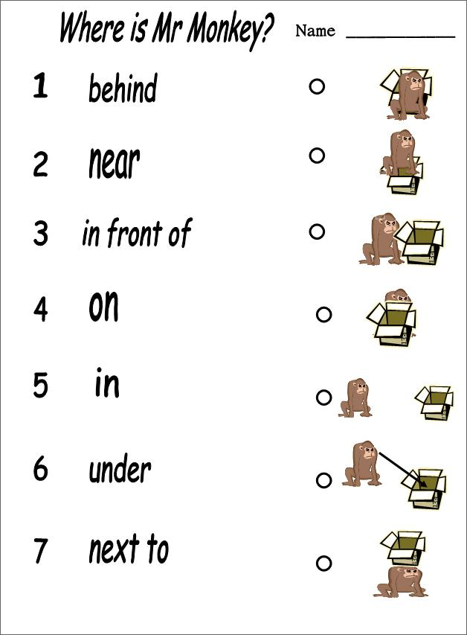

Slide 19

Where is the Monkey?
    Where is the Monkey?
The monkey is under the bed.
Where is the Monkey?
The monkey is in the drawer.
Where is the Monkey?
The monkey is on your head.
Where is the Monkey?
The monkey is in front of the TV.
Where is the Monkey?
The monkey is over the desk.
Where is the Monkey?
The monkey is next to the door.
Where is the Monkey?
The monkey is between the box and the ball.
Where is the Monkey?
The monkey is behind the curtain

Slide 20
My flat
We live in a flat. Our flat is not very big. It is very clean and comfortable. There are two rooms in our flat. There is also a kitchen and a bathroom. In the living-room there is a sofa, a TV, a bookcase, a coffee table, and two armchairs. In my room there is a bed, a desk, a wardrobe, and a shelf. I love my flat very much.
Questions:
Do you live in a flat?
Is your flat big?
Is it comfortable?
How many rooms are there in your flat?

Slide 21

Диалог “My house” (have got/has got) –
«Мой дом»
- Is your house big?
- No, my house isn’t very big. We’ve got 3 rooms and a kitchen in it.
- It’s great! What have you got in your bedroom?
- My room is nice. I’ve got a bed, a table and a new computer on it and some posters on the walls. My room has got yellow walls and a green carpet.
- Have you got a TV in your room?
- No, I haven’t. It’s in the sitting room.
- Have you got any pets in the house?
- Yes, we have got two cats. One is black, another is red.

Slide 22
