Slide 1
Открытый урок в 5 классе
Распорядок дня

Slide 2
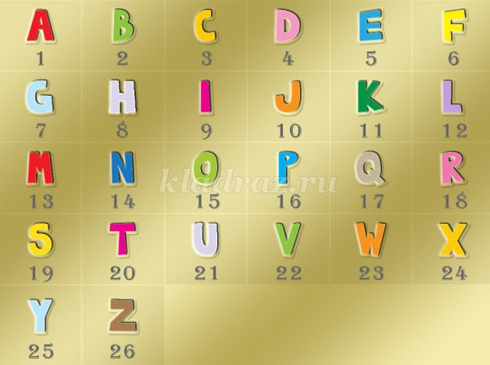
Topic of the lesson
4,1,9,12,25.
18,15,21,20,9, 14,5

Slide 3
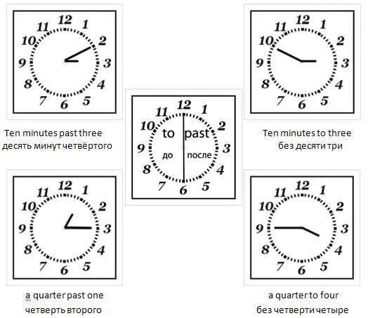
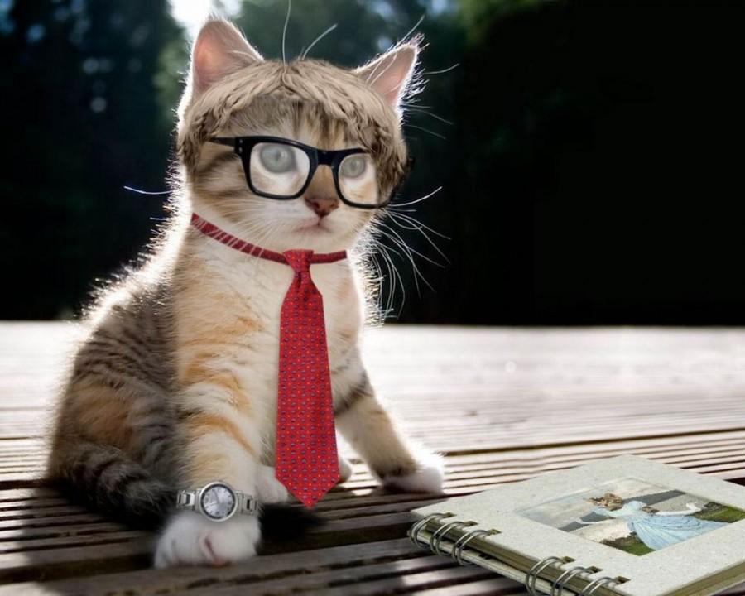
What time is it, please?
Excuse me, what is the time, please ?

Slide 4

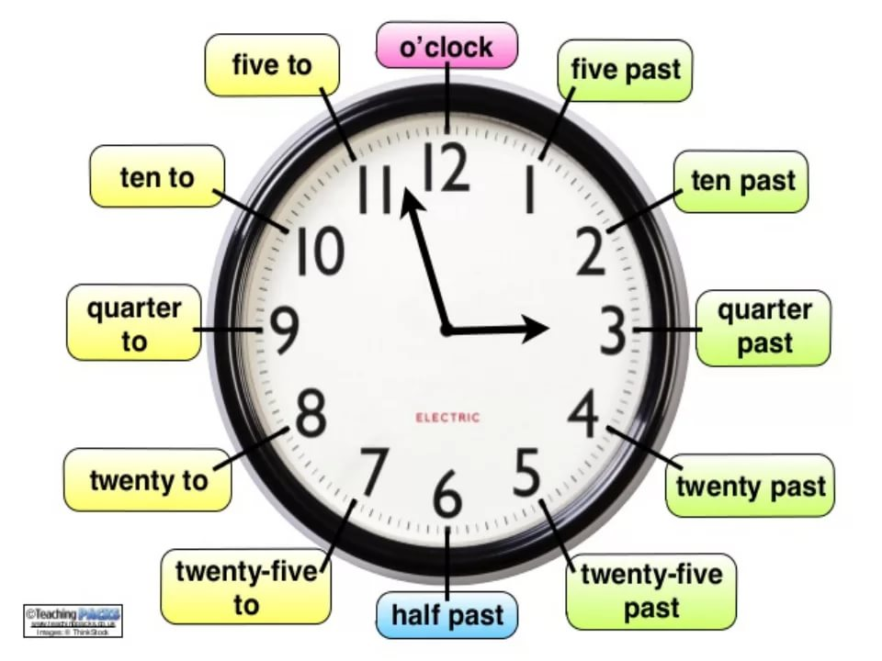

Slide 5

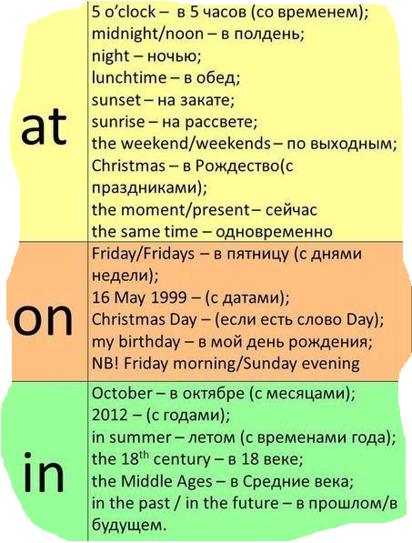
Preposition of time

Slide 6

At/On/In не используются перед:
this — this morning/this week и так далее
every — every day/every week и так далее
last — last August/last week и так далее
next — next Monday/next week и так далее
They are going on holiday next Monday.
Last summer we went to Scotland.
IN также имеет значение "через":
In five minutes/in a few days/in six weeks/in two years — через пять минут/через несколько дней/через полтора месяца/через два года
Hurry! The train leaves in five minutes. — Поторопись! Поезд отправляется через пять минут.

Slide 7
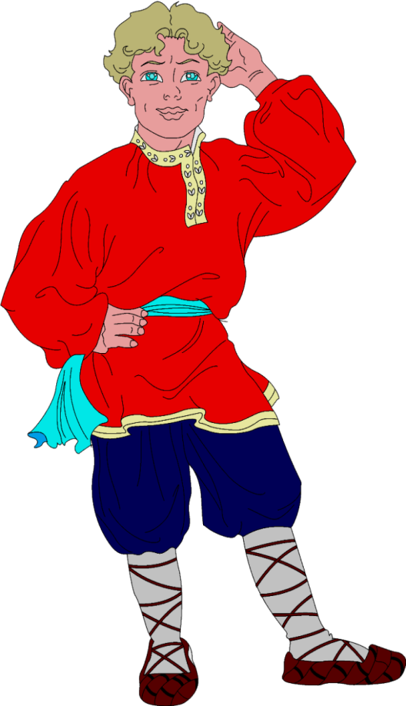
___Wednesday ___ 12.30 a.m.
____ 1977 ____September ____ 24 September
8. ____Friday
I'm leaving ________ next Saturday.
I always feel tired _____ the evening.
Will you be at home ________ this evening?
We went to Scotland _________ last summer.
What do you usually do _____ the weekend?
She phones me _______ every Sunday.
Can you play tennis ____ next Sunday?
I'm afraid I can't come to the party ______ Sunday.
We went to bed late _______ last night.
I don't like going out alone _____ night.
I won't be out very long. I'll be back ______ ten minutes.
At
In
On

Slide 8
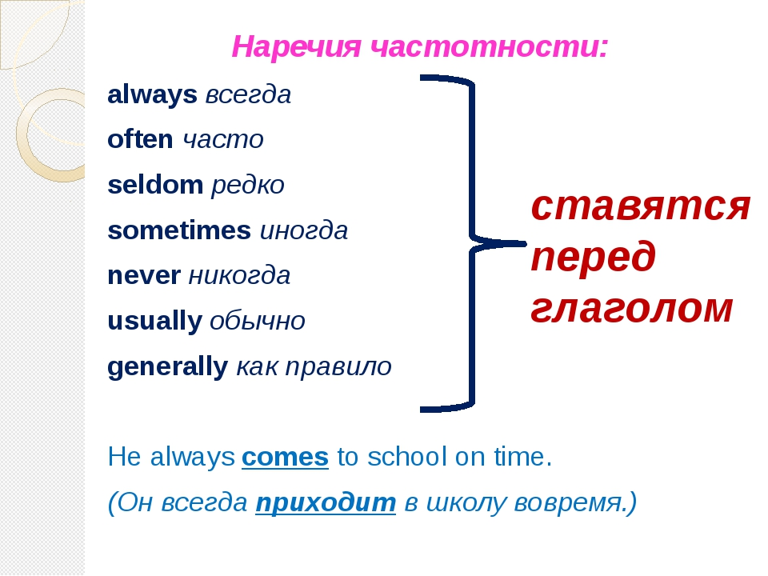
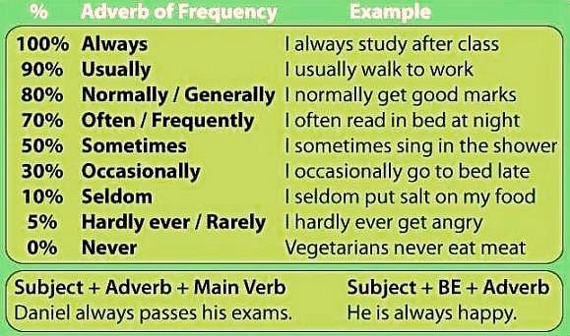
Adverbs of frequency

Slide 9
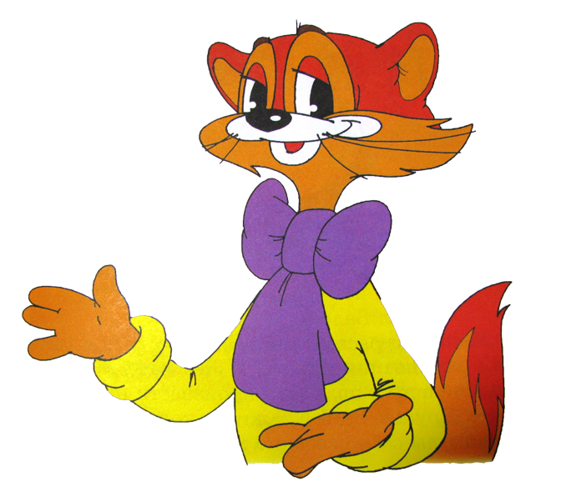
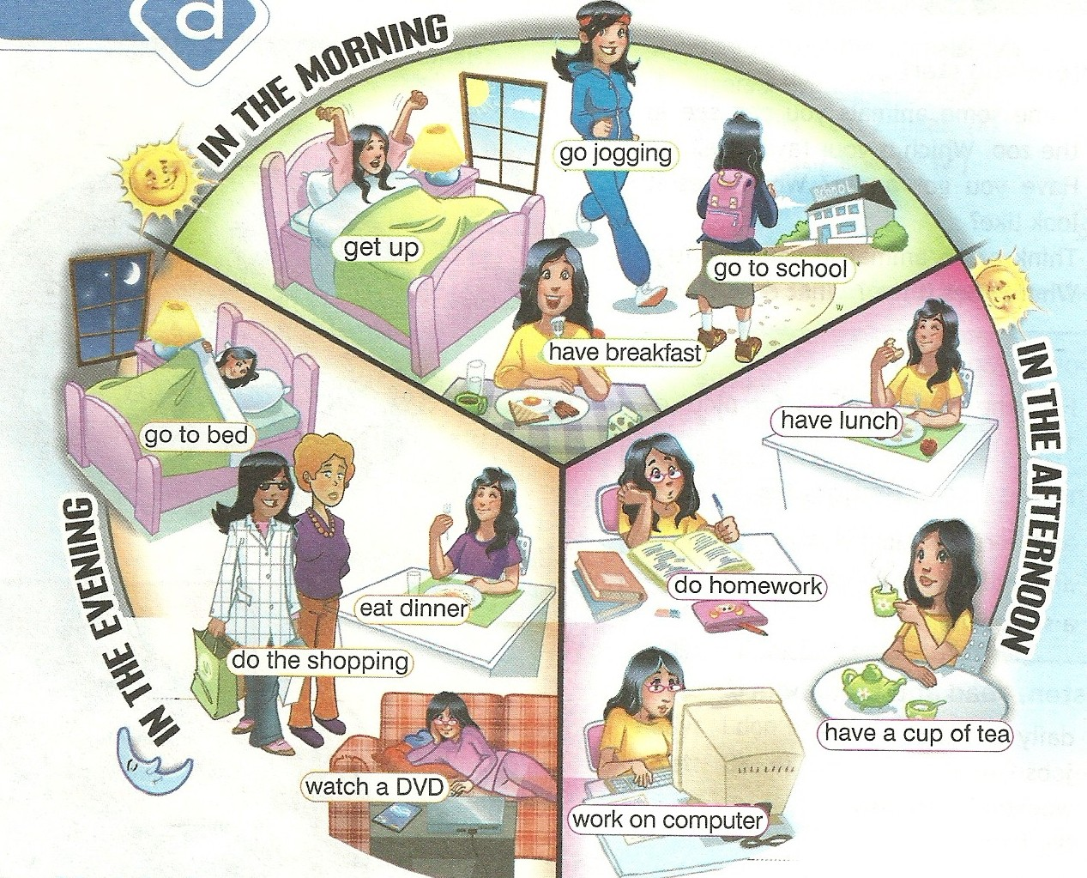
Wake up
HD 3033×1422

Slide 10
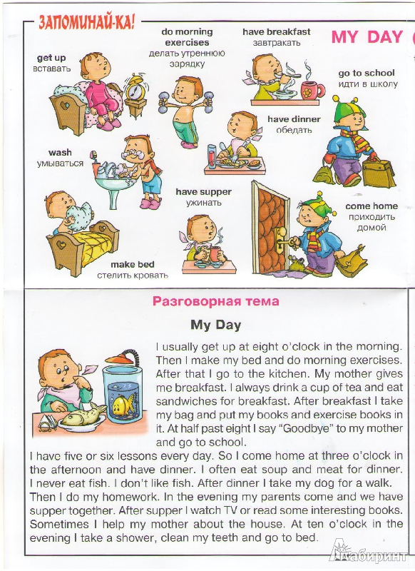


Slide 11

Спасибо за внимание
The end

