Slide 1
5 класс
Тема: Животные

Slide 2
THE PRESENT SIMPLE TENSE
ПРОСТОЕ НЕОПРЕДЕЛЕННОЕ ВРЕМЯ, ОБОЗНАЧАЮЩЕЕ ДЕЙСТВИЕ, КОТОРОЕ ПРОИСХОДИТ ОБЫЧНО, РЕГУЛЯРНО, ВРЕМЯ ОТ ВРЕМЕНИ.
S =3л. ед.ч.
(he, she, it) + Vs (es).
My father likes to read after work.
She always watches such programs.
It often rains in autumn.
УТВЕРДИТЕЛЬНОЕ ПРЕДЛОЖЕНИЕ
S + V.
Every year they go to see their relatives in Moscow.
My friends always smile when I tell them this story.
I prefer oranges to apples.
Notes:
https://yandex.ru/images/search?pos=6&img_url=https%3A%2F%2Ffs01.infourok.ru%2Fimages%2Fdoc%2F8%2F10387%2F640%2Fimg1.jpg&text=the%20present%20simple%20tense%20правила&rpt=simage&lr=16

Slide 3
ОТРИЦАТЕЛЬНОЕ ПРЕДЛОЖЕНИЕ
S + do not (don’t) + V.
They don’t go to see their relatives in Moscow еvery year.
My friends don’t smile when I tell them this story.
I do not like oranges.
S =3л. ед.ч.
(he, she, it) +
+does not (doesn’t) +V.
My father doesn’t like to read after work.
She does not watch such programs.
It doesn’t often rain in summer.

Slide 4
Общий вопрос Специальный вопрос
Do you like apples?
No, I don’t. Does he like apples?
Yes, he does
What do you like to read?
Which of the books do they prefer?
When does he usually visit library?
Who rereads this book again and again?

Slide 5
Альтернативный вопрос Разделительный вопрос
Do you like sunny or rainy weather?
I prefer sunny weather. Does your wife prefer summer or winter?
Your son likes to watch TV very much, doesn’t he?
You don’t like to watch such programs, do you?
You think that TV makes harm to children’s health, don’t you?

Slide 6
Do, does, do nоt, does not
. …. your mum work?
….your friend walk to school?
….you play snowballs in winter?
….your granny live in the country?
…. you swim well?
….your friend like playing computer games?
…. your mum like dogs?
…. you feed your pet?
…. your dad like fish?
….. you help your parents?
….your baby brother sleep a lot?
…. you like to draw?

Slide 7
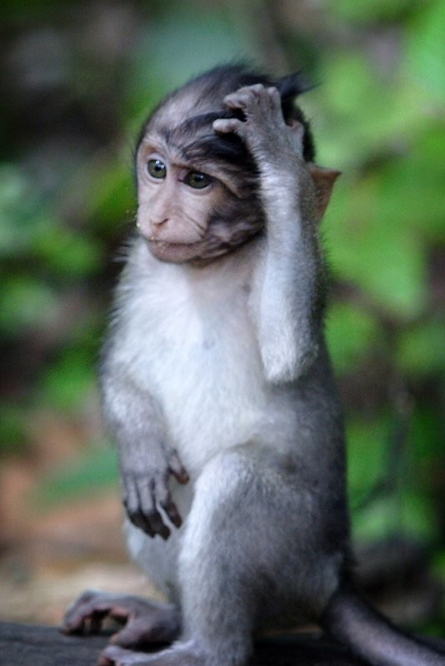
Найди названия животных
E | L | E | P | H | A | N | T
F | I | L | I | O | N | A | O
R | O | E | B | R | M | R | R
O | N | P | E | S | I | B | T
G | S | H | A | E | S | E | O
B | E | A | R | B | E | Z | I
E | A | N | E | K | A | N | S
E | L | T | O | I | L | R | E

Slide 8
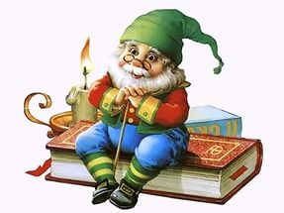
Lion, cobra, deer, grasshopper, crocodile, frog, ant, cow ,horse, bee ,kangaroo ,dolphin ,mosquito, peacock ,salmon, tortoise, budgie, cat ,beetle, koala ,flamingo, ladybird
1. INSECTS
2. FISH
3. AMPHIBIANS
and REPTILES
4. BIRD
5. MAMMALS

Slide 9
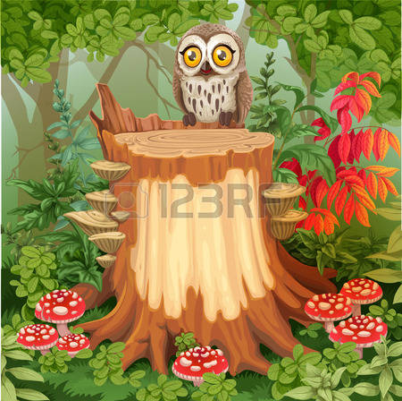
Соедини слова из двух колонок
1.elephant a)mane
2.peacock b)horns
3. lion c)fur
4. bear d)trunk
5. giraffe e)feathers
6. monkey f)hump
7. deer g)stripes
8.tiger h)teeth
9.camel i)neck
10.crocodile j)tail

Slide 10
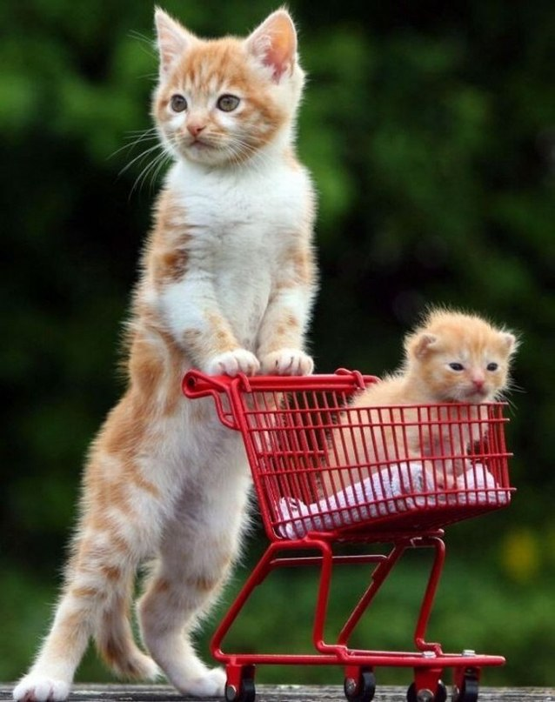
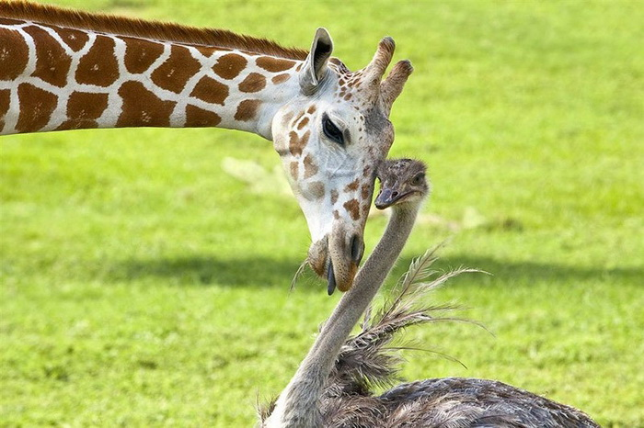
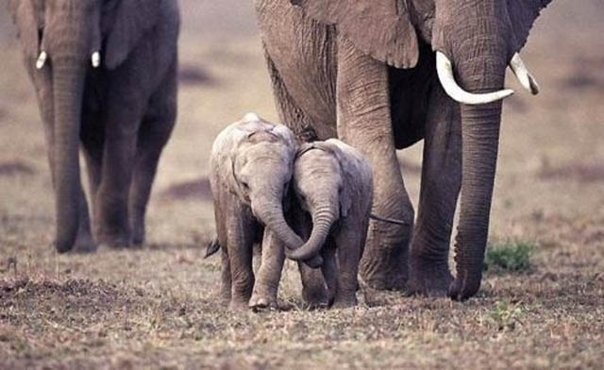
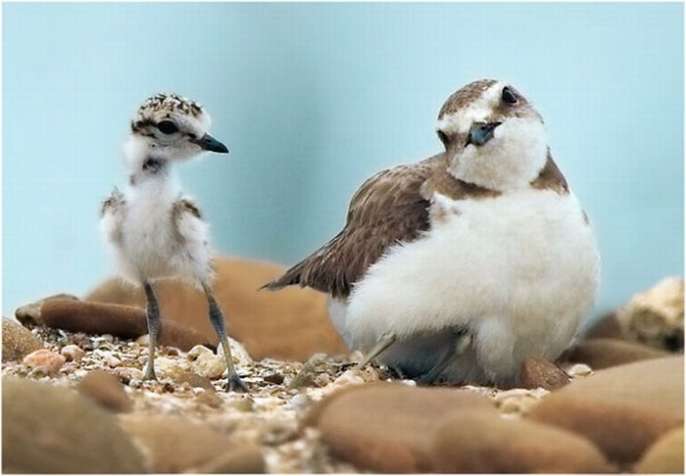
long – short; big – small; thin – thick

Slide 11
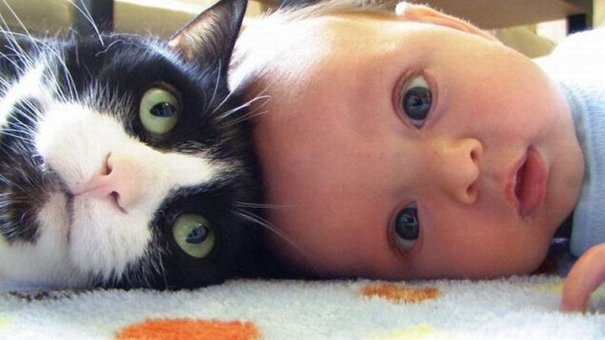
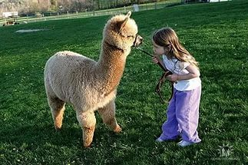
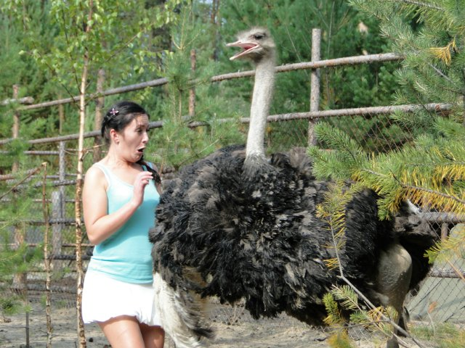
long neck neck skin feathers
Compare parts of the body of animals and human
eyes
eyes

Slide 12
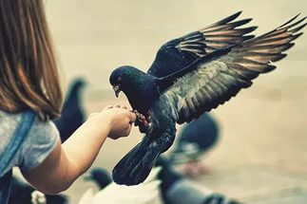
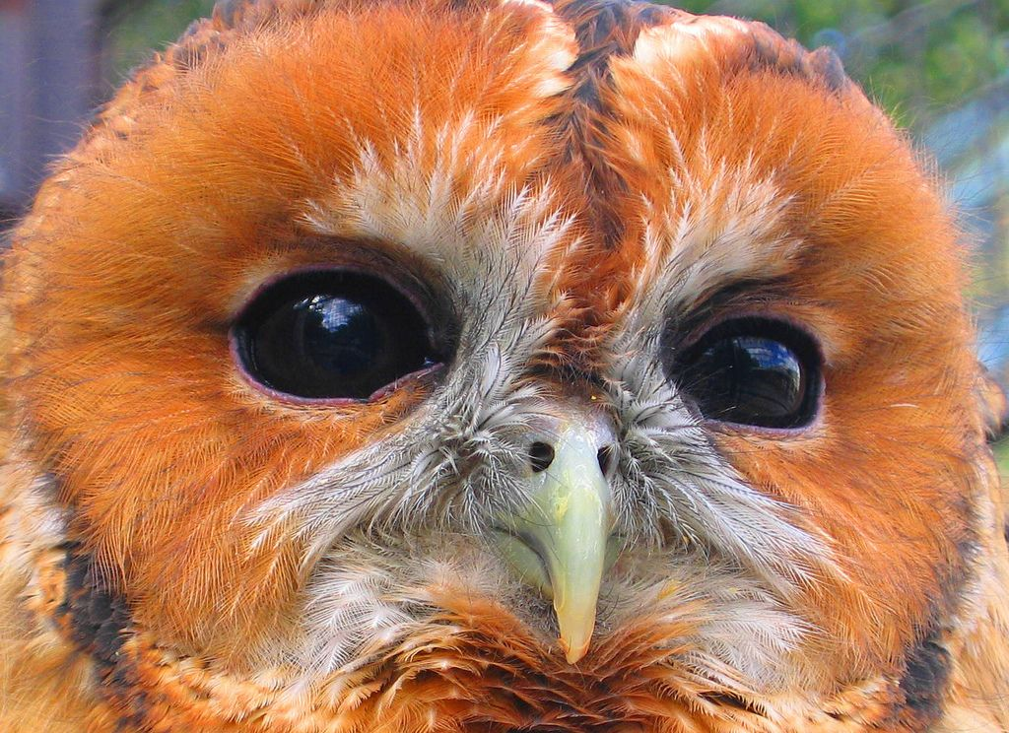
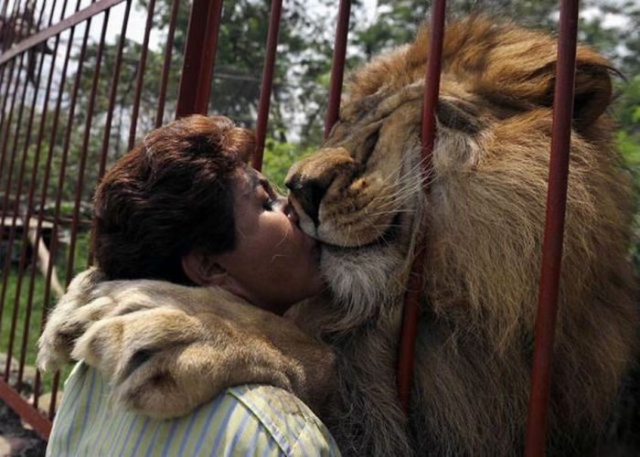
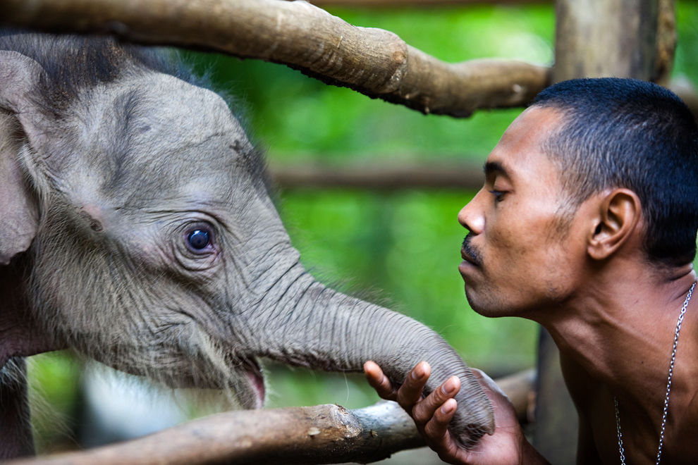
beak
hand wing
trunk nose
hair mane

Slide 13
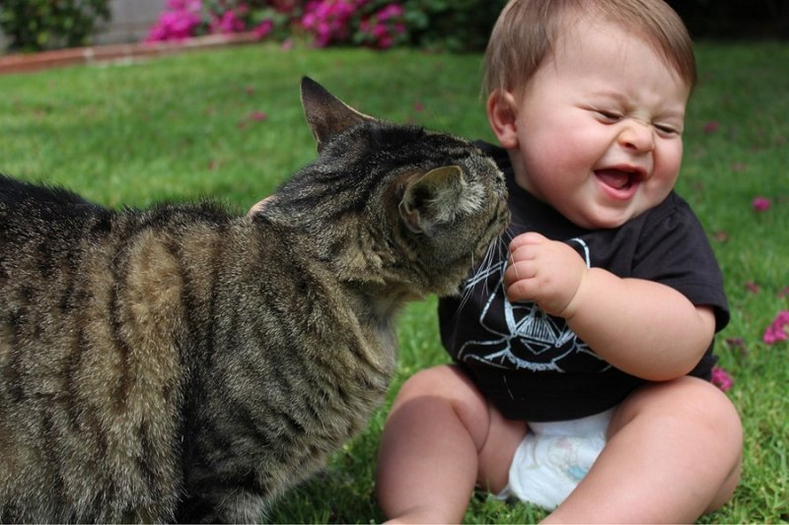
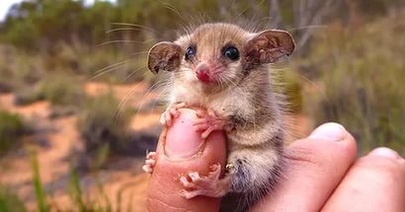
hair – fur finger -paws

Slide 14
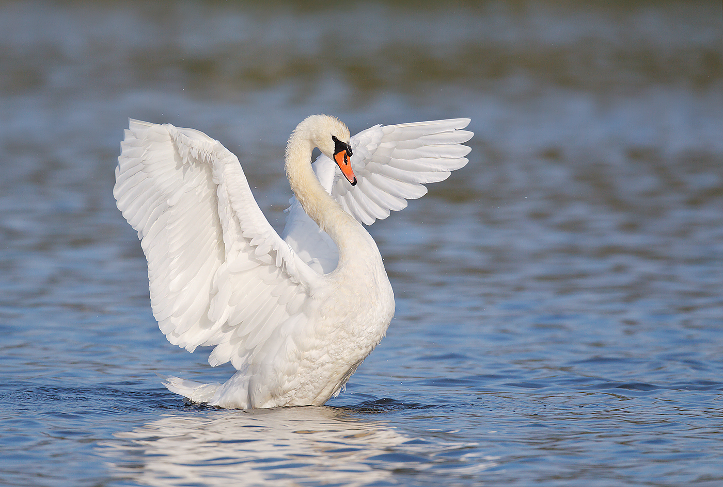
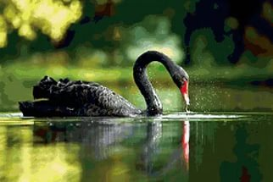
письмо
Model: The swan is usually white or black. It has got a long neck, a yellow beak with black around the eyes. It has got big wings and lots of feathers. I like swans because they are very beautiful and proud.

Slide 15
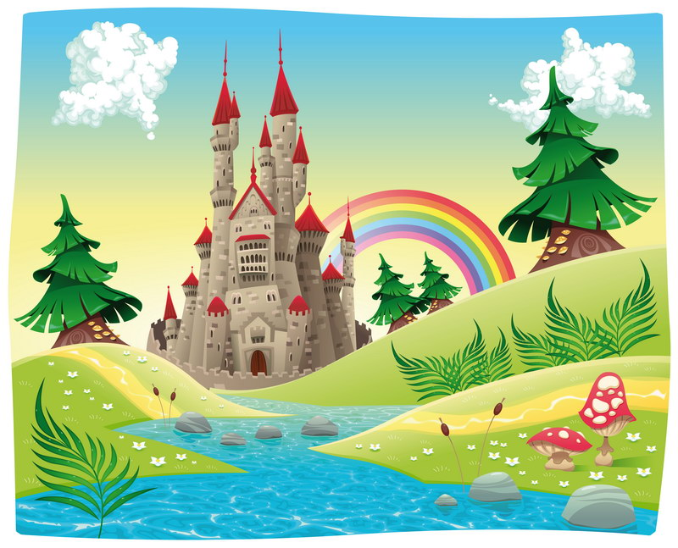
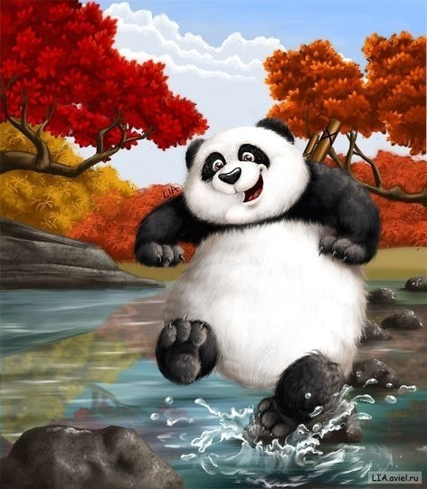
The end, thank you!!!!!!!

