Slide 1
MY THINGS
Module 2b
Презентацию подготовила: Вознесенская К.А.
учитель английского языка
МБОУ “Гатчинская СОШ 7”

Slide 2
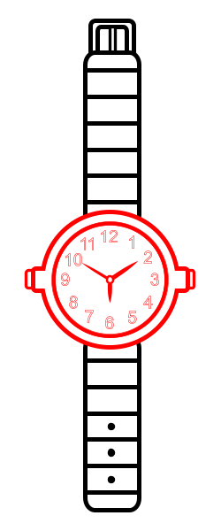
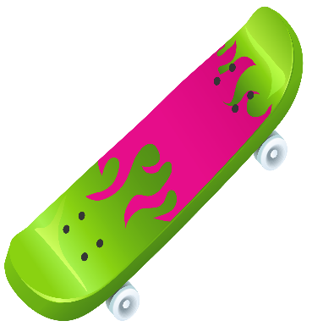
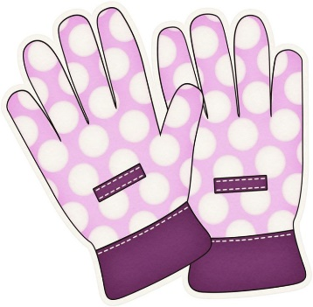




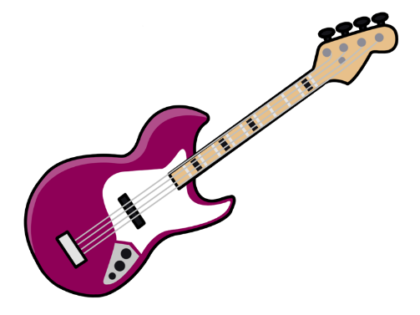
g_ita_ te_dy b_ar
h_lm_t
b_cy_le
s_a_f
w_t_h
sk_teb_a_d gl_v_s

Slide 3
guitar teddy bear
helmet
bicycle
scarf
watch
skateboard gloves

Slide 4
PLURALS
s, ss, ch, sh, x, o es
гласная + y s
согласная + y, y заменяется i es
f, fe, заменяется на v es

Slide 5
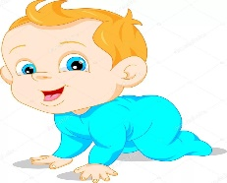




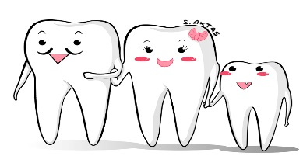
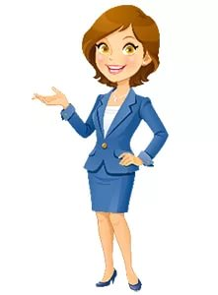



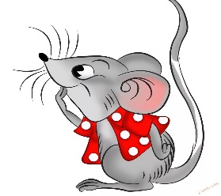


IRREGULAR PLURALS
child children
foot feet
tooth teeth
woman women
man men
mouse mice

Slide 6
Write the plurals
Box -
Woman -
Puppy -
Fox -
Mouse -
Potato -
Family -
Foot-
Knife -
Bus -
Child -
Sandwich -

Slide 7
Write the plurals
Box - boxes
Woman - women
Puppy - puppies
Fox - foxes
Mouse - mice
Potato - potatoes
Family - families
Foot- feet
Knife - knives
Bus - buses
Child - children
Sandwich - sandwiches

Slide 8
This/These That/Those
 | Близко | Далеко
Единственное число | This is…(это) | That is…(тот)
Множественное число | These are…(эти) | Those are…(те)

Slide 9
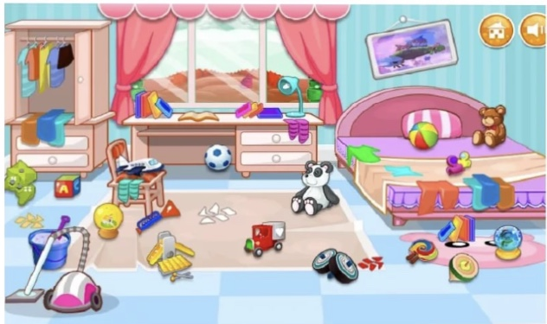
There …… two balls in the room.
There …… a skirt in the wardrobe.
…… …… teddy bears in the room.
…… …… a lamp on the table.
…… …… books on the table.
…… …… a bed in the room.

Slide 10
There are two balls in the room.
There is a skirt in the wardrobe.
There is teddy bears in the room.
There is a lamp on the table.
There are books on the table.
There is a bed in the room.

