Slide 1
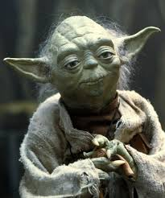

Greetings !
Let the force be with you, my young padavans.

Slide 2

Phrase of the day:

Slide 3


Slide 4
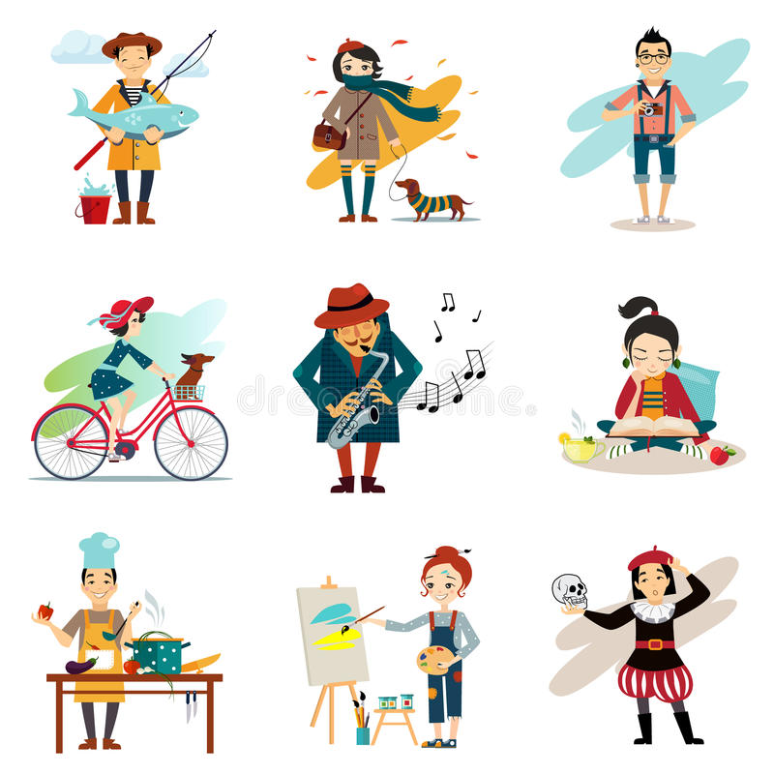

Slide 5

“Hobby”

Slide 6
To read, write and speak on the topic “Hobby”

Slide 7
Unit 8. Lesson 2. What’s your hobby?

Slide 8

Textbook

Slide 9
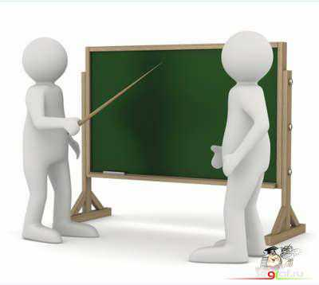
VOCABULARY p.145

Slide 10
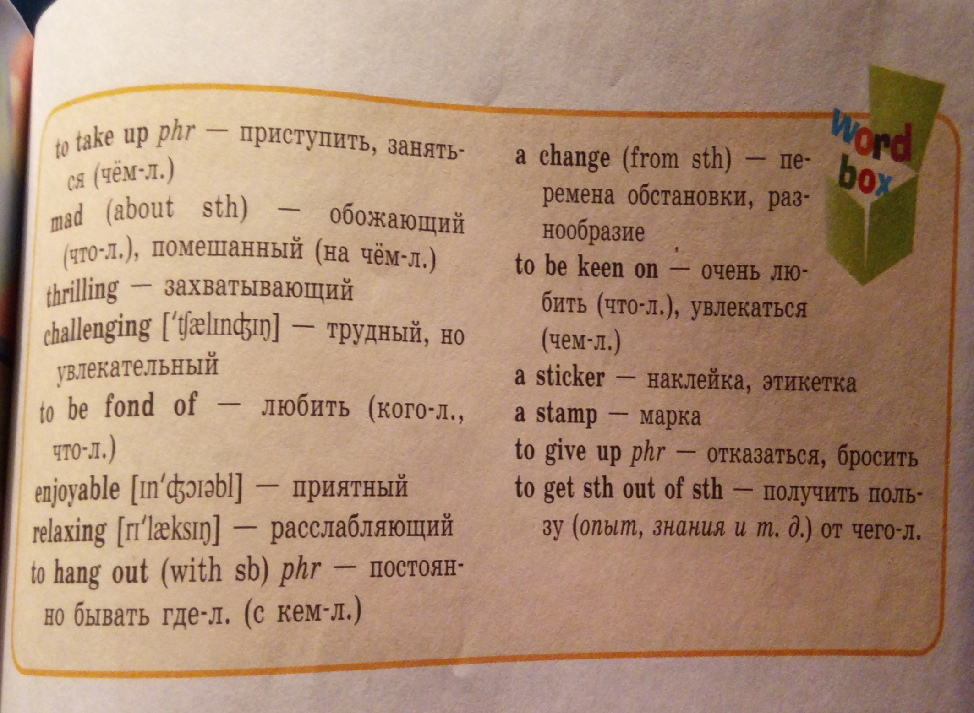

Slide 11

Grammar
P.147,193

Slide 12
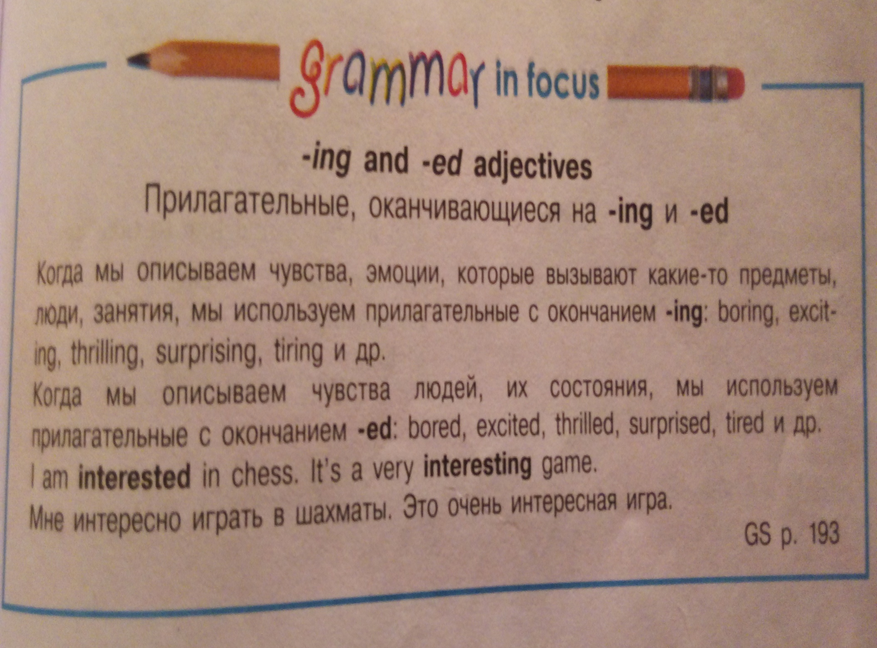

Slide 13
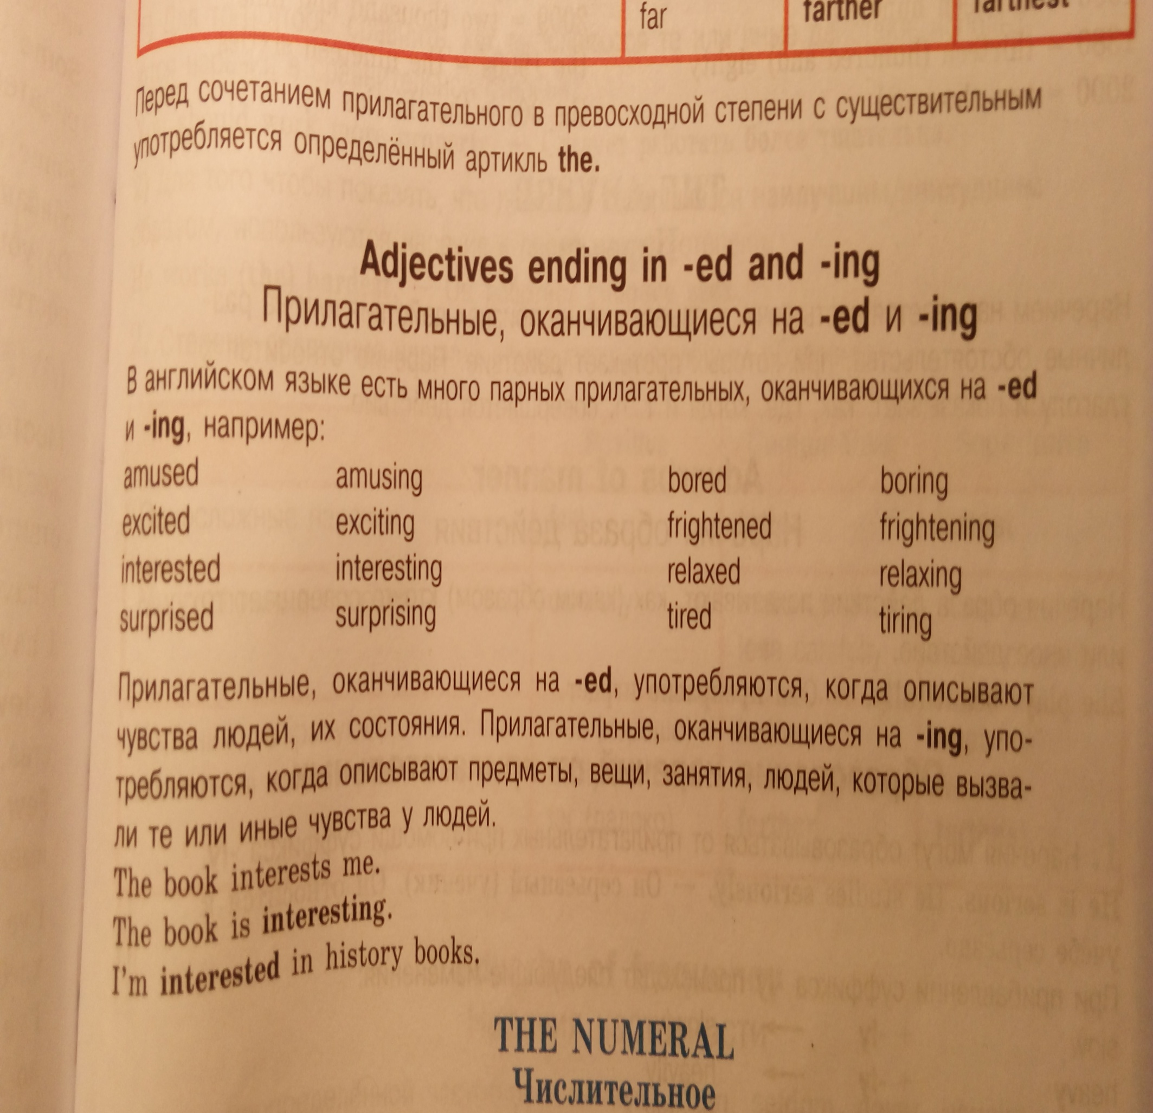

Slide 14
I use Adjectives ending in
-ed when
-ing when
I describe human feelings and their state:
Bored
Excited
Thrilled
Tired etc.
I describe human feeling, emotions that are caused by things, people, activities:
Boring
Exciting
Thrilling
Tiring etc.

Slide 15

Individually

Slide 16
Find yourself:
Variant 1
Variant 2
Никанор
Вячеслав
Арсен
Ярослав
Егор
Кирилл
Алина
Светлана
Айаан
Самир
Ренат
Олег
Анжела
Айлана
Лиана

Slide 17

5 minutes…

Slide 18
Choose the correct word to describe things and people’s feelings.
Variant 1
1. Tom is ________ in motorsport. He finds it _________. (interesting/interested)
2. I’m so ________ by collecting stamps. It’s _________ to learn a lot about the world. (amusing/amused)
3. Reading books is not ______ . I am never _______ with it. (boring/bored)
4. My Mum was _______ at the news. (surprising/surprised)
5. Cycling is an ________ hobby. (exiting/exited)
Variant 2
1. It was not ________ for Tom to do the tests. (interesting/interested)
2. Our teacher was _________ with Nick who was not a prodigy. (disappointing/disappointed)
3. Pupils were _________ because their marks were not good. (depressing/depressed)
4. George didn’t have a brother or a sister. He was ________ to tears. (boring/bored)
5. Looking after his Grandma wasn’t the most _________ way to spend a Saturday morning. (exiting/exited)

Slide 19


Slide 20
Key to the grammar test:
Variant 1
interested/interesting;
amused/amusing;
boring/bored;
surprised;
exiting.
Variant 2.
interesting;
disappointed;
depressed;
bored;
exiting.
*five correct answers = «Excellent»

Slide 21

Listen and repeat

Slide 22
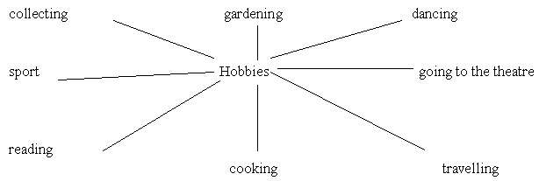

Slide 23

All together

Slide 24
Answer the following questions:
What is a hobby?
Is it interesting to have a hobby?
What can people collect?
What do people usually learn when they collect things?
What hobbies do you know?
What is your hobby?
What are you interested in?
What hobby do you prefer?
You are a collector, aren’t you?
What collection(s) do you have?
Are you proud of your collection(s)?
Is it fun to have a hobby?

Slide 26
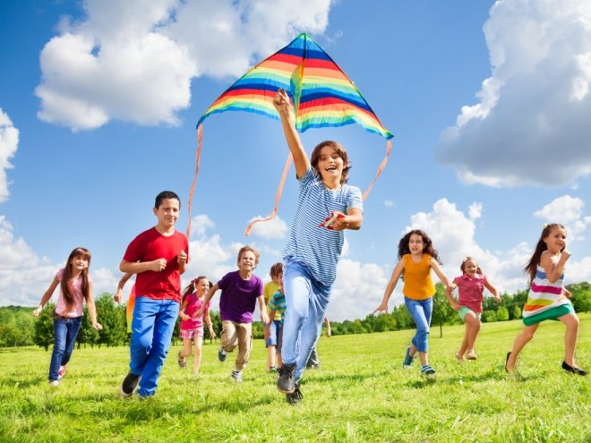
Kite-flying

Slide 27

Pair work

Slide 28
KITE-FLYING
Kite-flying is an old hobby in England. Many years ago people in London liked kite-flying. In our days young men and old men, women and children take their kites to the parks and threw them up into the sky. The kites are of many colors. Some of them are square and others have three corners. Some kites are like boxes, some look like balls or flowers. Many people, and children too, make their kites themselves. They make kites of paper, and fix bright ribbons to them. Some people buy their kites in the shops. In some countries kite-flying is a sport. People have competitions in kite-flying.
Kite-flying – запуск бумажного змея
to throw (threw) – бросать, кидать
to fix – укреплять
ribbon – лента
1. In what country do people like kite-flying very much?
2. What do kites look like?
3. What are kites made of?
4. Can you make a kite?
5. Have you ever seen a competition in kite-flying?

Slide 29

Act out

Slide 30
Dialogue 1
- Harry, let’s play football in the yard.
- I’d love to but my leg hurts.
- Well then, how about walking in the park? The weather is nice today.
- That’s a good idea, but I hate hanging out in the park. It’s a waste of time.
- In my opinion you are just lazy!
- No, I’m not. Besides there is an interesting film on TV in the afternoon. I enjoy watching old comedies.
- As for me I prefer go in for sport to watching TV. Playing football or tennis is a change from school, isn’t it?
- You are right, Tom. But remember tastes are differ.
Dialogue 2
(Mary is speaking by telephone)
– Bob? This is Mary. How are you?
– Fine. And you?
– Fine too. What are you doing?
– I’m listening to music. It’s really relaxing. In my leisure time I enjoy listening to rock music. Do you like rock music?
– I like music, but I don’t like rock. I get pleasure from growing flowers. I’m so amused by this hobby. There are many beautiful flowers in our house.
– Do you have any orchids in your collection?
– Yes, there are some orchids, they are nice. Would you like to see my flower collection?
– That’s a good idea. Thank you.

Slide 31

We did it!

Slide 32

Conclusion

Slide 33

Home assignment

Slide 34
Please do one of the following by FRIDAY:
Master Karate or Aikido or Kendo or any other kind of martial arts (I’m forming a clan full of adepts of ‘’my’’ religion);
Wear a fake mustache for 24 hours (yes, you’ve read it correctly, it is what it is);
End world hunger (the force is with you);
Find your nemesis, earn their trust, then vanquish them (preferably with magic);
Use conditioner before your shampoo (I’m just curious);
Refresh your vocabulary on page 145 (textbook) and make exercise 2 on pages 62-63 in Readers.
Anyway, have fun!;)

Slide 35

See you on Friday!

