Slide 1
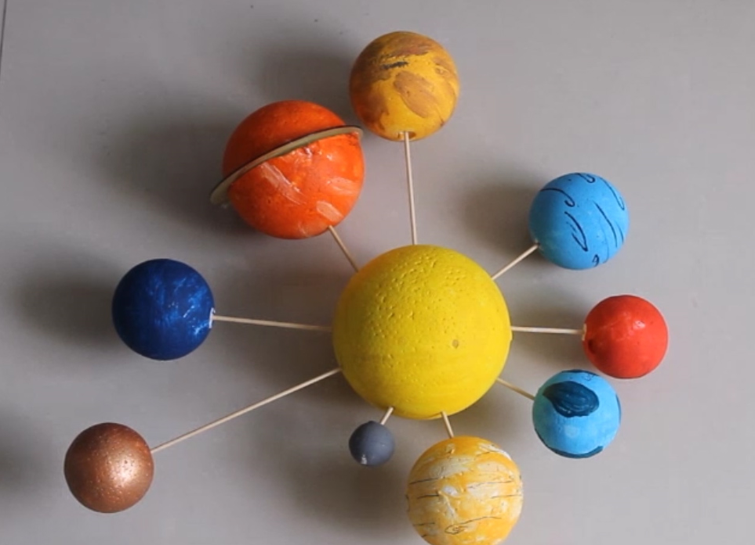
Planets in the solar system

Slide 2
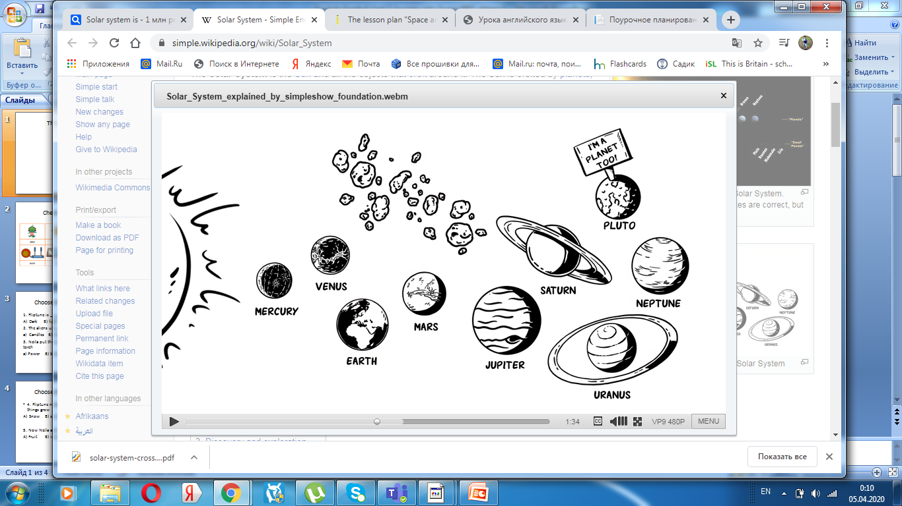
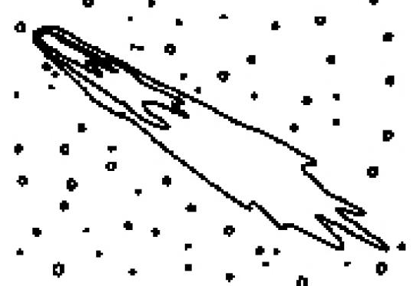
What do you know about the solar system?
comets
asteroids

Slide 3
The Solar System is the Sun and all the objects
that orbit around it. The Sun is orbited
by planets, asteroids, comets and other things.
The Sun is a star. There are eight planets in the Solar
System. There are: Mercury, Venus, Earth, Mars,
Jupiter, Saturn, Uranus and Neptune.

Slide 4
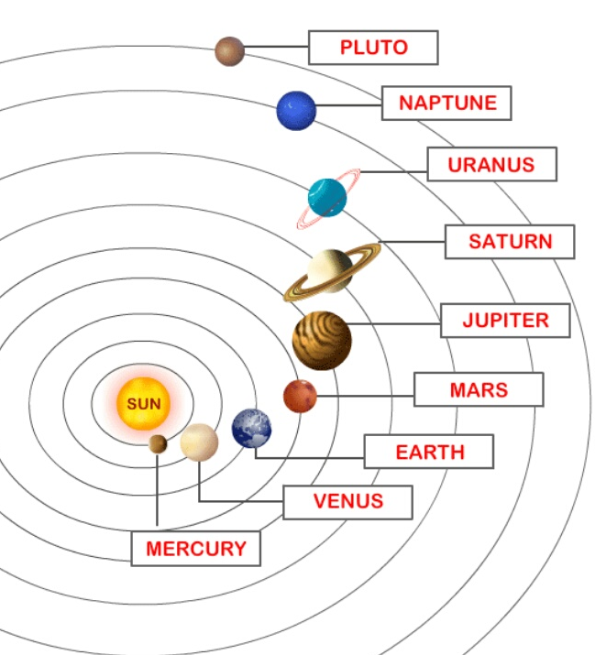

Slide 5
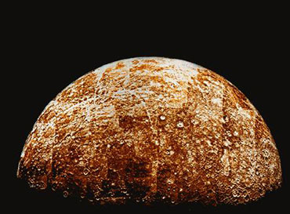
Mercury
My name is Mercury;
I’m the second hottest planet.
The closest one to the sun;
A year of my surface is 88 days.
I’m the smallest but I’m lots of fun.
The distance from the Sun is 58 million km.

Slide 6
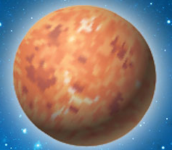
Venus
My name is Venus.
I’m the hottest planet.
But, the second
planet from the sun.
I’m the brightest
planet in the solar
system.
And, I’m too hot for
anyone. The distance
from the Sun is 108
million km.

Slide 7
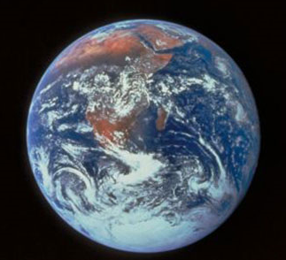
Earth
My name is Earth. I’m
the planet you live on.
The 3rd planet from the
sun. I’m the only planet
with organic life. So, take
care of me, because we
are all one. The distance
from the Sun is 150 million
km.

Slide 8
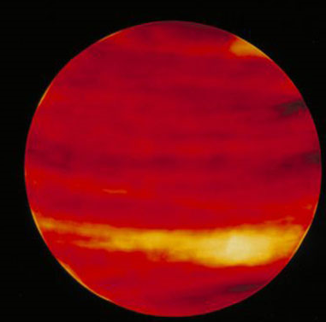
Mars
My name is Mars.
I’m red in color.
The 4th planet from the sun.
I have the highest
mountains in our solar
system. A volcano named
Olympus Mons.
The distance from the Sun is
228million km.

Slide 9
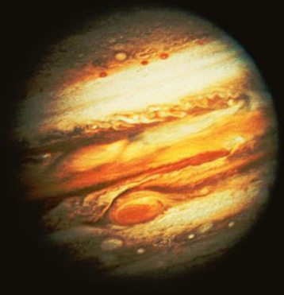
Jupiter
My name is Jupiter.
I’m covered in clouds.
I’m the 5th planet from
the sun.
My giant red spot is a
raging storm. As for
size, I’m the biggest
one. The distance from
the Sun is 778 million
km.

Slide 10
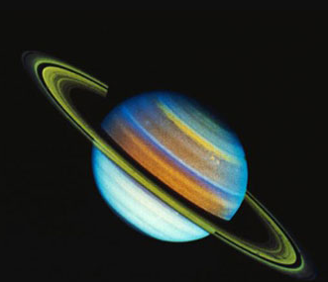
Saturn
My name is Saturn. I’m
brown in color.
I’m the 6th planet from
the sun.
My outer rings are
extremely thin.
They are made of dust
icy chunks. The distance
from the Sun is 1.4
billion km.

Slide 11
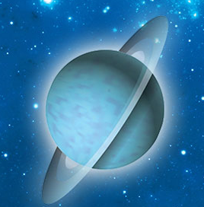
Uranus
My name Uranus and I’m
blue in color.
I’m the 7th planet
from the sun.
Humans have named
me the icy planet.
Because, I’m the
coldest one.
The distance from the Sun
is 2.9 billion km.

Slide 12
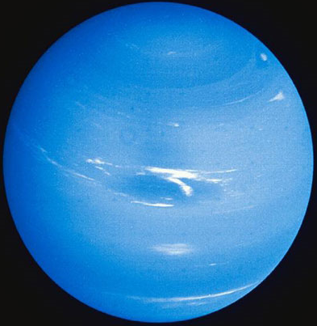
Neptune
My name is Neptune.
I’m blue in color.
I’m the 8th planet from
the sun.
I have too many storms
in my atmosphere.
And, I’m the furthest
planet from the sun! The
distance from the Sun is
4.5 billion km.

Slide 13
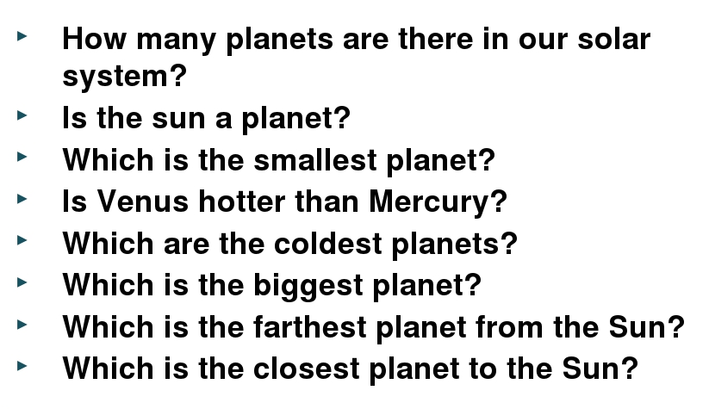
Answer the questions

Slide 14
True of False
1) The Sun is a planet false
2) Jupiter is larger than Neptune. ______
3) Venus is the closest planet to the sun. ______
4) Saturn is the 7th planet from the sun. ______
5) Mars has got rings around it. ______
6) There are eight planets in the solar system. ______

Slide 15
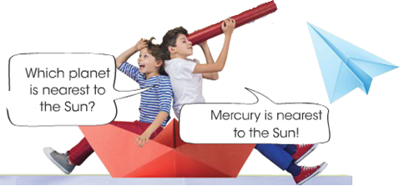
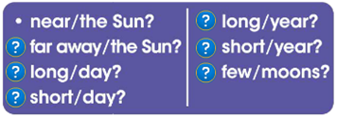
Let’s play

