Slide 1
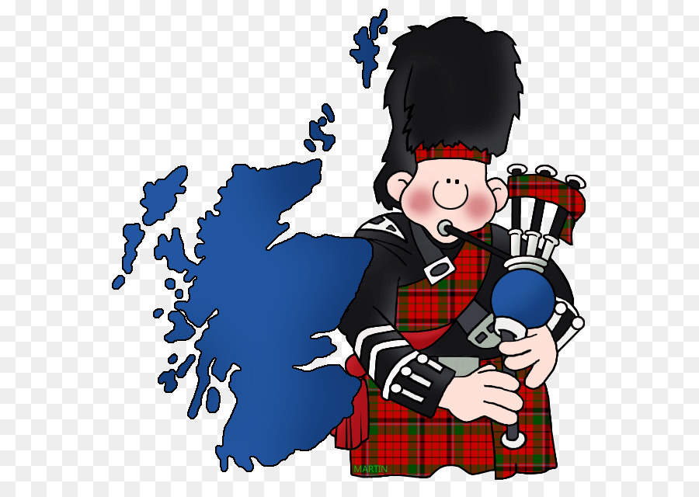
Traditional Costumes Of The British Isles

Slide 2
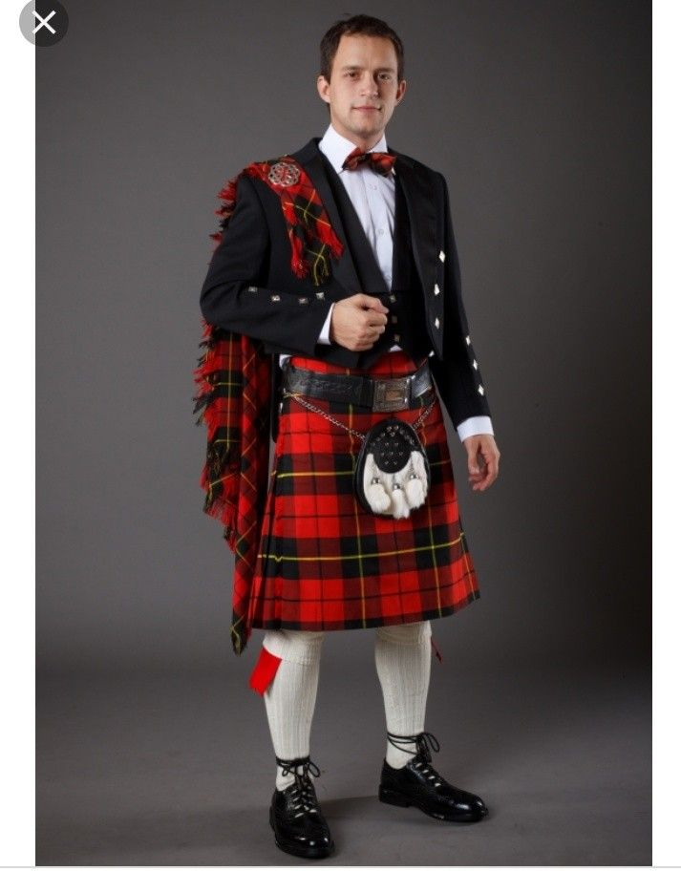
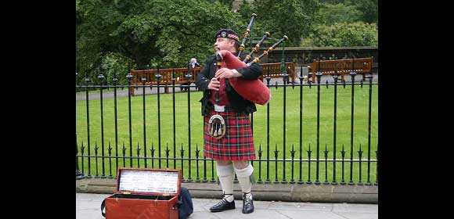
Scotland
Probably the best know traditional costume in the UK is the Scottish kilt with its distinctive tartan pattern. Kilts were pleated woolen skirts, worn only by man , and fastened in front with a special pin. A goatskin bag called a sporran was worn around the waist and a cloak was draped over one shoulder. Each clan or family had its own tartan design. The kilt is still worn on special occasion today.

Slide 3

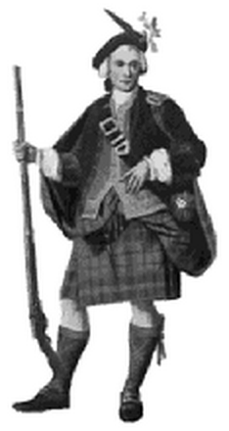
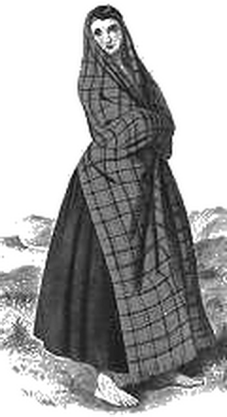
One of the most famous national costumes of the world is a Scottish kilt. And remember that men do not wear skirt, wear a kilt.

Slide 4
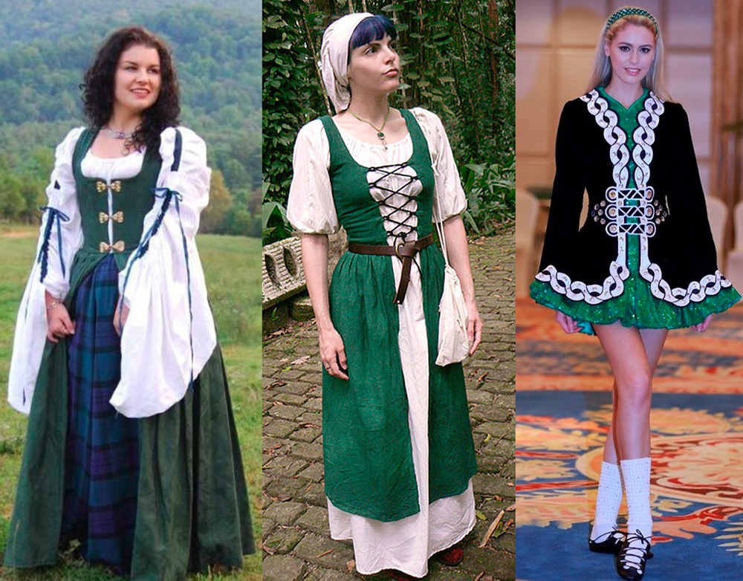
Ireland
Irish traditional costumes make you think of Irish folk dancing. Female dancer wear a long-sleeved dress, knee-high white socks and black shoes. The colorful patterns on the dresses are based on Celtic designs.

Slide 5
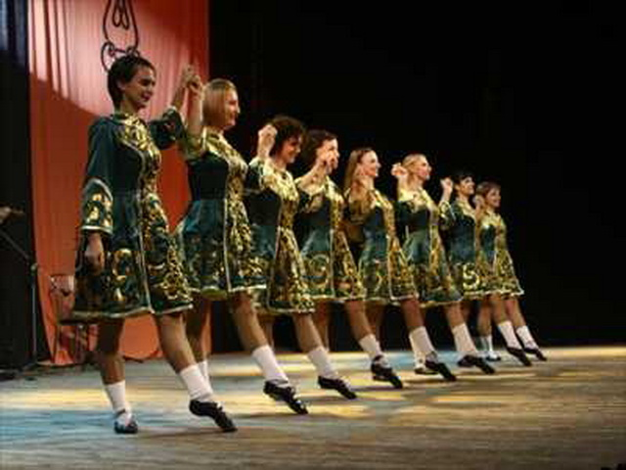
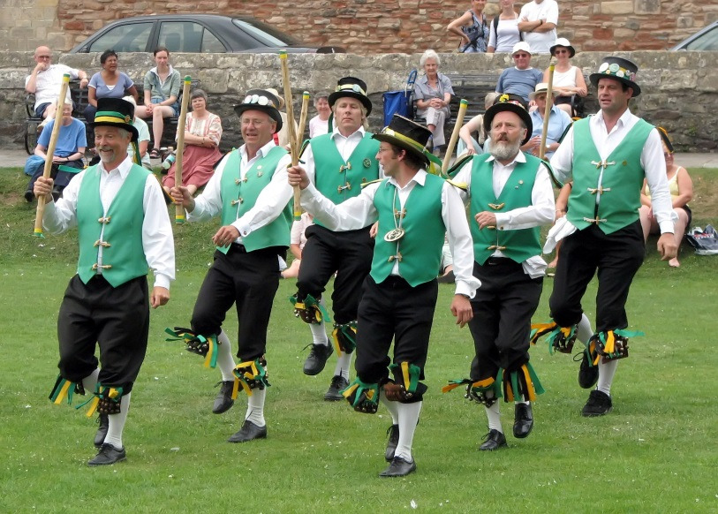
so, in Ireland there are dances which are known for everything and are called - the Irish dances.

Slide 6
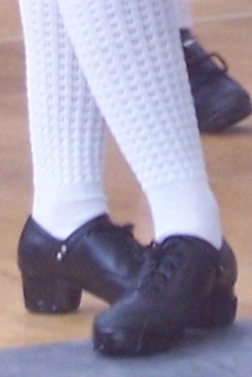
Hard shoes
The hard shoe, which is also called heavy shoe and jig shoe, is, unlike tap shoes, made with fiberglass tips, instead of metal. The first hard shoes had wooden taps with metal nails.
Dancers used the sounds created by the nails to create the rhythms that characterize hard shoe dancing.
Beginning in the 1990s shoes tips were made using resin or fiberglass to reduce the weight and enhance the sound of the footwork. Hard shoes are made of black leather with flexible soles. Sometimes the front taps are filed flat to enable the dancer to stand on his or her toes, somewhat like pointe shoes.
Each shoe has eight striking surfaces: the toe, bottom, and sides of the front tap and the back, bottom, and sides of the back tap (the heel). The same hard shoes are worn by all dancers, regardless of gender or age.

Slide 7
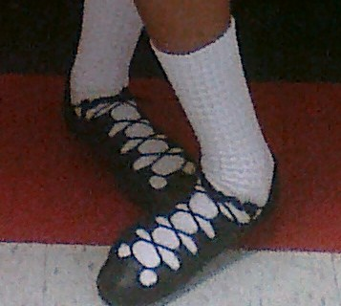
Soft shoes
Soft shoes, often called "ghillies" (or "gillies"), fit more like ballet slippers and are made of black leather, with a leather sole and a very flexible body. They lace from toe to ankle and do not make sounds against the dance surface. They are worn by female dancers for the light jig, the reel, the single jig, the slip jig, and group dances with two or more people.
The second kind of soft shoe is worn by male dancers; these are called "reel shoes" in black leather, with fiberglass heels that the dancers can click them together.

Slide 8
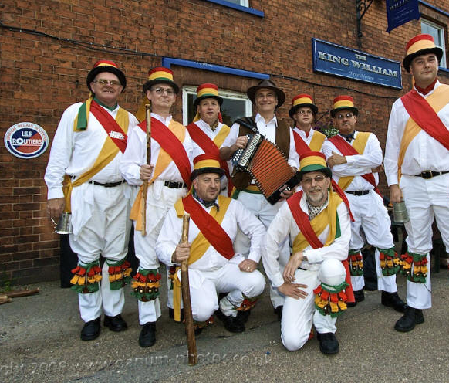
England
Morris dancing with its traditional costumes is a familiar sight in England. These dances are performed outdoors in country villages during the summer. The dancers wear white trousers, a loose white shirts and a pad of bells around the bottom half of the leg. Their hats are decorated with ribbons and flowers, and they wave handkerchiefs in the air as they dance.

Slide 9
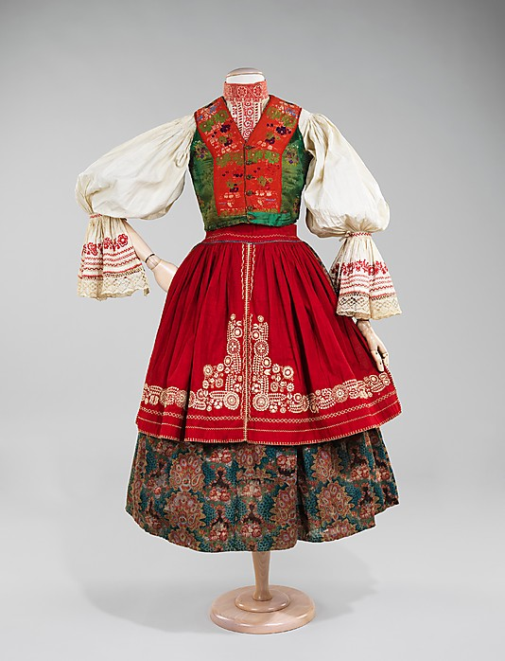
There were many attempts to create a suit, but, as usual nobody can solve as it has to look. Even Henry VIIIth invited the artist Van Dyck to create an English national suit, it also didn't work well

Slide 10
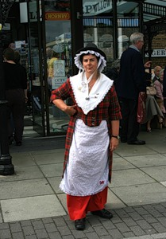
Wales
What everyone recognises about the Welsh costume is its tall black hat or “beaver had” , worn over a lace cap. Women in the past wore it with a long full skirt and a white apron. A shawl, usually red, was worn around the shoulders. The outfit was complete with black shoes and stockings, and ladies carried a basket.

