Slide 1
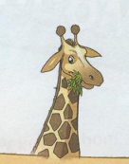
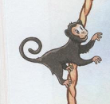






a dolphin
a monkey
a whale
a giraffe
a lizard
a crocodile
a seal
a hippo

Slide 3
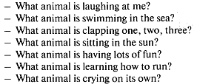
a tall giraffe
a silly monkey
a clever dolphin
a little seal
a lazy lizard
a big whale
a baby hippo
one crocodile

Slide 4
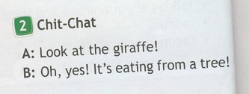

Slide 6
I usually play tennis.
They often swim in the sea.
You sometimes read a book.
He plays football every day.
She always sings songs.
Look! She is playing the piano now.
Listen! I am singing now.
They are swimming now.

Slide 7




2
3
4
5

