Slide 1
THE COVER LETTER

Slide 2
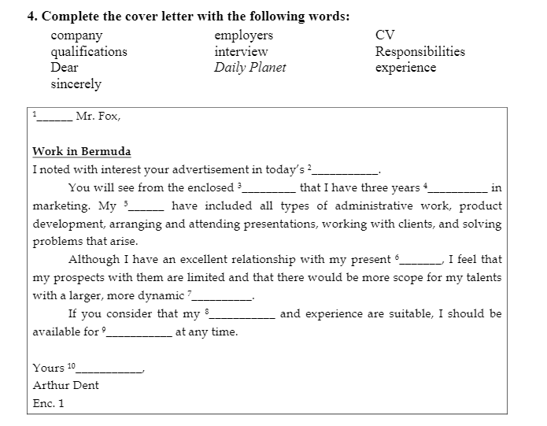

Slide 3
RULES FOR WRITING A GOOD COVER LETTER
Explain why you are sending a resume
Tell specifically how you learned about the position or the organization
Convince the reader to look at your resume
Call attention to elements of your background
Show your attitude, personality, motivation, enthusiasm, and communication skills
Provide any information specifically requested
Indicate what you will do to follow-up

Slide 4
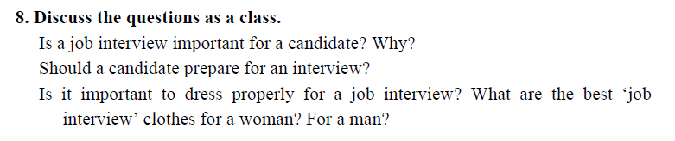

Slide 5
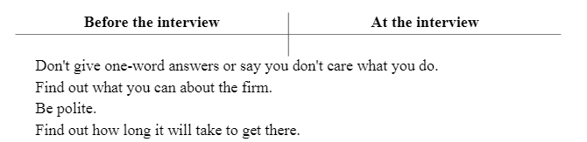
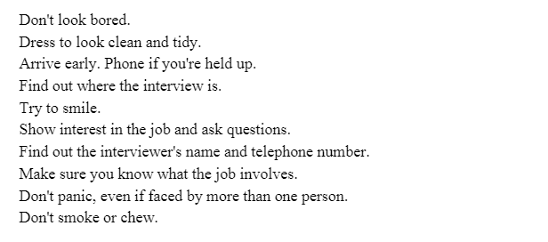

Slide 6
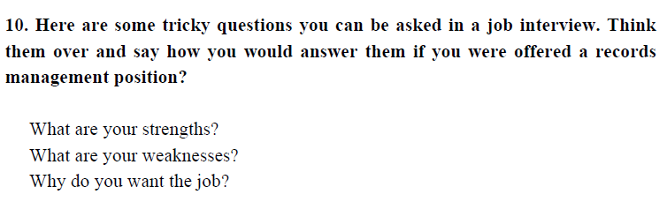

Slide 7
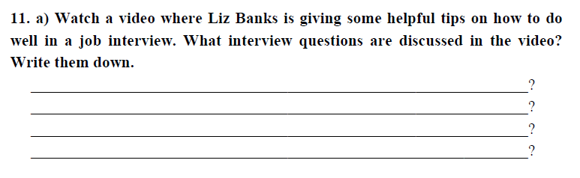

Slide 8
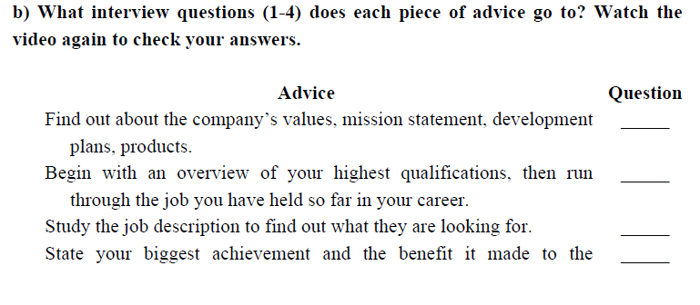
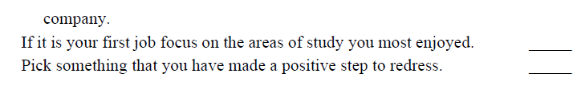

Slide 9
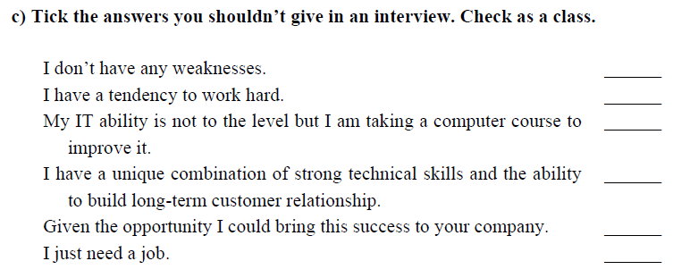

Slide 10
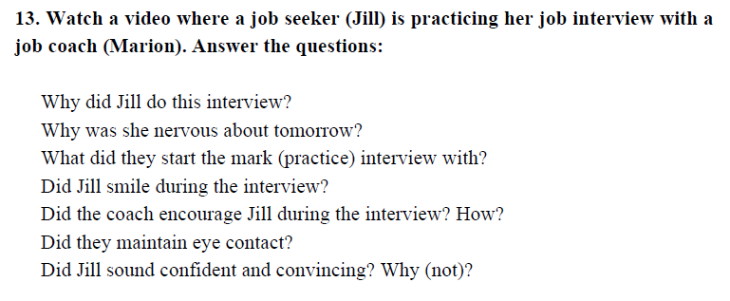

Slide 11
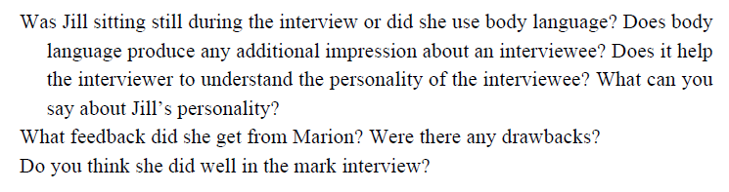

Slide 12


