Slide 1
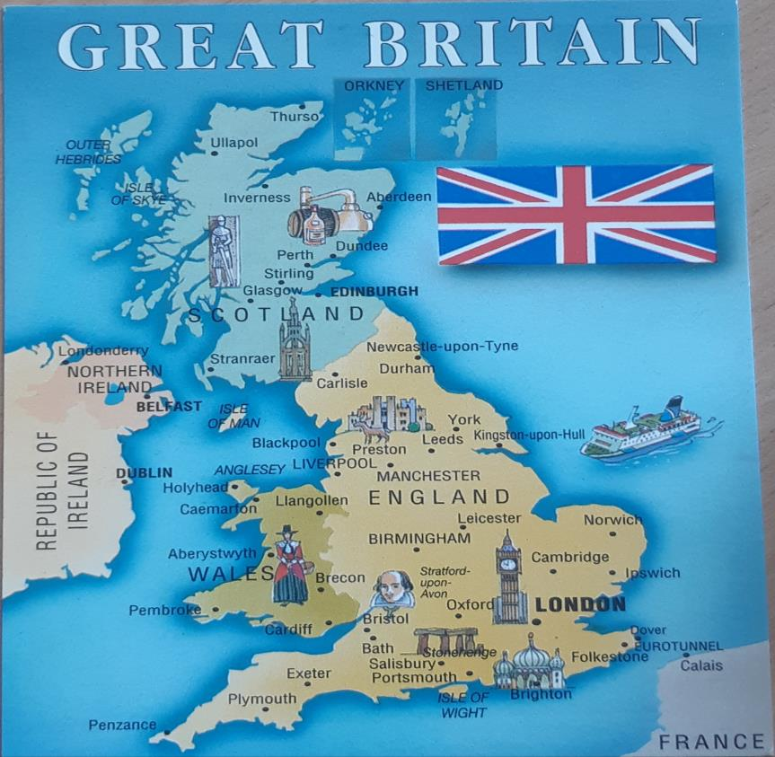
ENGLISH — A LANGUAGE OF THE WORLD

Slide 2
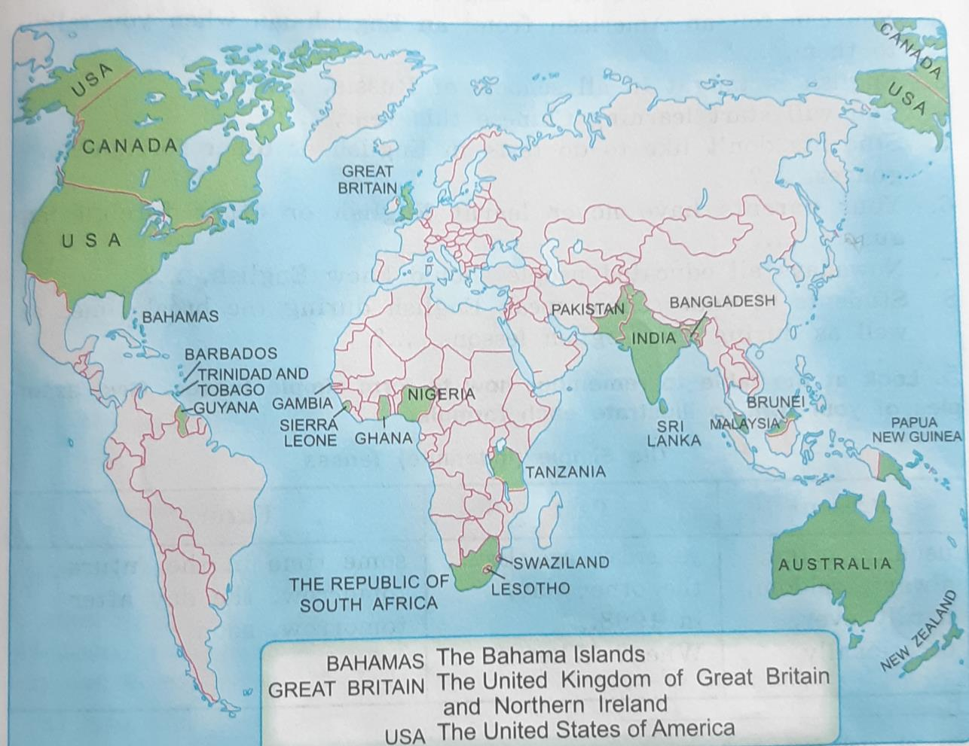
English where it is spoken in the World

Slide 3
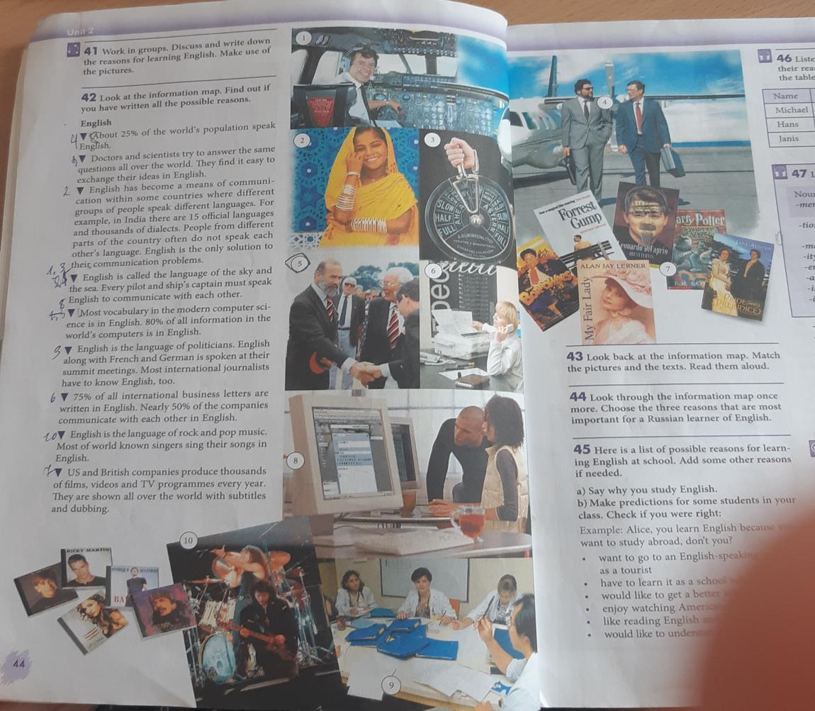
ENGLISH HAS
BECOME
A MEANS OF
COMMUNICATION

Slide 4
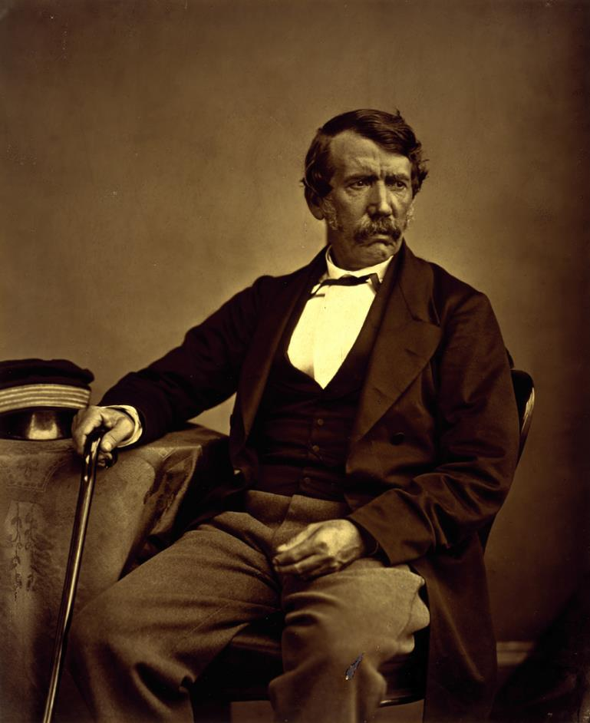
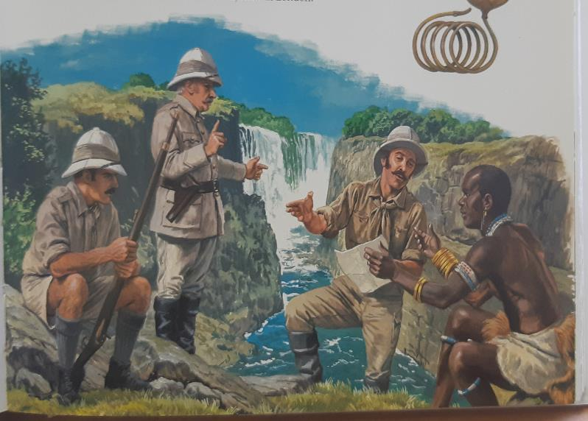
EXPLORATION OF AFRICA
David Livingstone was one of the pioneers of exploration in Africa

Slide 5
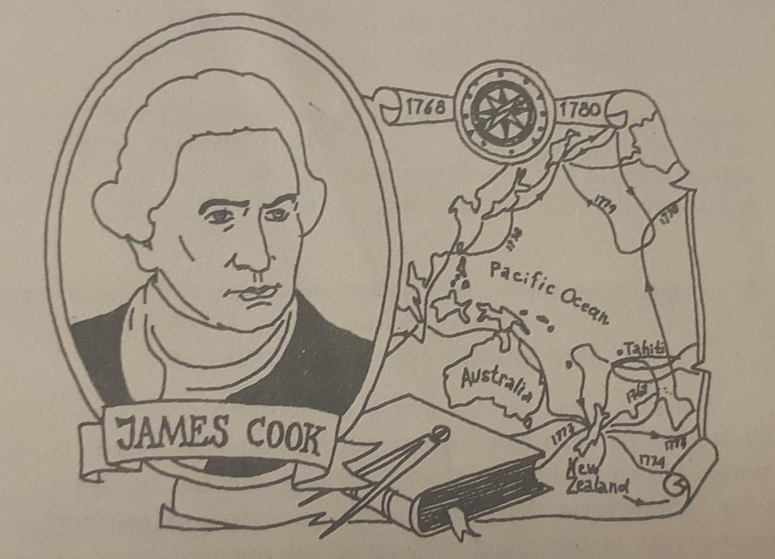
JAMES COOK
James Cook was a great English sailor who discovered many new lands and gave them English names.

Slide 6
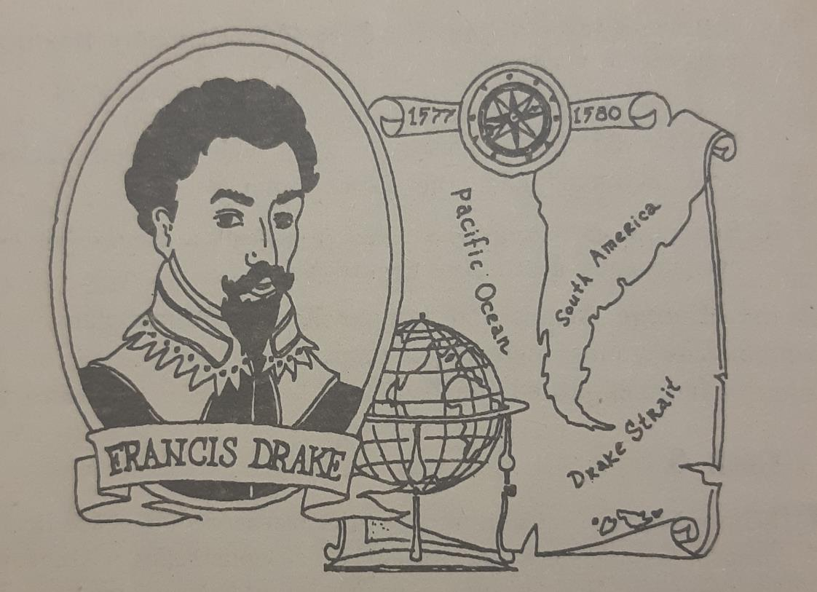
FRANCIS DRAKE
Francis Drake was the first English man who made a journey round the World. He crossed the Atlantic Ocean and found the way to the Pacific Ocean and Indian Ocean.

Slide 7
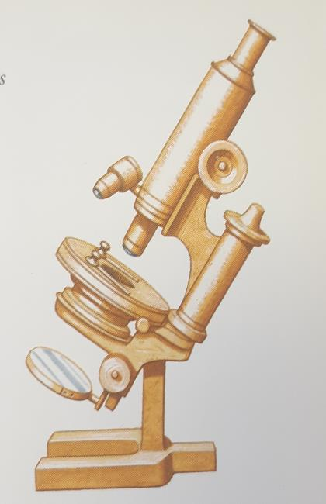
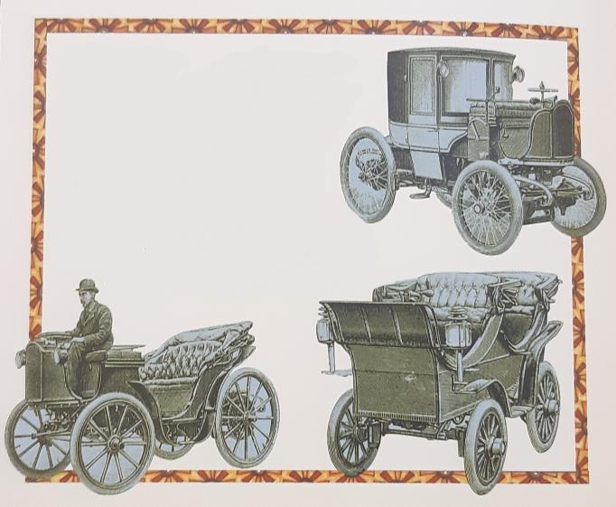

INVENTIONS AND DISCOVERIES

