Slide 1


Slide 2

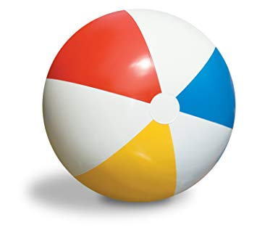
Checking up the home task

Slide 3

People and profession

Slide 4

The 12th of November
Class work
People and profession

Slide 5
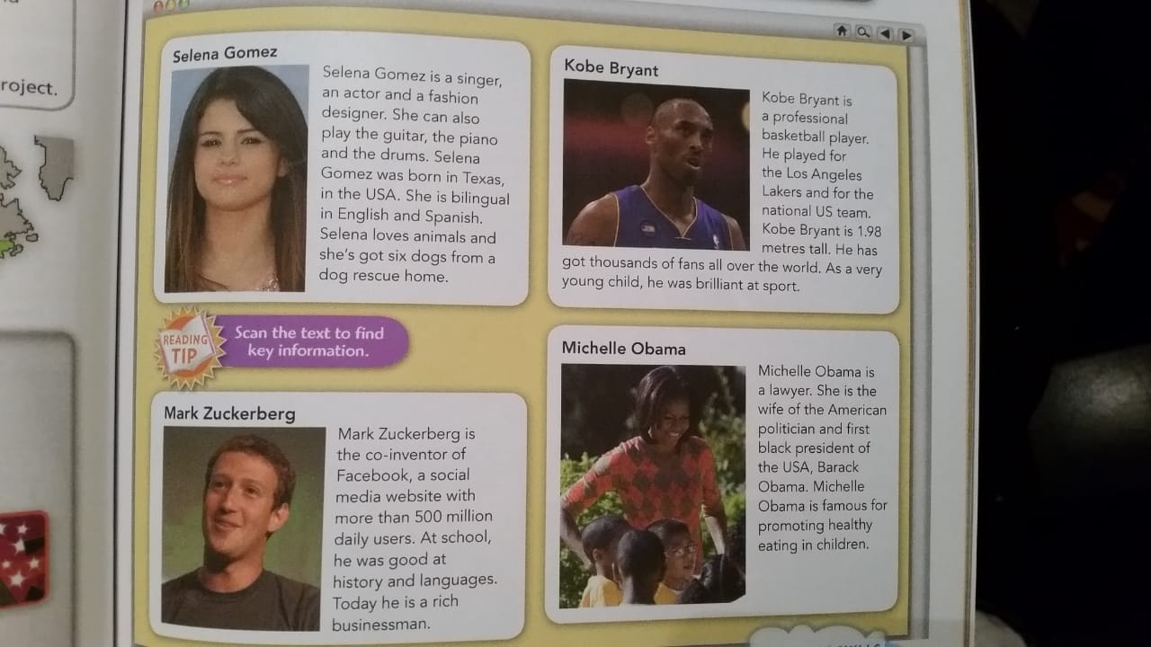
Read the text and translate

Slide 6
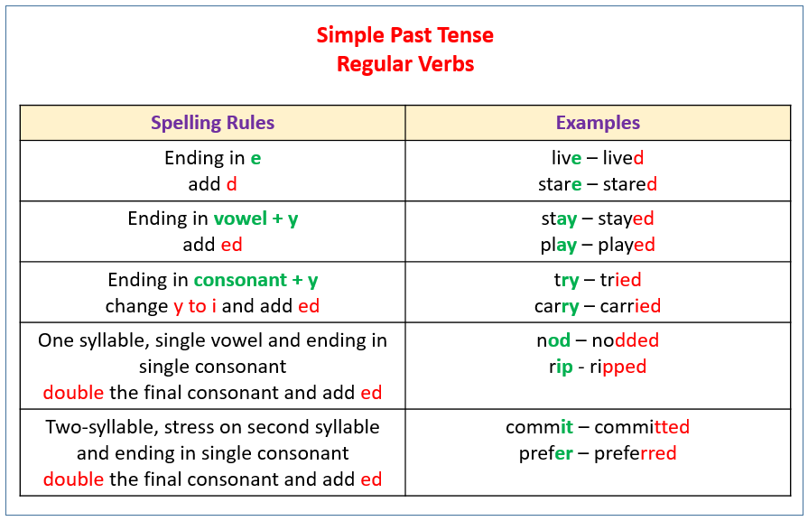
Revision

Slide 7

I read this book yesterday.
They did not go to the library.
Did you watch TV last night?
She danced with Jack last Sunday.
She did not buy dress last week.
Did you use a computer yesterday?

Slide 8



Slide 9
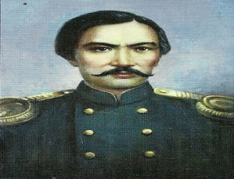
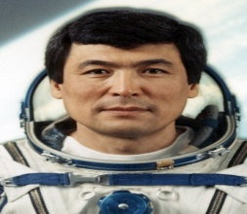
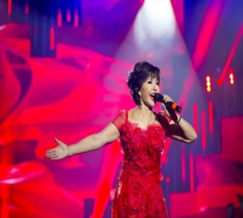
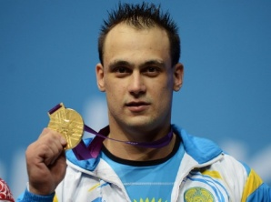
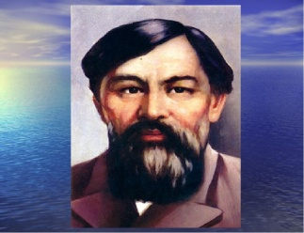
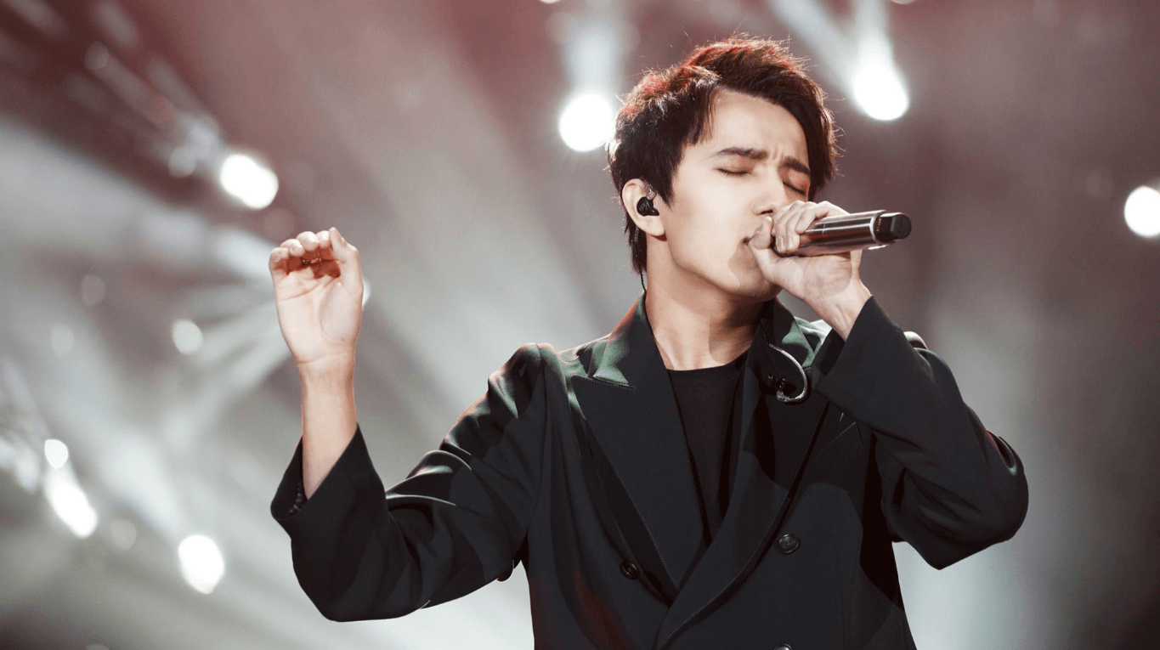
Read and match
Who is he?
-He was a cosmonaut
3) Who is he?
- He was a poet.
4) Who is he?
- He was a teacher, writer
5) Who is she?
- She is a singer, Kazakh aсtor.
6) Who is he?
- He is a singer.

Slide 10


Listen to audio and when you hear the name of the profession, clap your hands. Be careful!

Slide 11

Homework: P.34, ex.3,4

Slide 12
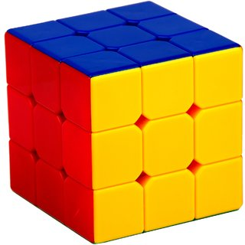
Reflection:
This person works in politics?
This person plays an instrument and writes music?
This person acts in films?
This person play basketball?
Who do you want to be?
This person writes for newspapers and websites?

Slide 13



