Slide 1
April, 13th

Slide 2
In this lesson we will:
Talk about ability; talk about physical exercises; describe actions;
Learn how to use adverbs of manner correctly, practise using the modal verbs “ Can with adverbs of manner.
Learn some interesting phrases about physical activity;
Do some writing, reading exercise to improve our writing and reading skills
Play a game to show our abilities.

Slide 3
Make up questions.
Mike can play the violin. ______________
Alex can hop along. _____________
I can do judo. ___________________
She can do gymnastics. ____________

Slide 4
Can / can’t
Can is to say that you know how to do something.
I can skip.
Can't is to say that you don't know how to do something.
I can’t skateboard.

Slide 5
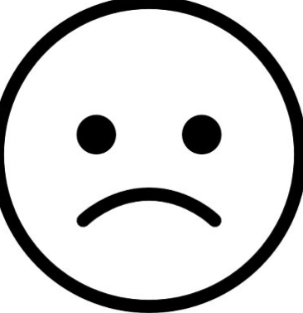
Ex. 19 P. 101 Make sentences with Can/ can’t
Gulnara /do karate
We / have a picnic today
Sanzhar / jog all day
Bakhytzhan / surf at all
Ayaulym /sail with us

Slide 6
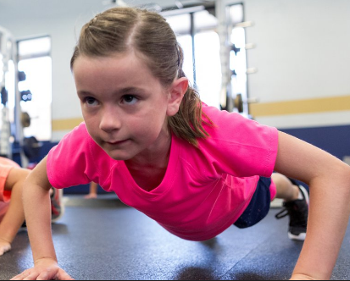
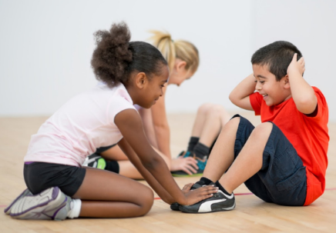
1) to do push - ups

Slide 7
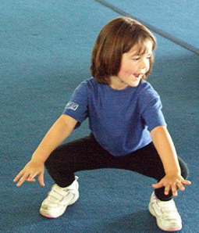
to sit-ups

Slide 8
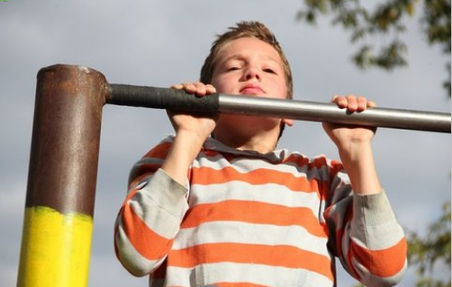
to do push-ups on the bars.

Slide 9
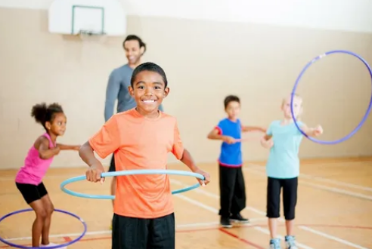
to roll a hoop

Slide 10
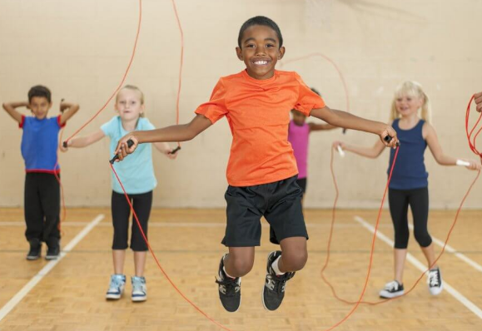
to jump/ skip rope

Slide 11
Look at these pictures and say:
Do you do physical exercise every day?
What physical exercise do you do every day?

Slide 12
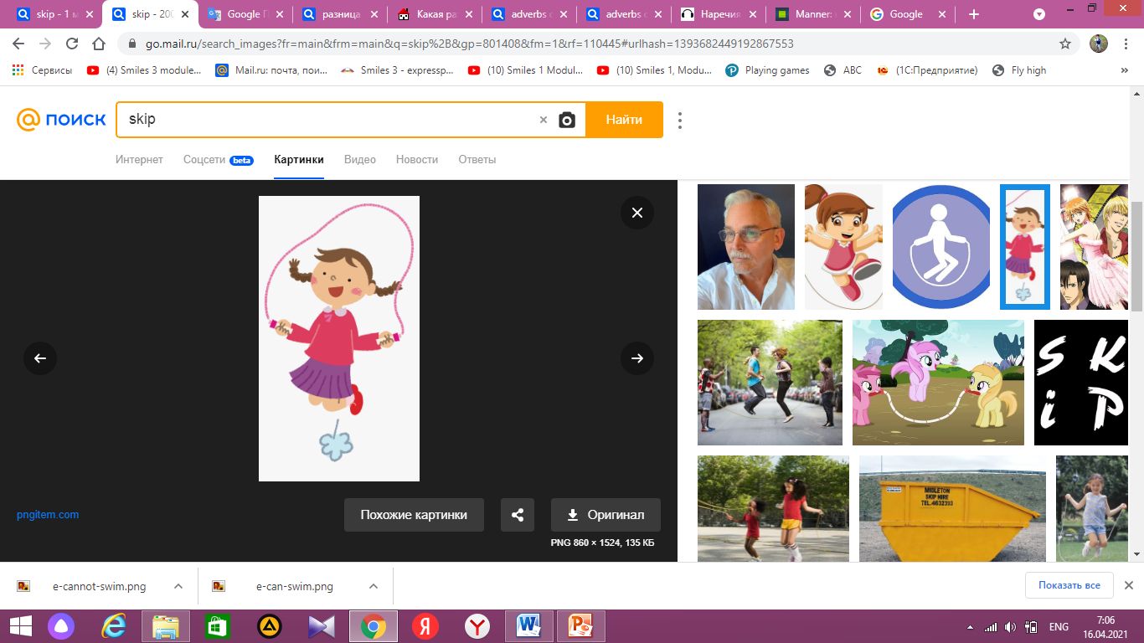
3) Adverbs of manner
Наречия образа действия
Adverbs of manner describe verbs. They show how someone does something. Adverbs usually go after verbs.
Наречия образа действия описывают
глаголы. Они показывают,
как кто-то что-то делает.
Наречия обычно идут после глаголов.
He can skip quickly. (How?)
Он прыгает быстро. ( как? Каким образом?)

Slide 13
Forming adverbs from adjectives.
In most cases, an adverb is formed by adding
-ly to an adjective:
quick – quickly
2) If the adjective ends in y, it should be replaced with ily
Happy → Happily
But!
Good –well fast –fast

Slide 14
4) Make adverbs from the adjectives
Slow –
Easy -
Bad –
Good –
Fast -

Slide 15
Translate the sentences
Он пишет медленно (Slow)
Мой брат бегает быстро (fast)
Я читает плохо (bad)
Я говорю на англиском хорошо. (well)

Slide 16
What can Khan Sultan do? Ex. 20. p. 101
He can skateboard very carefully.
He can play the violin beautifully.
He can do karate well.
He can skip quickly.
He can ride a bike fast.

Slide 17
Let’s play what you can do!
Can you do push-ups?
How many sit-ups can you do?
Can you roll a hoop?
Can you skip along?

