Slide 1
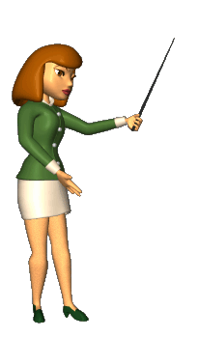
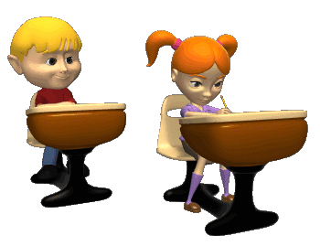
Present Simple Tense

Slide 2
Настоящее простое время
Обозначает регулярное действие, то, что происходит постоянно, каждый день
Указатели времени: usually – обычно every day – каждый день often – часто always – всегда sometimes – иногда
Вспомогательные глаголы
do does (в 3-ем лице, ед.ч.) Употребляются только в вопросительных и отрицательных предложениях

Slide 3


Positive | Negative | Interrogative
V, V+-s,-es I read. He She reads. It We You read. They Example: We often read books. She swims well. | do/does not + V I We do not You read. They He She does not It read. Example: He does not play football. | Do/Does not + V ? I we Do you read ? they he Does she read? it Example: Do you learn well? Does she work?

Slide 4
№1. Сделай предложения отрицательными
I live in London.
He likes to drink coffee.
You get up at 7 o’clock.
Doctors go to hospital.
My sister goes to school every day.
№2. Сделай предложения утвердительными
Foxes don’t live in the forest.
My sister doesn’t make her bed every day.
I don’t do exercises every day.
My brother doesn’t work at school.
We don’t play the piano every day.

Slide 5
№3. Спишите предложение и подчеркните слово с ошибкой
He take a shower at 7 o’clock.
When do she come home?
She don’t skate every winter.
I does my homework every day.
Does you like to sing?
№4. Составь предложение из слов
live, where, she, does ?
don’t, baseball, play, I.
to, likes, she, books, read
Monday, go, the, I, swimming pool, to, every
doesn’t, TV, she, watch, like, to

Slide 6
№5. Составь общий и специальный вопросы к предложениям:
I go to school at 8 o’clock every day.
Nick plays football in the gym on Sundays.
They read books every evening.
You buy milk every Thursday.
She works at college.
№6. Откройте скобки и напишите глаголы в правильной форме.
One fly … (to fly) , two flies … (to fly).
One girl … (to cry), four girls … (to cry).
When a wolf … (to see) the moon, it … (to begin) to howl.
Wolves and sheep … (to be) never friends.
Our hens … (to lay) a lot of eggs.
Boys … (to fight) and… (to shout).
That boy … (to try) to catch some balls.
These girls … (to try) to run away from an angry turkey.
If one goose … (to have) one tooth, how many teeth … (to have) thirteen geese?

Slide 7
№7. Вставьте глаголы из скобок в форме Present Simple.
He ________ (get) up at 7.
He ________ (have) his English lesson every day.
Не ________ (speak) English to his friends.
He ________ (play) board games in the afternoon.
Sometimes he ________ (swim) in the lake.
He often ________ (go) hiking.
He sometimes ________ (sit) by the camp fire in the evenings.
He never ________ (go) on a trip without his friends.

Slide 8
№8. Вставьте глаголы в Present Simple.
go, like, love, watch, read, like, walk, come, do, watch
My name's Pavel. In the evening I usually (1) ____ my homework.
Then I (2) ______ TV or video.
I (3) _____ action films! They are super!
Then I (4) ______ my dog.
After that I (5) _____ home, (6)____ a book and (7) _____ to bed.
My sister is little. She doesn't (8) _____ action films.
She (9) ___________ cartoons.
She (10) ___________ them every day.

Slide 9
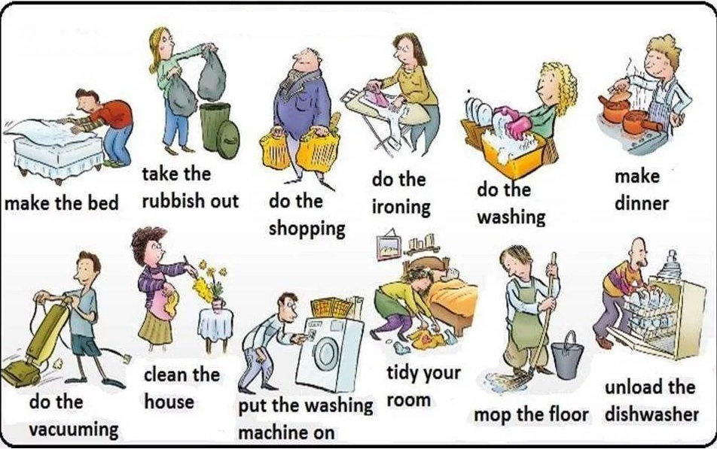
№8. Составьте предложения в Present Simple.

