Slide 1

решение ср № 11 вариант 3
К УМК Алгебра 7 класс авторы: С.М.Никольский,
М.К. Потапов
Ворожейкина Татьяна Евтифьевна
учитель математики
МОУ-СОШ с.Журавлевка

Slide 2
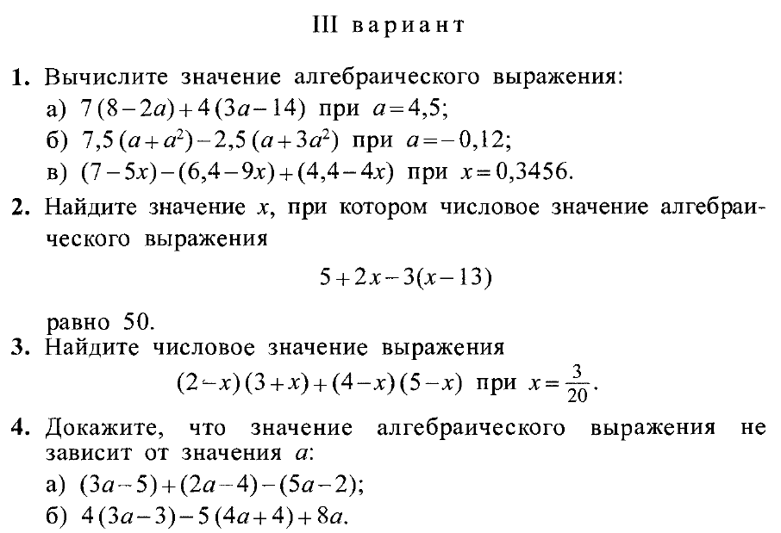

Slide 3
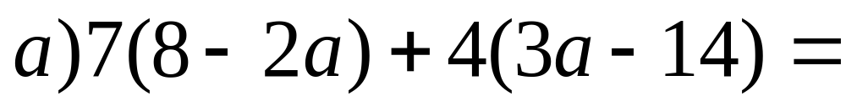
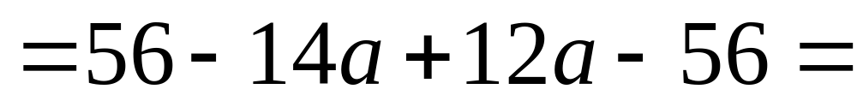
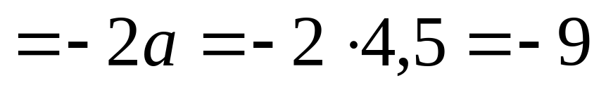
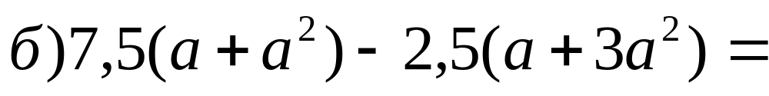
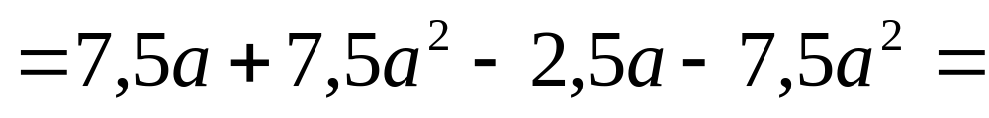
№1
Notes:
Welcome to Power Jeopardy
© Don Link, Indian Creek School, 2004
You can easily customize this template to create your own Jeopardy game. Simply follow the step-by-step instructions that appear on Slides 1-3.

Slide 4
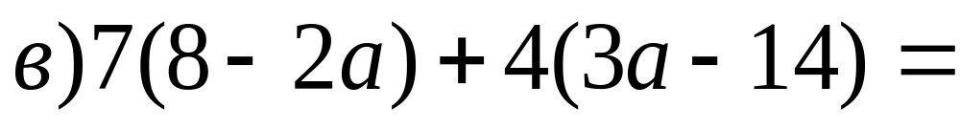
№1
Notes:
Welcome to Power Jeopardy
© Don Link, Indian Creek School, 2004
You can easily customize this template to create your own Jeopardy game. Simply follow the step-by-step instructions that appear on Slides 1-3.

Slide 5

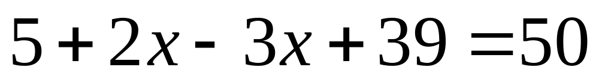
№2
Раскроем скобки:
Приведём подобные слагаемые:
-х + 44 =50
-х = 50 - 44
-х = 6
х = -6
Ответ: при х = -6
Notes:
Welcome to Power Jeopardy
© Don Link, Indian Creek School, 2004
You can easily customize this template to create your own Jeopardy game. Simply follow the step-by-step instructions that appear on Slides 1-3.

Slide 6
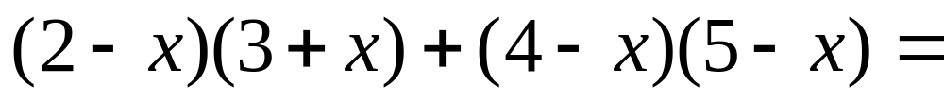
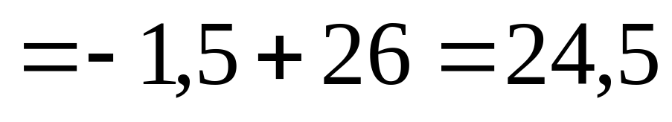
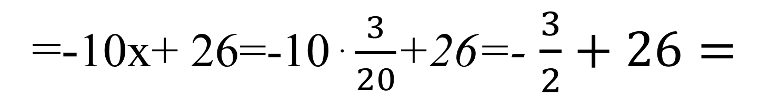
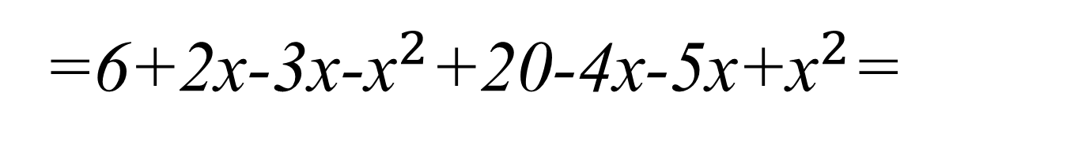
№3
=6+2х-3х-${\text{х}}^{2}$+20-4х-5х+${\text{х}}^{2}$=
=-10х+ 26=-10ּ$\frac{3}{20}$+26=- $\frac{3}{2}+26=$
Notes:
Welcome to Power Jeopardy
© Don Link, Indian Creek School, 2004
You can easily customize this template to create your own Jeopardy game. Simply follow the step-by-step instructions that appear on Slides 1-3.

Slide 7
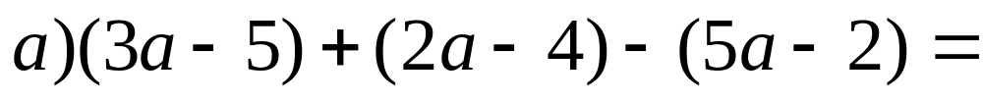
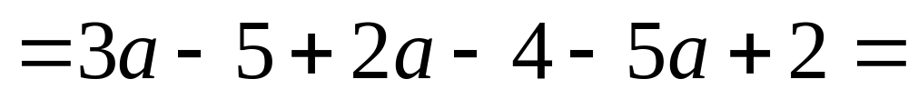
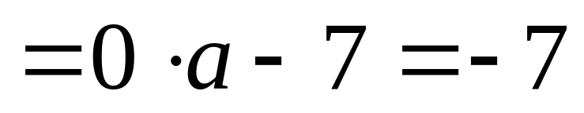
№4
Раскроем скобки:
Приведём подобные слагаемые:
Notes:
Welcome to Power Jeopardy
© Don Link, Indian Creek School, 2004
You can easily customize this template to create your own Jeopardy game. Simply follow the step-by-step instructions that appear on Slides 1-3.

