Slide 2
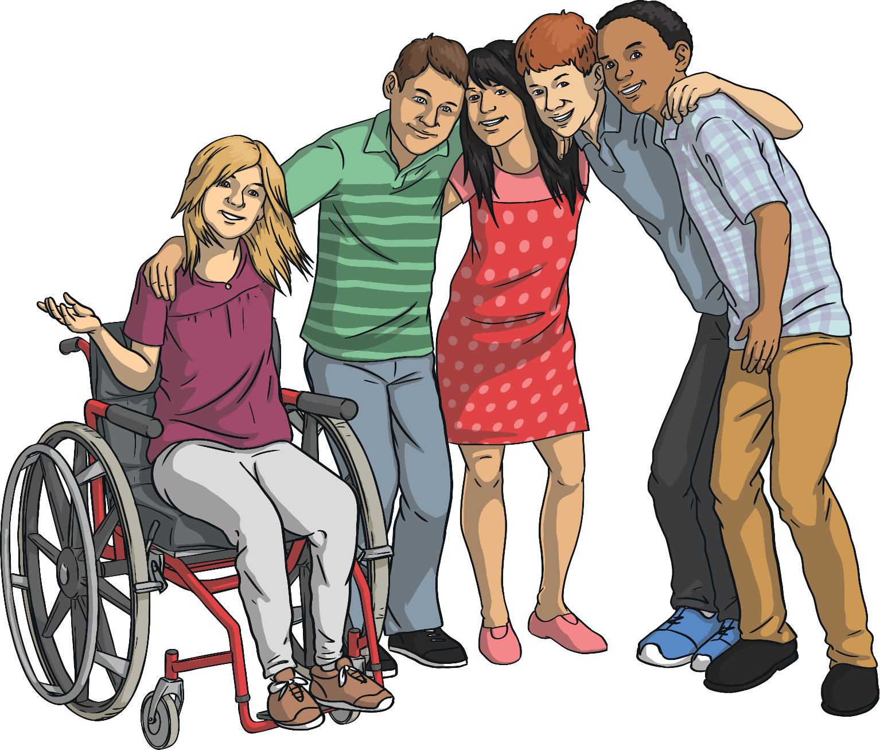
What should you do?

Slide 3
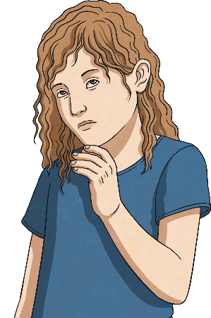


You join a website with lots of cool games on it, but first you need to fill out your name, phone number and home address.
What should you do?
A
Fill in with some fake details.
B
Fill it in with your details.
Never share personal information, such as your name, school or phone number with people you don’t know offline.
C
Don’t fill it in and tell an adult you trust.

Slide 4
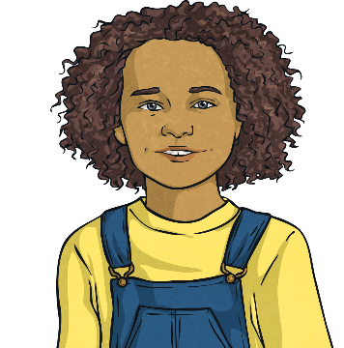
Someone you don’t know has sent you a friend request.
Someone you don’t know has sent you a friend request.
What should you do?
A
Ignore it and hope it doesn’t happen again.
You should never accept a friend request from someone you don’t know in real life.
B
B
Tell an adult you trust.
C
Accept it and look at their profile.

Slide 5
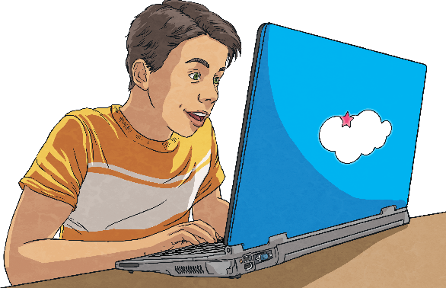
A page pops up saying, ‘You’ve won!’ and it tells you to click on it.
What should you do?
A
Feel excited and click to see what you’ve won.
B
Click on it and tell your friends.
Scammers might use viruses or malware to trick you so they can get your passwords or bank details from your device. Don’t click on anything you aren’t sure about.
C
Don’t click on it and tell an adult..

Slide 6
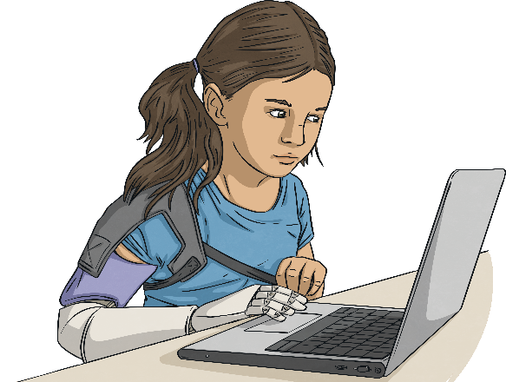
Someone in a game wants to trade or borrow items. You are worried about whether to trust them or not.
What should you do?
A
Trade your rare items with them and wait to see what they give you.
B
Give them an item that you didn’t want anyway.
Some people in games are scammers. This means they might offer things that aren’t true, lie or pretend to be famous so you will swap an item with them. It’s OK to just say, ‘No,’ and report the person to the game. Don’t swap or gift anything if you’re not sure who they are.
C
Say, ‘No’.

Slide 7

Someone you’ve met in an online game asks which school you go to.
1
What should you do?
Never share personal information, such as your name, school or phone number with people you don’t know offline.
A
Don’t tell them but tell an adult you trust that this has happened.
B
Tell them because maybe they go to the same school.
C
Say another school that you know.

Slide 8
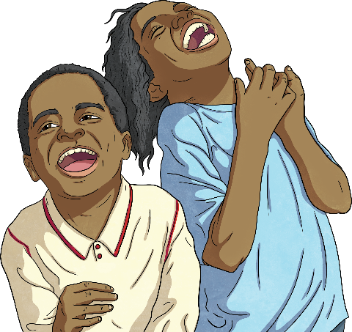
You took some funny photos with your best friend. Later, you shared them with five other friends.
At school the next day, everyone is talking about the photos and your best friend is cross with you.
What should you do?
A
Tell your best friend you’re sorry and you won’t do it again.
If you share photos with some people, they might share them with more people. Always get permission before sharing photos and think carefully before you send them. Talk to an adult you trust. The adult should ask everyone to delete the photos.
B
Tell a teacher at school or an adult as soon as you get home.
C
Laugh with everyone else because the photos were funny.

Slide 9
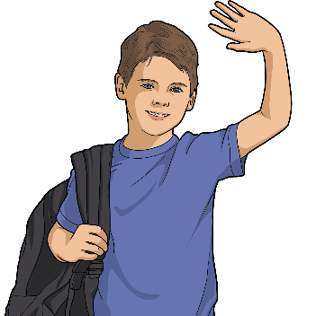
Your best friend from swimming sends you a friend request online.
Someone you don’t know has sent you a friend request.
What should you do?
It’s OK to accept friend requests from people you know and trust offline.
A
Accept it.
B
Ignore it.
C
Say, ‘No,’ and block them.

Slide 10
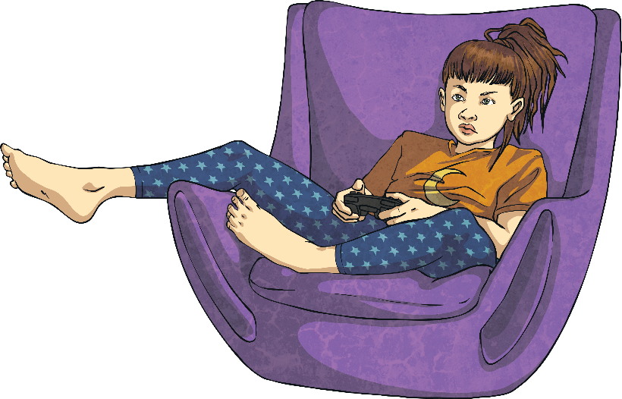
Someone wants to play a game online with you and offers you lots of coins if you’ll play.
What should you do?
A
If you don’t know someone offline and they message you, block them and tell an adult you trust.
Block them and tell a trusted adult.
B
Reply and say, ‘Yes please’.
C
Ignore the message and hope they’ll go away.

Slide 11
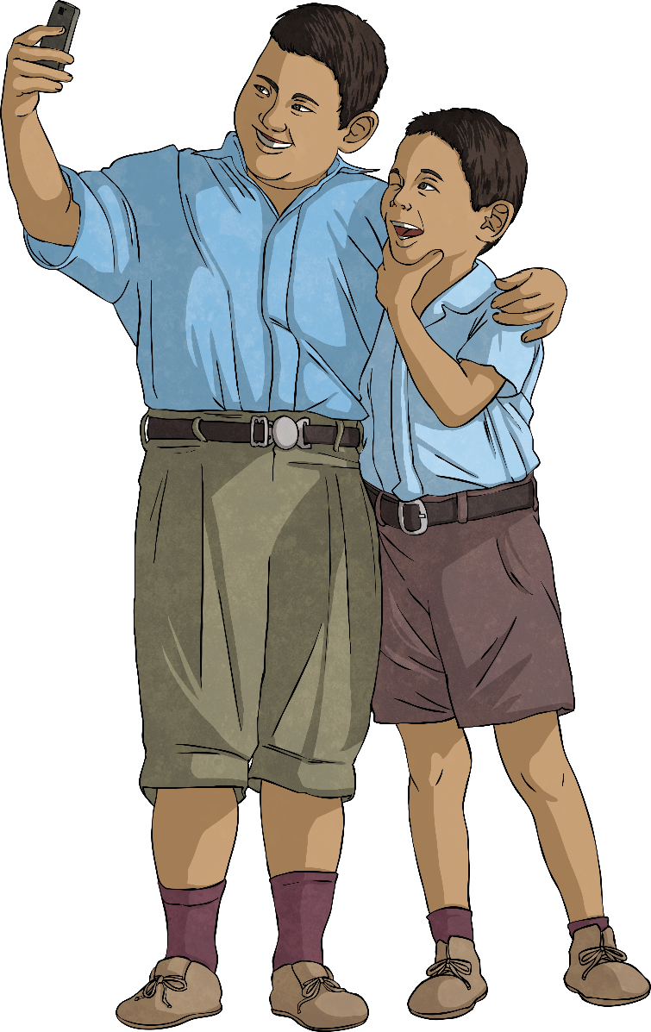
You have made friends online. The friend has asked you to send them a photo of yourself.
What should you do?
A
Take a selfie and send it.
B
It’s OK to say, ‘No,’ to someone. Never share any personal information or photos with people you don’t know. Once it’s been shared, you can never be sure who has seen it or shared it.
Don’t send him anything, block him if he asks
again and tell an adult.
C
Ask your friend what to do.

Slide 12
Someone you don’t know has been sending you lots of nice messages.
10
What should you do?
A
If someone you don’t know is messaging you, tell an adult you trust.
Tell an adult you trust.
B
Ignore the messages.
C
Reply to the messages to say, ‘Thank you’.

Slide 13
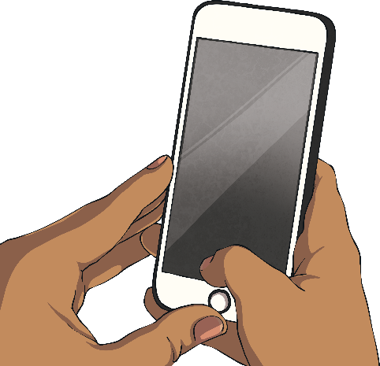
Someone in your class wants you to take a photo of your brother being silly and post it online without your brother knowing.
What should you do?
A
Take a photo and post it.
B
Sharing a photo publicly or privately without your brother’s permission might upset him. Think about how you would feel if someone did that to you.
Tell them, ‘No,’ because you know your brother wouldn’t like it.
C
Take the photo but send it to them in a private message.

Slide 14
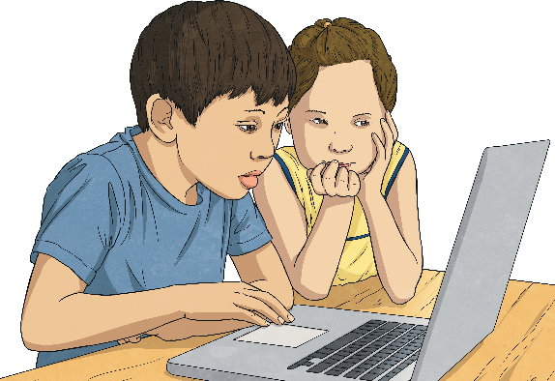
You’re watching a video when something pops up that makes you jump and worries you.
What should you do?
A
If something you see or hear online doesn’t feel right or makes you feel worried, sad or scared then you must tell an adult you trust.
Put the screen down and tell an adult you trust.
B
Click the ‘X’ and watching something else.
C
Ignore it and don’t tell anyone.

Slide 15
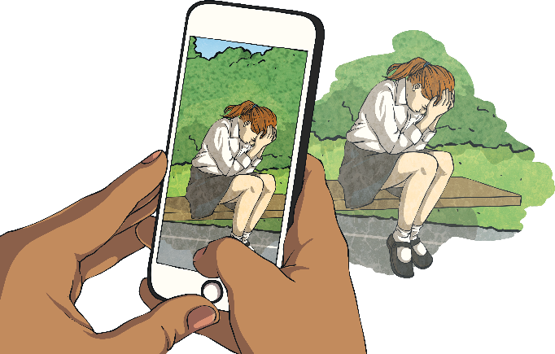
Your friend has posted a photo of you that you don’t like.
What should you do?
A
Post an embarrassing photo of them to get them back.
B
Ignore it and hope no one will see it.
C
If a friend posts something that makes you feel bad or unhappy, ask them to take it down. Ask a trusted adult to help you. If they won’t delete it, the photo can be reported.
Ask your friend to delete it.

Slide 16
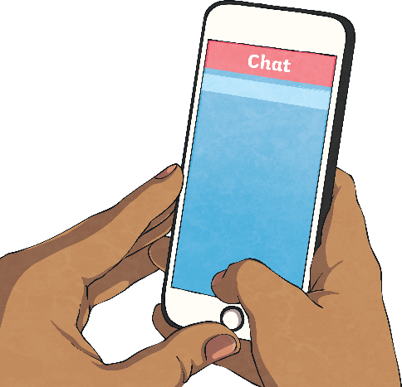



Your friend is planning to meet up with someone they don’t know but who they have been messaging.
What should you do?
A
Tell them you will come too.
B
Tell an adult you trust.
You should never meet anyone you don’t know.
C
Argue with your friend.

