Slide 1

ARE YOU AWARE OF YOUR RIGHTS?

Slide 2
decent-достойный
abuse-оскорбление
neglect-безнадзорный
torture['tɔːʧə]-пытка
to uphold-соблюдать
to hang out with-
проводить время с кем-либо

Slide 3

As a child or
a young person you have
the right:

Slide 4
to live
(obvious but important)
to choose your
own religion
to be with you parents
to be protected
from abuse
and neglect

Slide 5
to express the
views you have
to a decent standard
of living
to choose your
friends and hang out
with them

Slide 6
to be protected from
all forms of cruelty,
exploitation
and torture

Slide 7
Match the halves
Following the rules | freedom of speech
Consequences result from | a right
If you don’t accept responsibility | to feel safe
Equal opportunity is | is a responsibility
Everyone has a right | not accepting responsibilities
One right is | other people can lose their rights

Slide 8
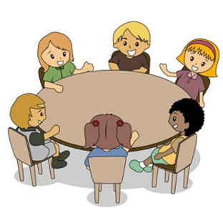
Do you know about your rights?

