Slide 1
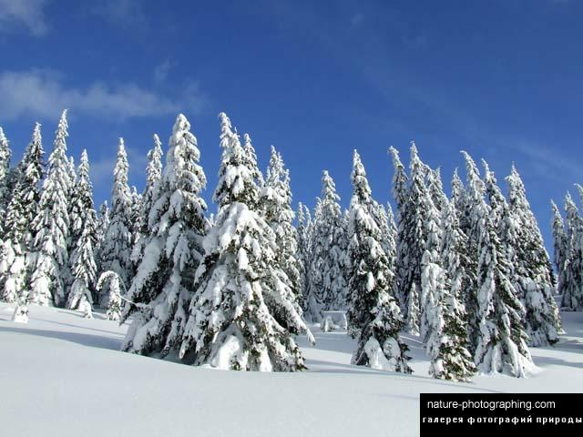
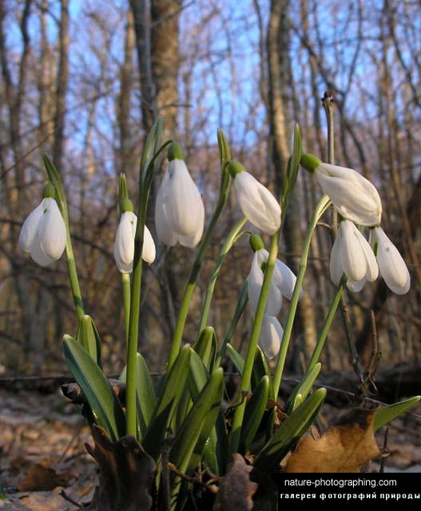
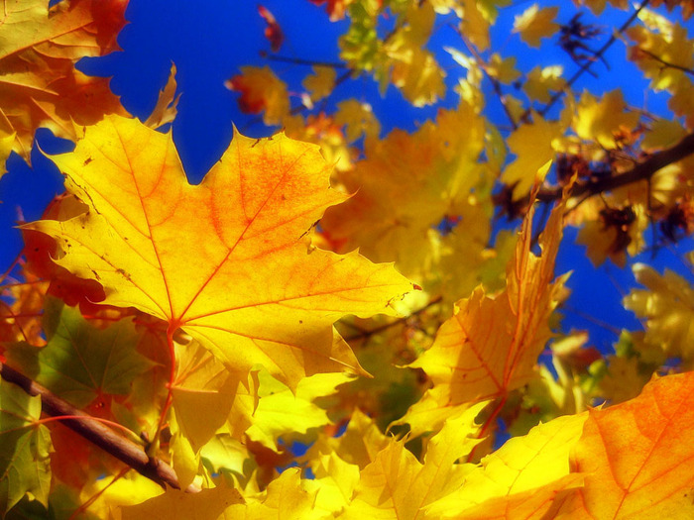
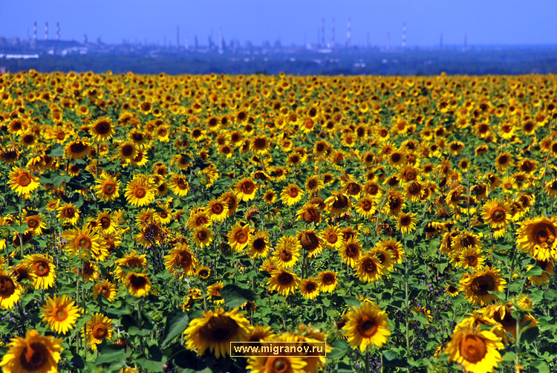
.
THE ENGLISH YEAR
SEASONS

Slide 2
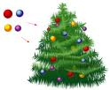
This is the season
When children ski
And Father Frost
Brings the New Year Tree.

Slide 3
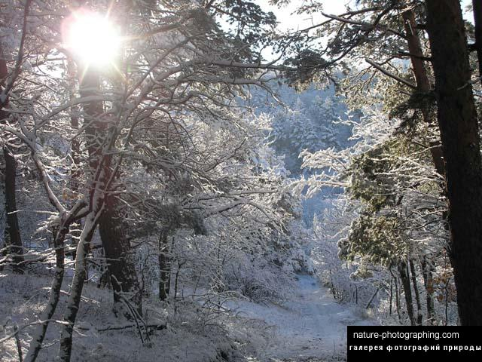
WINTER

Slide 4
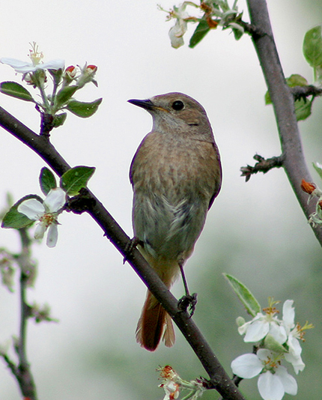
This is the season
When birds make their nests
This is the season
We all like best.

Slide 5
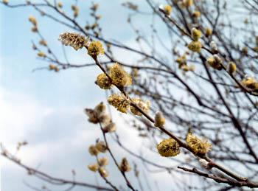
SPRING

Slide 6
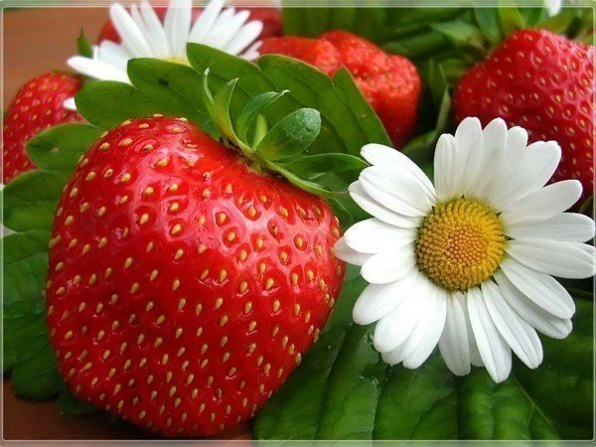
This is the season
When nights are short
And children have plenty
Of fun and sport.

Slide 7
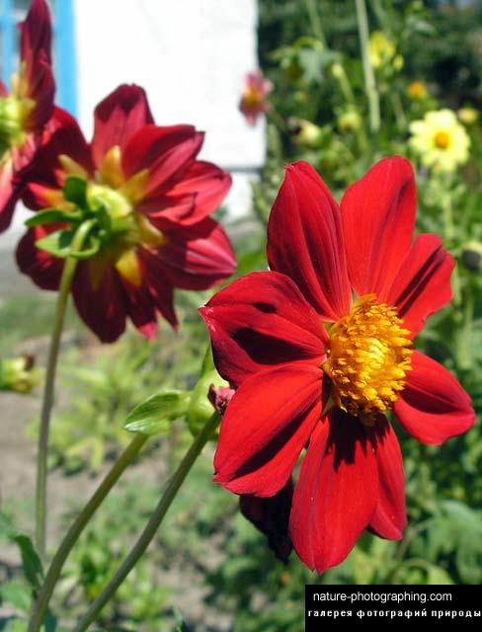
SUMMER

Slide 8

This is the season
When fruit is sweet,
This is the season
When school friends meet.

Slide 9
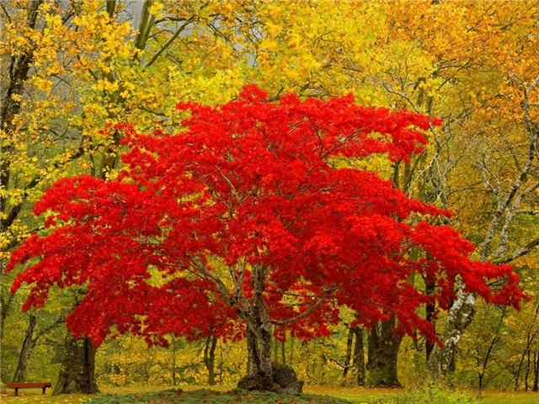
AUTUMN

Slide 10
.
My favourite season is …
My favourite seasons are...

Slide 13
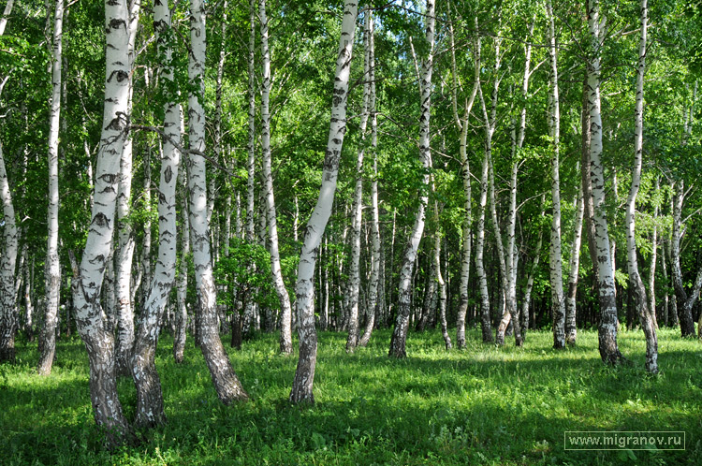

Slide 14
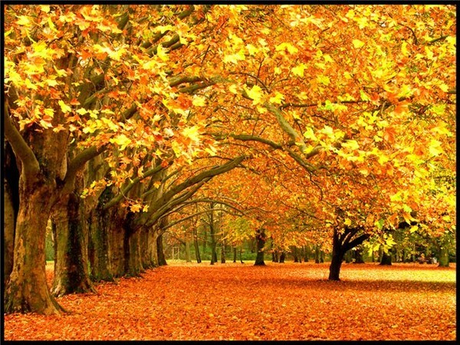

Slide 15
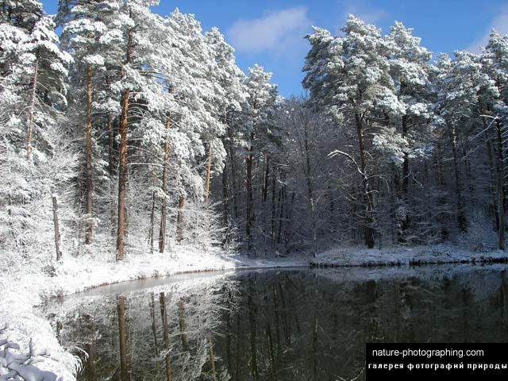
WINTER:
DECEMBER
JANUARY
FEBRUARY
NOVEMBER
DECEMBER
JANUARY
FEBRUARY

Slide 16
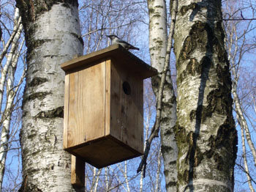
SPRING:
MARCH
APRIL
MAY
MARCH
APRIL

Slide 17
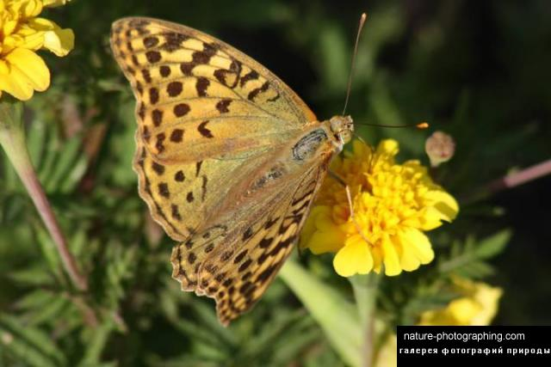
SUMMER:
JUNE
JULY
AUGUST
MAY
JUNE
JULY
AUGUST

Slide 18
AUTUMN:
SEPTEMBER
OCTOBER
NOVEMBER
SEPTEMBER
OCTOBER

Slide 19
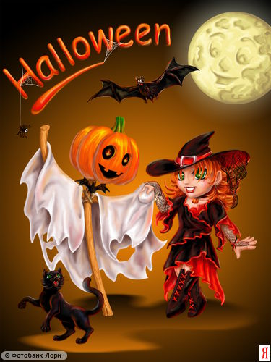

Slide 20


Slide 21
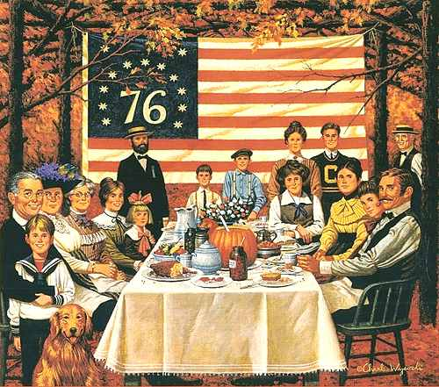

Slide 22
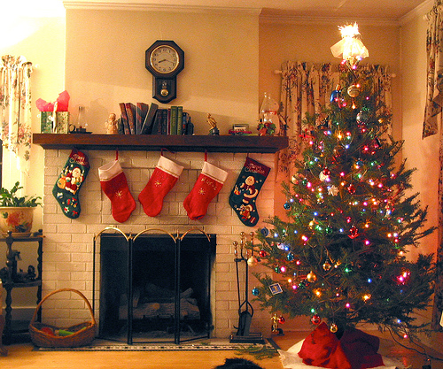

Slide 23
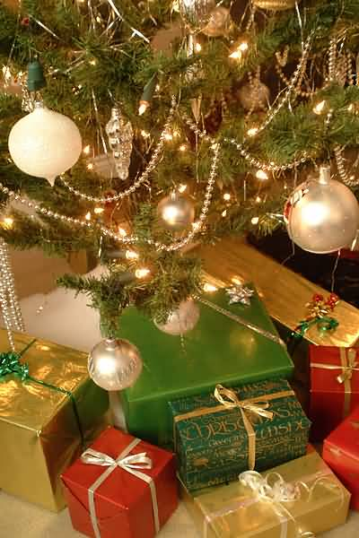

Slide 24


Slide 25
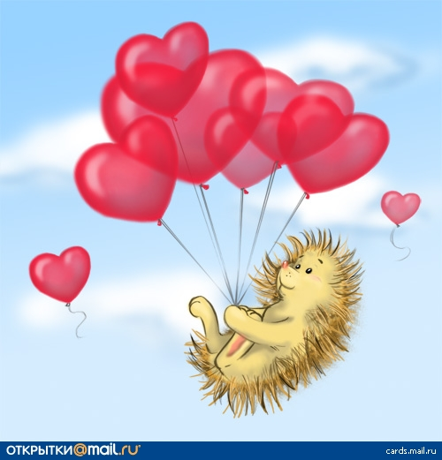

Slide 26
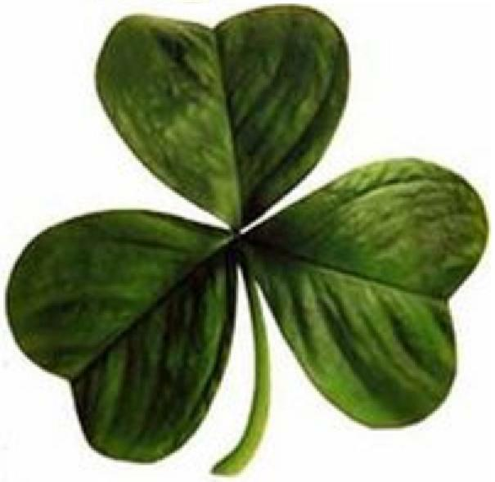

Slide 27
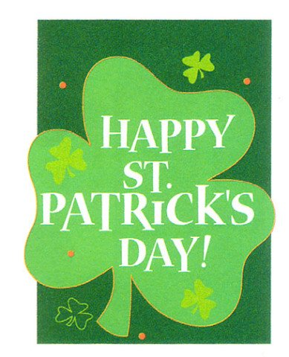

Slide 28
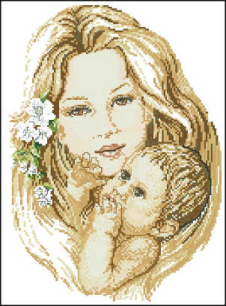

Slide 29


Slide 30
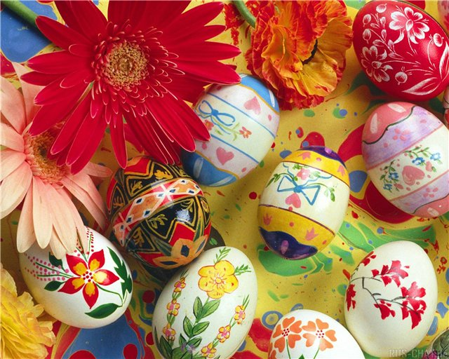

Slide 31
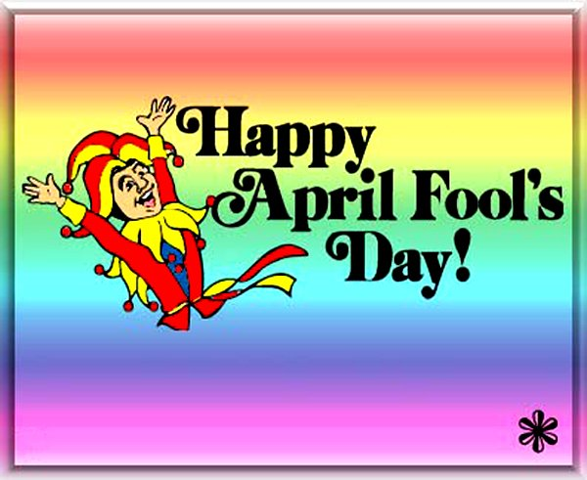


Slide 32
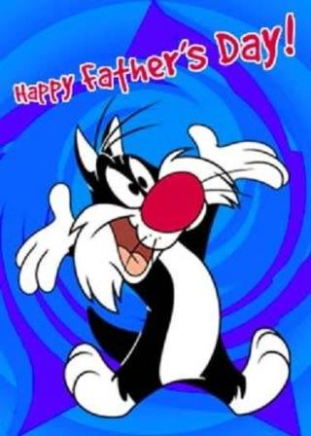

Slide 33
TRUE OR FALSE:
There are twelve months in a year.
In Great Britain there are 3 summer months.
In winter in Great Britain it rains and snows.
Summer comes after winter.
In November in America there is a great holiday-Thanksgiving Day.
June comes after August.
Winter is the coldest season of the year.
Halloween is a nice, funny and “tasty” holiday.
All seasons are beautiful.

Slide 34
.
ALL SEASONS ARE
BEAUTIFUL

Slide 35
Complete the sentences:
I don’t like autumn, it’s a … season. It’s often…
In summer the days are … and the nights are…
In winter you can have a very… You can enjoy… Forests and fields are … with snow.
I think that forests are more … in autumn than in winter-the leaves in the trees are…
Autumn is a “tasty” season-there are a lot of …
In spring I enjoy the sun because…
I think all the seasons …

Slide 36
CROSSWORD
1.Summer comes … spring.
2.Autumn is here. Look at this red … on the ground.
3.People … Christmas in winter.
4.Many birds live in this big green …
5. … is the first month of the year.
6.In spring the … is green.
7.March, April and May are the … months.
8.There are four seasons in the … .

Slide 37
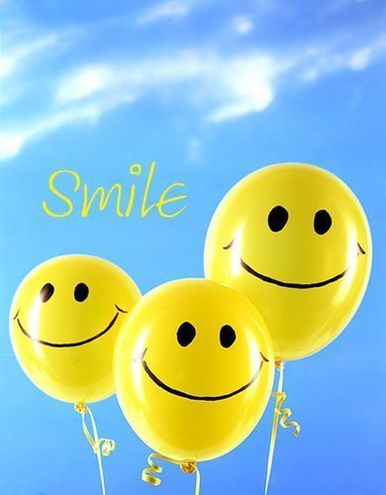
THE SONG.
IF YOU ARE HAPPY…

Slide 38
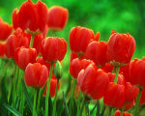
Спасибо за внимание!
Thank you for your attention!
Презентацию подготовила
Юнусова наиля исмагиловна, преподаватель английского языка

