Slide 1


Slide 2
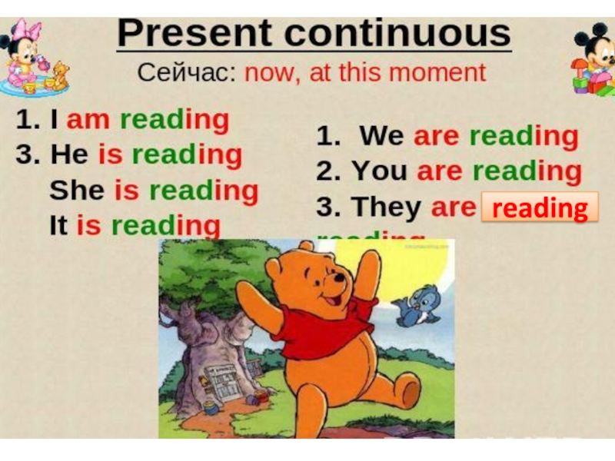

Slide 3


Slide 4
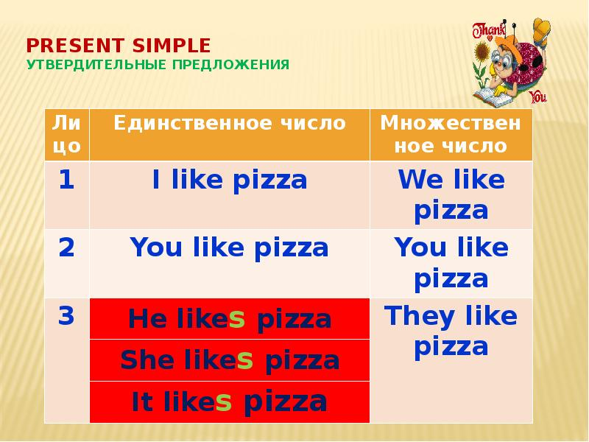

Slide 5
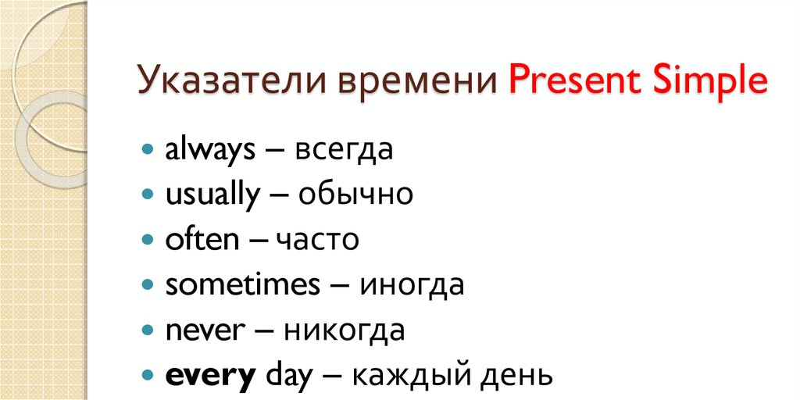

Slide 6
№1. Заполни пропуски, используя Present Simple или Present Continuous (в тетрадь запиши полностью получившееся предложение):
Jack ………….. milk now. (drink)
Alice sometimes …….. comics. (read)
Dogs never …… salad. (eat)
My fiends …….basketball now. (play)
I ……. now. (write)
We often ……. TV in the morning. (watch)
He…… his teeth now. (clean)
She usually…… to school at 8 o’clock. (go)
He ……. now. (jump)
Rob……… a bath every day. (have)

Slide 7
№4. Вставь am/ is/ are/ was/ were и запиши получившееся предложение:
He …. a football player last year.
Girls ….. late for school two days ago.
The house ….. big last month.
Children …… at school today.
Cats ….. under the bed now.
You ……. excited yesterday.
We …… in the classroom yesterday.
Rob and Bob…… on the pirate ship now.
Fred ….. in England last summer.

Slide 8
№ 5. Прочитай текст и ответь на вопросы:
Last week Lucy didn’t go to school. She was ill. Her mum was busy, she cleaned the house. Lucy was unhappy. She didn’t read and she didn’t watch TV. She didn’t go for a walk. She was in her bedroom all day. She didn’t want any lunch. She wanted to be well.
What is the girl’s name?
Was Lucy’s mum busy?
What did Lucy’s mum do?
Where was Lucy?
What did Lucy want?

Slide 9


