Slide 1
Past Continuous

Slide 2
Past Continuous
Действие происходило в определенный момент в прошлом, причем этот момент может уточняться обстоятельством времени или при помощи придаточных предложений времени, вводимых союзами when, while

Slide 3
Word Markers
while, at … o’clock, all morning/afternoon/evening, all day, all week, when, as.

Slide 4
Past Continuous
Be +V ing
V ing
I, He, She, It was
We, You, They were
I was watching TV at 7 o’clock yesterday.

Slide 5
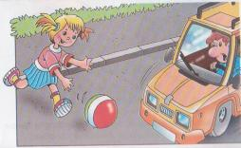
Past Continuous
Действие происходило в прошлом и было прервано другим действием.
John was driving a car when Ann jumped in front of his car.

Slide 6
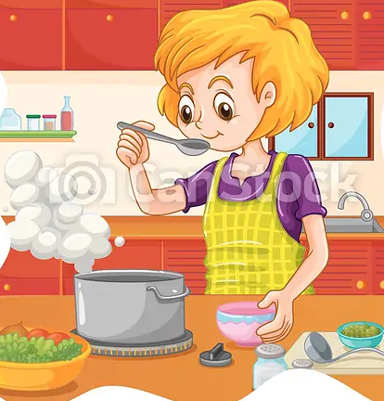

Past Continuous
Два действия происходили одновременно.
While my sister was cooking, I was reading a book.

Slide 7
Find the sentences in Present Continuous.
At 7 o’clock the match started on TV, so Dad was still watching it at 7.30. Mum was sitting in the kitchen. She was quietly reading a woman’s magazine. Rosie was trying on her Mum’s clothes in her room. Nick’s cousins were listening to rock music. It was very loud so they didn’t hear the crash. At 7.30 the dogs were lying in front of the fire and they were sleeping. Nick went into the garden with his friend to play football. So at 7.30 he was still there.

Slide 8
Past Continuous
Be +V ing
I, He, She, It wasn’t
We, You, They weren’t
I wasn’t watching TV at 7 o’clock yesterday.
V ing

Slide 9
Make the sentences negative.
1. We were doing our homework at ten o’clock yesterday.
2. I was reading at five o’clock yesterday.
3. Kate was visiting her aunt at this time yesterday.
4. The girls were preparing for the test at 6pm yesterday.
5. They were flying to London at 3 o’clock yesterday.
6. It was snowing hard all morning last Tuesday.

Slide 10
Past Continuous
Be +V ing
V ing
Was I, he, she, it
Were we, you, they
Were you watching TV at 7 o’clock yesterday.
Yes, I was.
No, I wasn’t.

Slide 11
Complete some sentences, using Past Continuous.
While I __ (to copy) the exercise, my friends __ (to describe) a picture.
When we came in, the children __ (to clean) their desks.
We met her at the bus stop. She _(to wait) for the bus.
Some of the children _ (to ski) while other children _ (to skate). Everybody _ (to have) a lot of fun.

Slide 12

Fill in the gaps
1. … they having lunch at home?
2. … Ann singing a lovely song?
3. … the baby crying?
4. … these children listening to the music?
5. … the women watching TV at home?
Was
Was

Slide 13
Complete some sentences, using Past Continuous.
When we came they _ (to get) everything ready for Christmas. Bob and Helen _(to decorate) the Christmas tree.
The girls __ (to feed) the birds in the garden while the boys _ (to make) a bird-house.

Slide 14
Make up some questions, using Past Continuous
Where | the white bears | swimming | were ?
In the swimming pool.
2. It | was | raining ?
- Oh, no. It wasn’t. The sun was shining brightly.
3. The elephant | what | eating | was ?
- Some grass and fruit.

Slide 15
Make up some questions, using Past Continuous
4. What | was | playing with | the monkey ?
— With a small ball.
5. Were | how many lions | sleeping in the cage?
— Both of them.

Slide 16
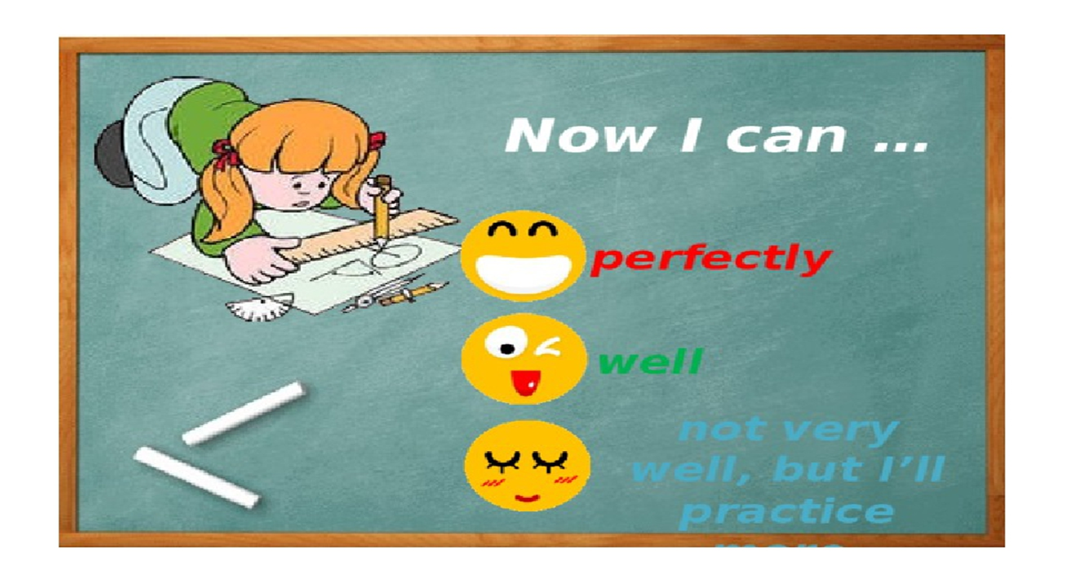
Complete the sentences.

Slide 17

Thank you for your attention.

