Slide 1

Seasons and the weather

Slide 2

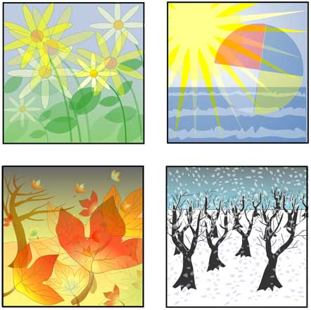
There are four seasons in the year.

Slide 3
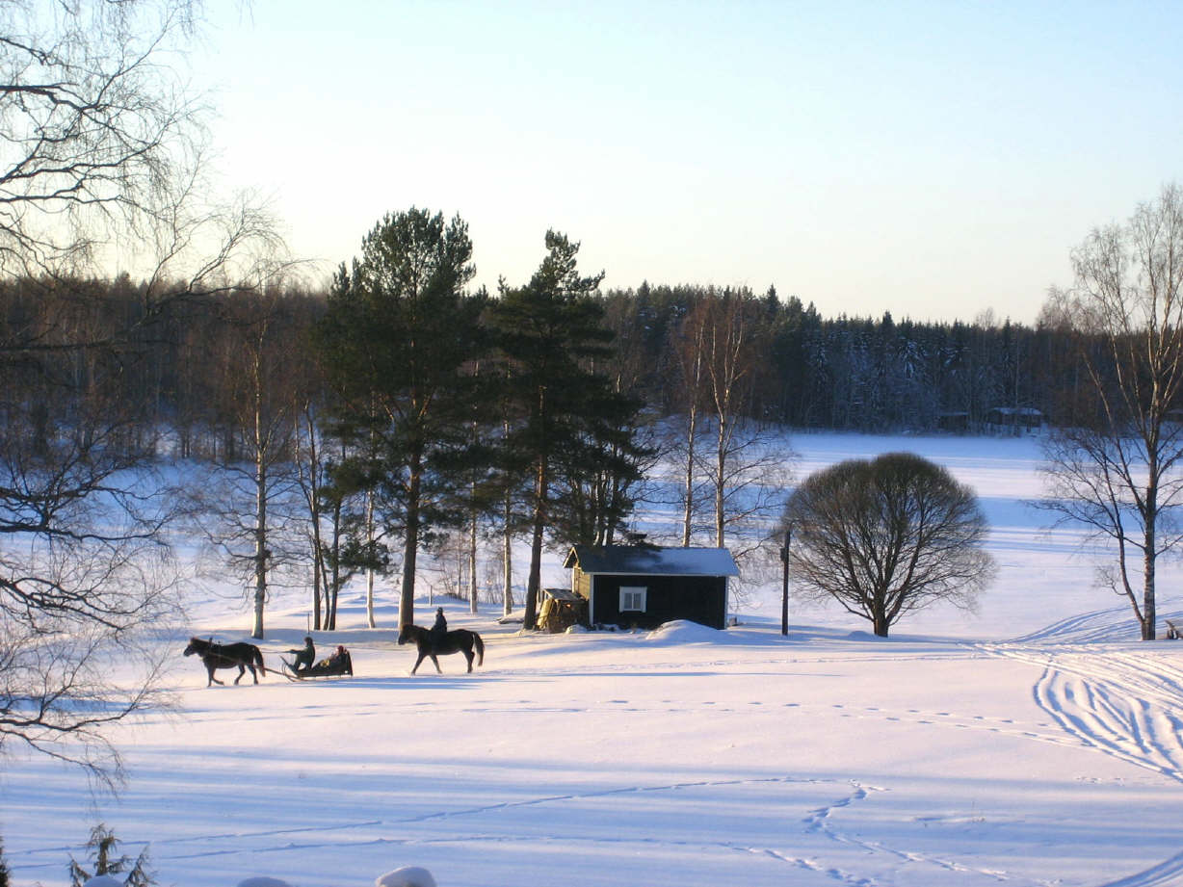
Winter - зима
winter

Slide 4
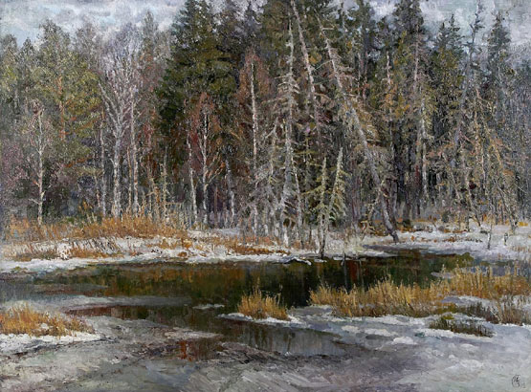
spring
Spring

Slide 5

summer
summer

Slide 6
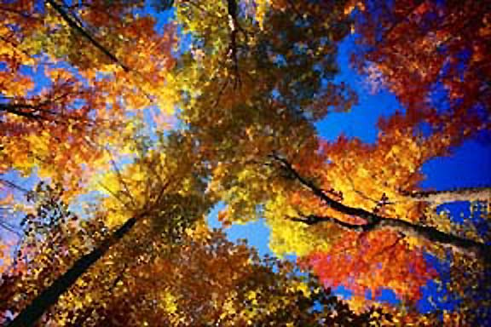
autumn
autumn

Slide 7
Запомните новые слова.
Солнечно Sunny
Ветрено Windy
Облачно cloudy
Снежно snowy
Жарко hot
Холодно cold

Slide 8

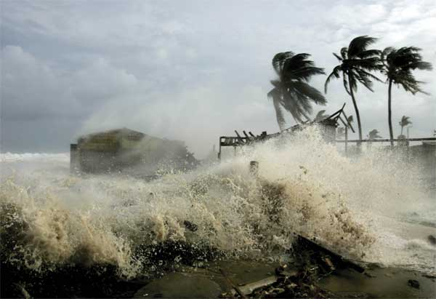
Windy

Slide 9
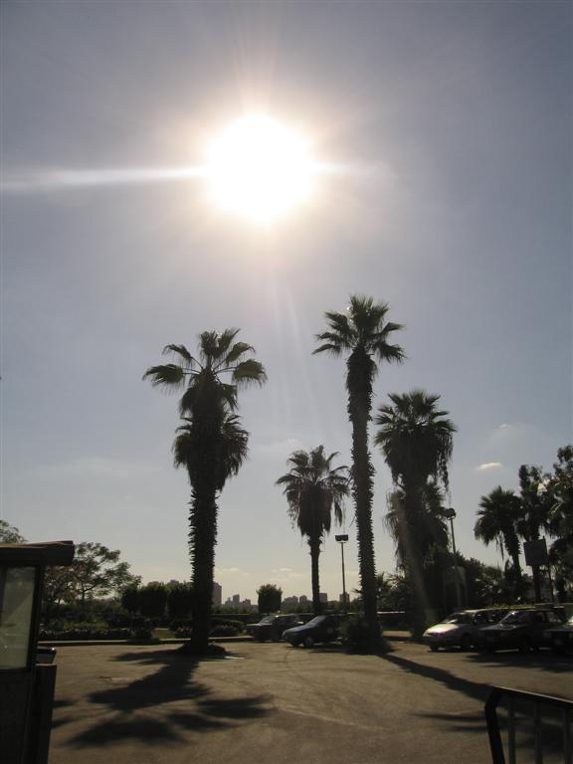
HOT

Slide 10

rainy

Slide 11
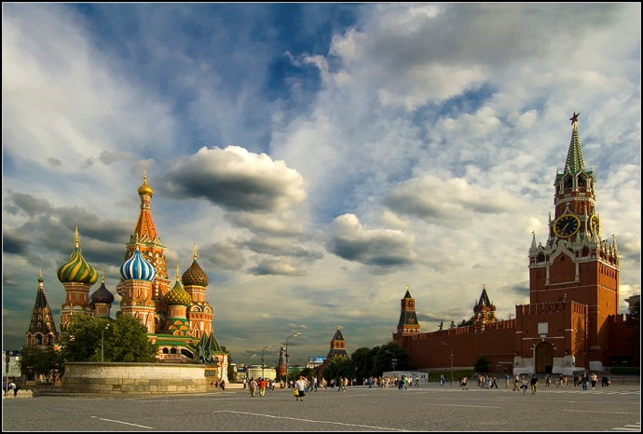
cloudy

Slide 12
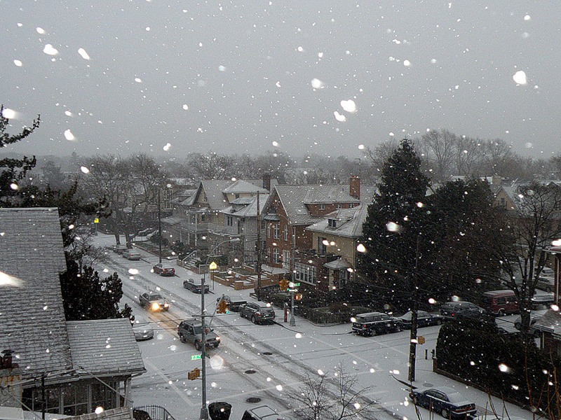
snowy

Slide 13
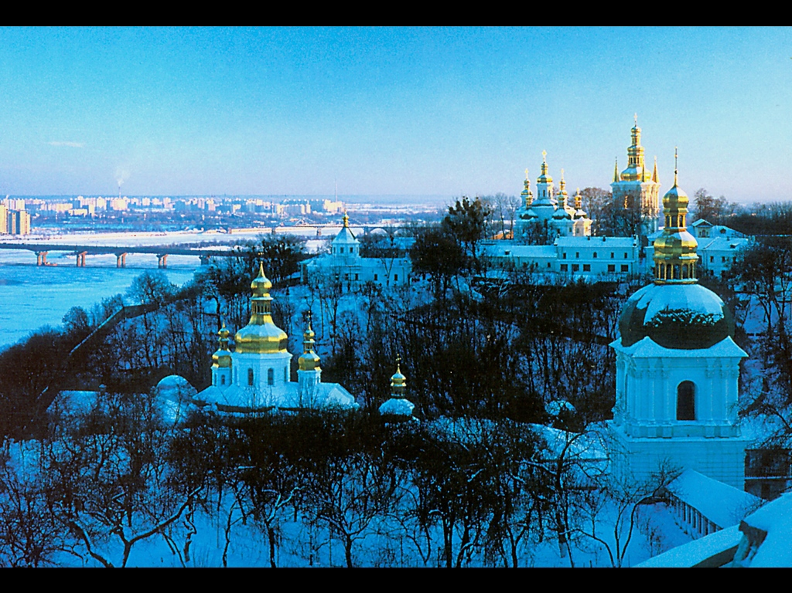
cold

Slide 14
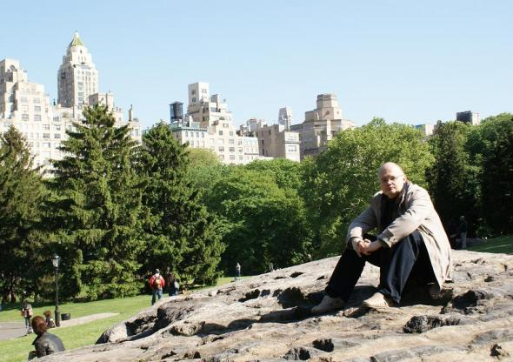
sunny

Slide 15
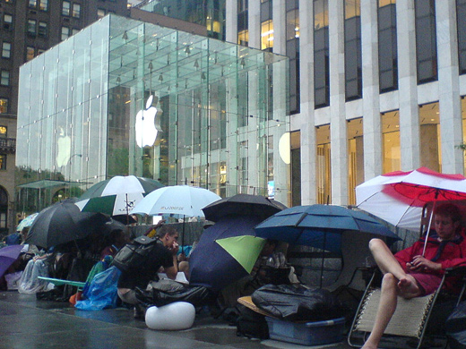
Какая погода в разных странах?
It is ……………. In America
rainy

Slide 16
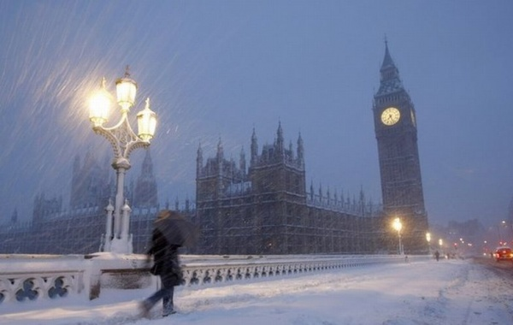
It is……. In England
Snowy

Slide 17
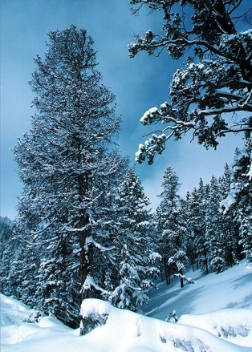
It is…………..in Russia
Cold

Slide 18

It is………. in Africa.
Hot

Slide 19
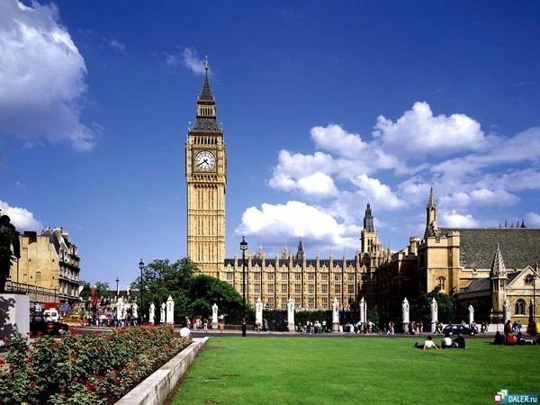
It is …….. in England.
Sunny

