Slide 1

Число 19

Slide 2
Продолжи числовой ряд
Вставь пропущенные числа
10, 11, …, …, 14 ,…, …, 17.
10, 11, 12, 13, 14, 15, 16, 17.
20, 19, …, …, 16, 15, …, 13.
20, 19, 18, 17, 16, 15, 14, 13.

Slide 3

Давайте посчитаем
12 + 5
18 – 6
16 - 5
12 + 3
17 – 4
13 + 5
18 – 4
12 + 4
18
12
15
13
17
16
11
14

Slide 4
10 +8 =10
16-6 =18
17-5 =4
14-10 =12
16-4
=8
18-10
=12

Slide 5
+
12 5= 17
13 2= 15
+
-
-
17 3= 14
19 2= 17
+
10 9= 19
+
16 2= 18
+
16 3 =19
12 3 =15
+
+
11 5 =16
11 7 =18
+
-
13 3 =10
-
18 3 =15

Slide 6
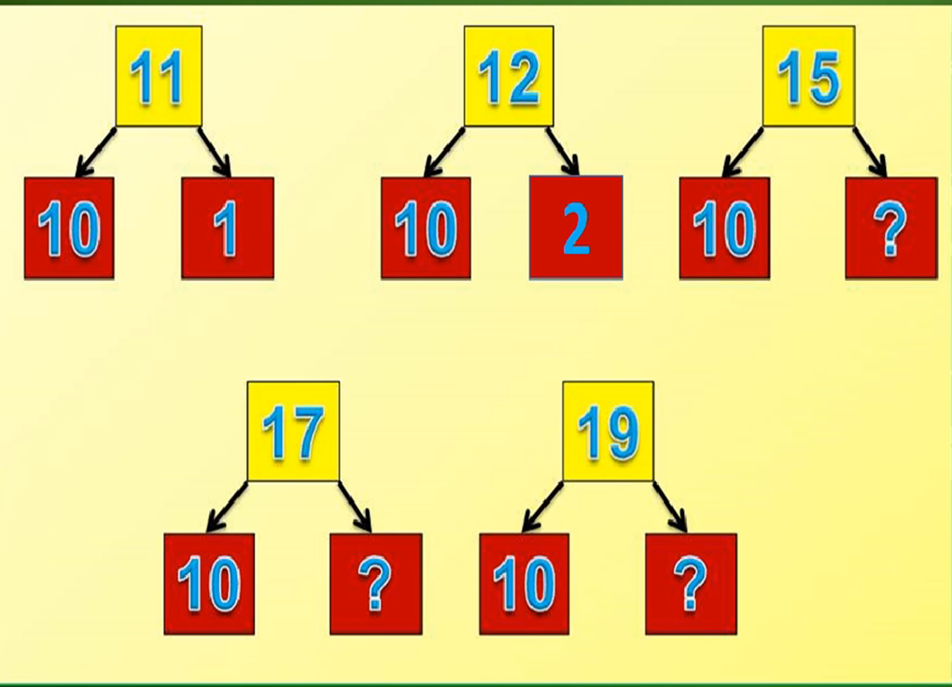
10
1
10
2
10
5
10
7
10
9

Slide 7
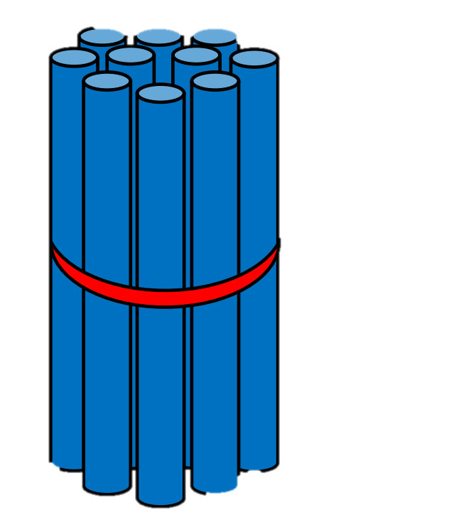

10 + 9 = 19

Slide 8
19 - 9 = 10

Slide 9
19 - 10 = 9

Slide 10
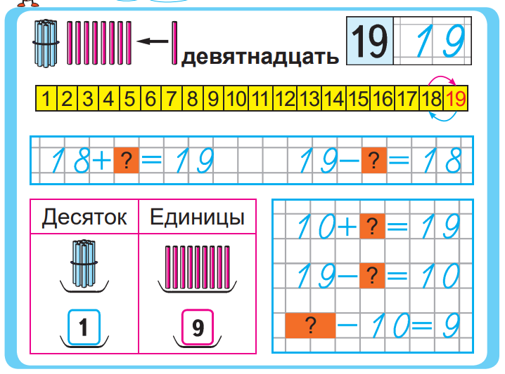




Slide 11
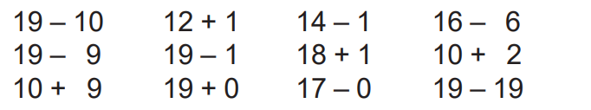


=9
=13
=13
=10
=10
=18
=19
=12
=19
=19
=17
=0
14
17
1
>
=
<
19
13
14
>
<
<

Slide 12

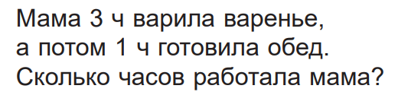
3 + 1 = 4(ч)

Slide 13
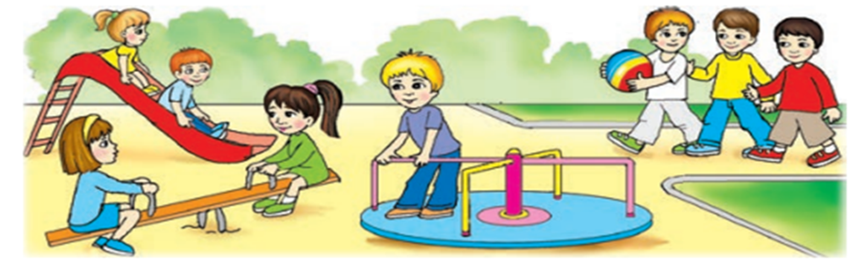
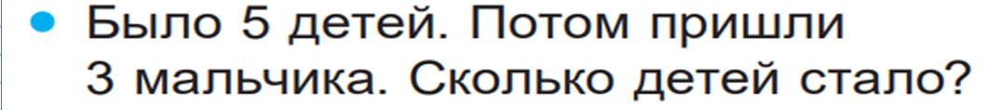
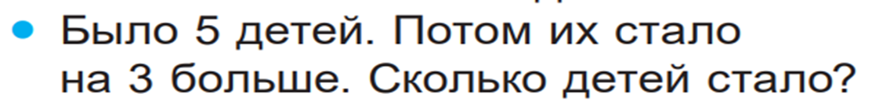
5 + 3 = 8(д.)
5 + 3 = 8(д.)

Slide 14
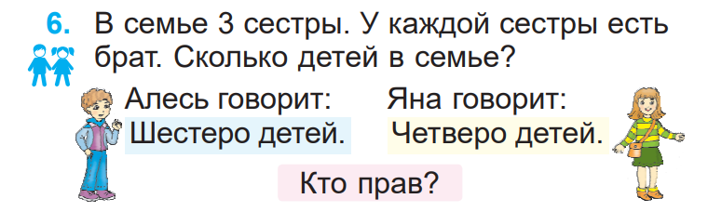





Slide 15
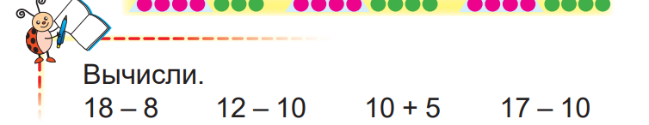
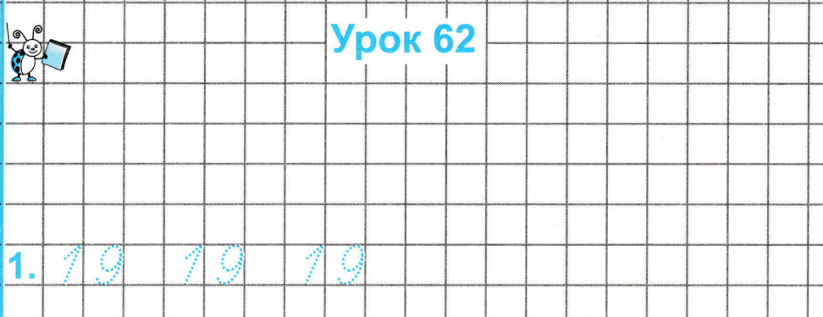

1 8 - 8= 1 0
1 0 +5= 1 5
1 2 - 10 = 2
1 7 - 10 = 7

Slide 16
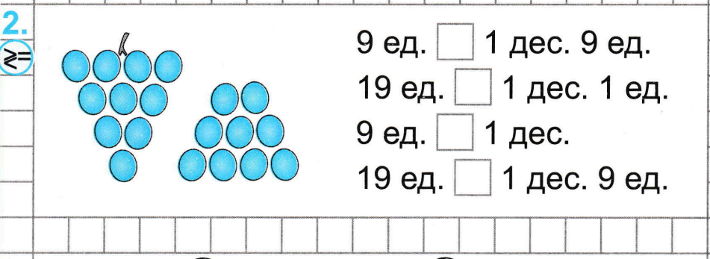
<
>
<
=

Slide 17
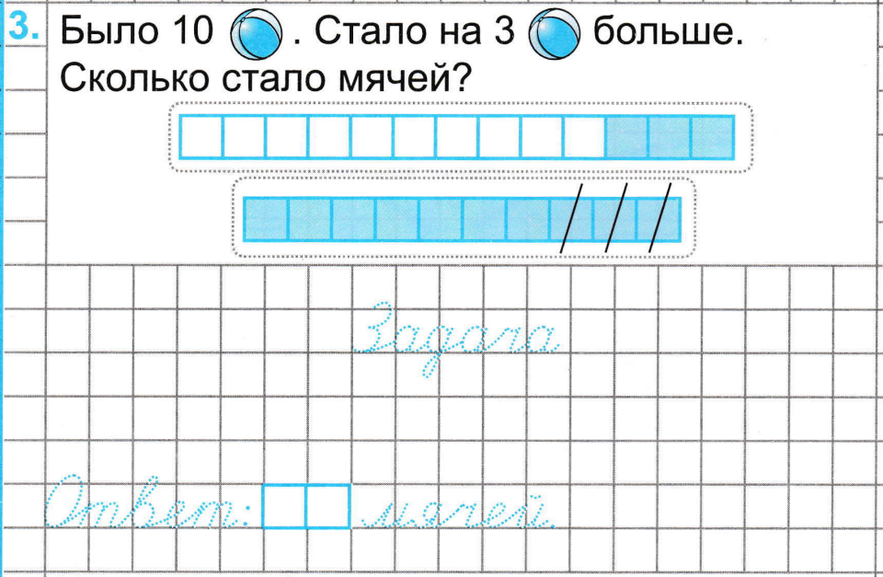
1 0 + 3= 1 3(м.)
1 3

Slide 18
