Slide 2



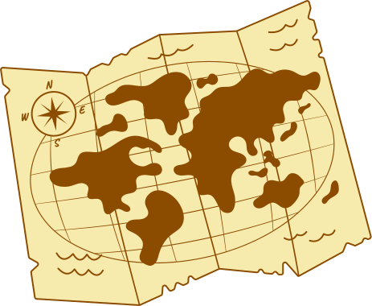
Что нужно для того, чтобы не заблудиться, но заглянуть во все самые интересные уголки мира?

Slide 3


  Много рисунков
  Таблицы и схемы
  Подробные руководства
  Справочные материалы
  Памятки
  Упражнения

Slide 4

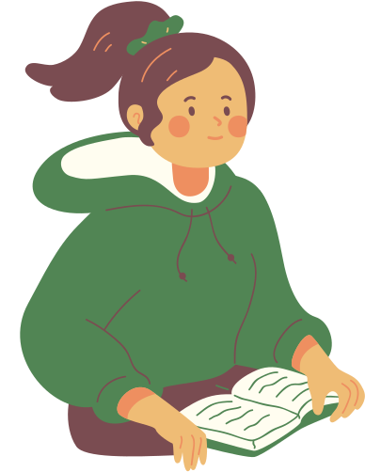
Родственные слова:
учить, учиться, ученик, обучающийся, учитель, учёный, учёность, учебный, учение, ученический, учёба, училище и др.
Учебник

Slide 5

Богатство и выразительность русского языка

Slide 6


Богатство
Обилие, изобилие, пышность, великолепие
Выразительность
Красочность, колоритность, сочность, живопись, образность

Slide 7
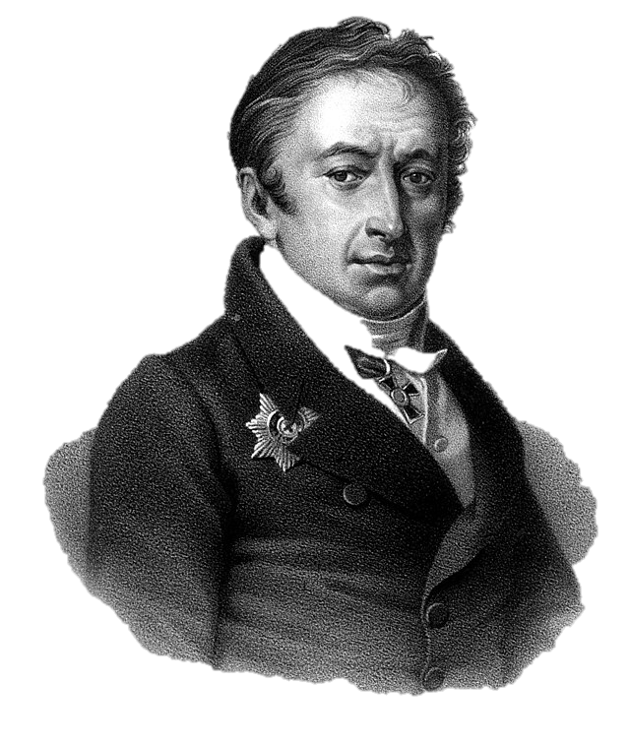
“Богатство языка есть богатство мыслей”
Николай Михайлович
Карамзин
1766-1826 гг.

Slide 8
В чём проявляется богатство и выразительность русского языка?
Многозначные слова
Употребление слов в переносном значении
Синонимы
Антонимы
Устойчивые обороты (фразеологизмы), в том числе пословицы
Образование новых слов от иноязычных
Появление новых значений у старых слов

Slide 9

Adding detail to descriptions

Slide 10

Compare the descriptions
I waited at the empty train station. It felt a little lonely and scary to be all alone for the first time. To ease my nerves, I took a deep breath and thought about what I would eat for lunch.
I waited at the eerily quiet train station. Not a single soul passed and the longer I stood there, I felt the platform expand until I was just a tiny ant standing all alone. I felt my hands sweat, growing tiny puddles in my palms as I tried to imagine the tantilising scent of freshly baked bread that was waiting for me at lunch.

Slide 11



What do we learn?
Language techniques enhance the descriptions you try to create. They add spice and more ways for the reader to relate to the information and imagine it! This will help to transport them to the new worlds in your writing and also make your work sound more interesting.
This does not mean that every sentence needs to have a language technique. Think about it, when you have too much of the same thing, you get sick of it. The same concept applies here, you should have enough to make your work sound amazing but not too much where it is hard to read and understand.

Slide 12
How do they make writing better?

Slide 13
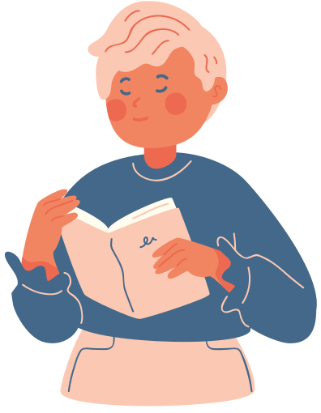

Which one is better?
Read the following examples and decide which one shows a greater depth of love.
My Mum loved me.
I could feel the branches of my mum’s efforts extend over me, creating a canopy that always protected me.

Slide 14



Whilst both of the quotes showcase love for their mum, the second quote uses a metaphor to highlight how much effort and protection has been provided to make the individual feel a deep sense of connection and love.
Both examples mean the same thing but just by using a language technique, you can show more emotion and depth in your writing.
What do we learn?

Slide 15



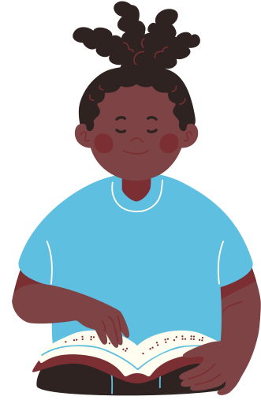






Elements

