Slide 1
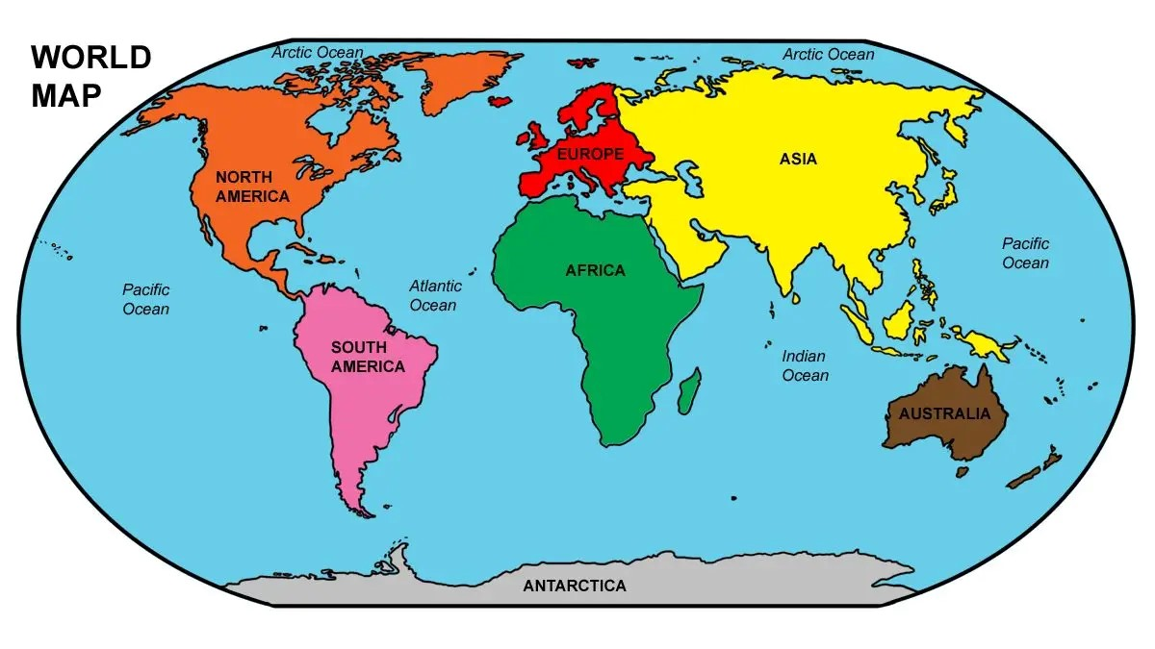


Slide 2
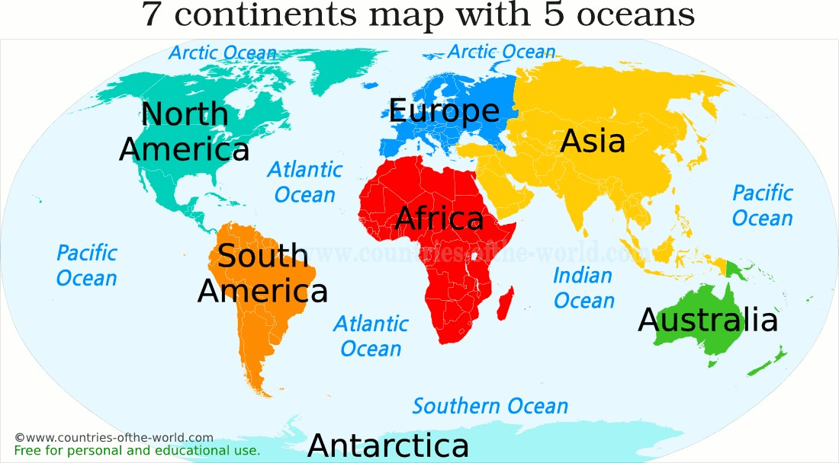

Slide 3


Slide 4
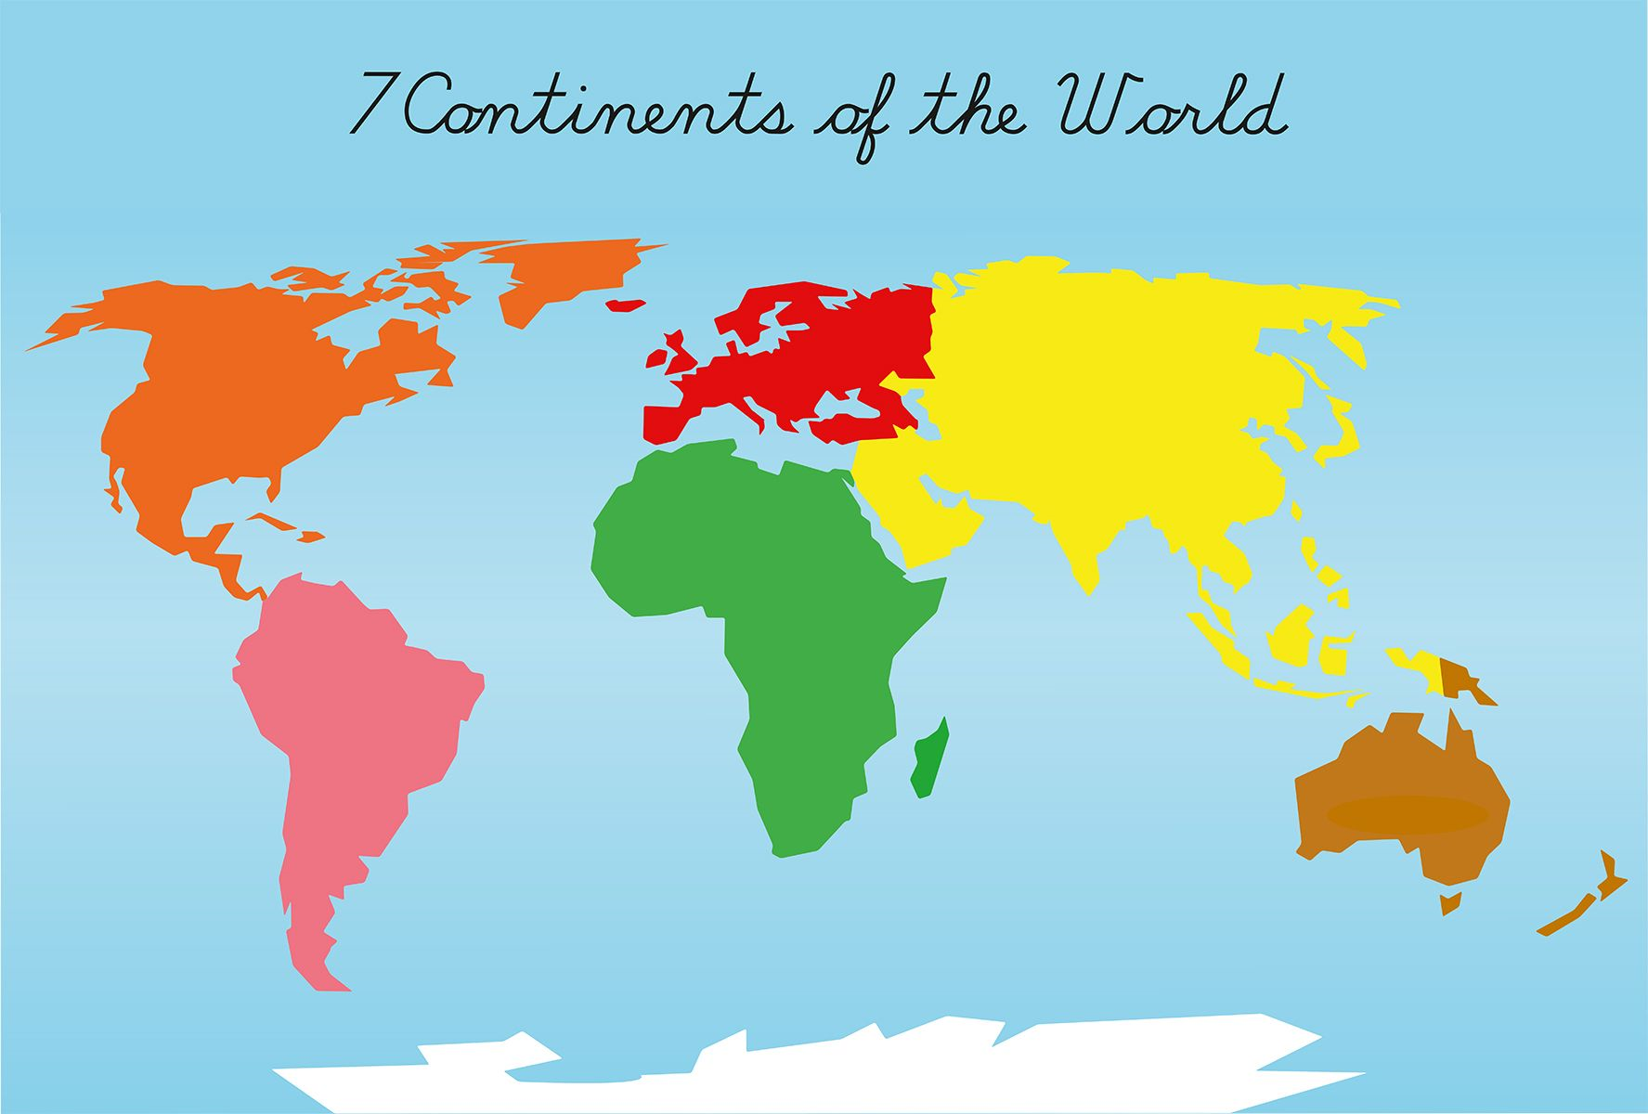
Тема урока

Slide 6
What is the difference between the names of the continents and oceans?
North America South America Africa Europe Asia Australia Antarctica | The Arctic Ocean The Atlantic Ocean The Indian Ocean The Pacific Ocean The Southern Ocean

Slide 7
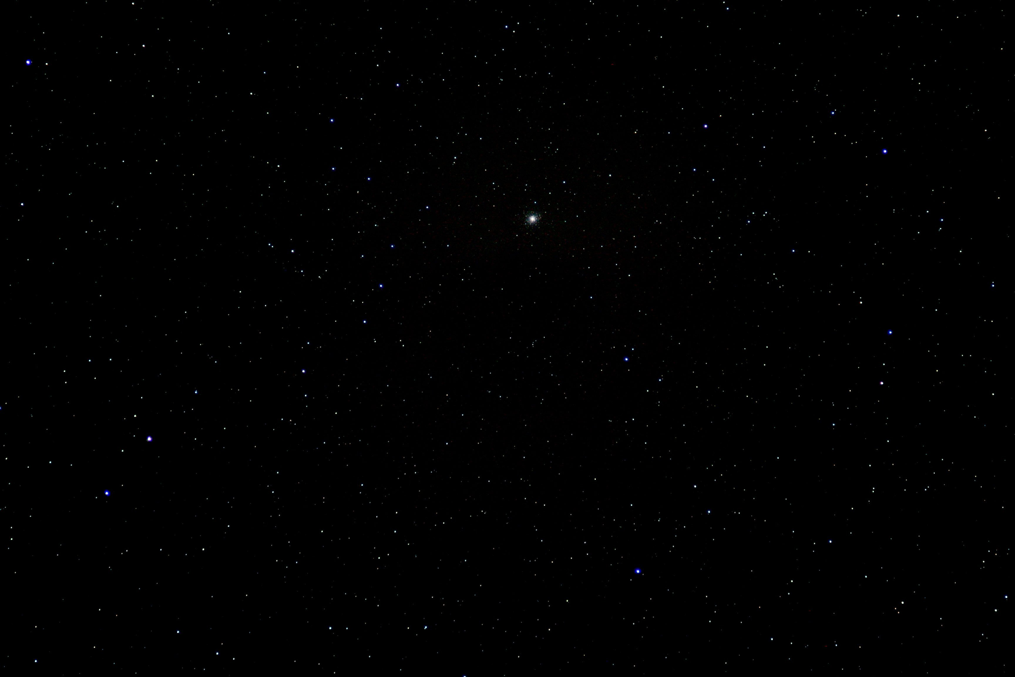

Slide 8
Answers
1. The Atlantic Ocean
2. __ Africa
3. __ North America
4. The Pacific Ocean
5. The Indian Ocean
6. __ Australia
7. __ Europe
8. __ South America
9. The Arctic Ocean
10. __ Asia
11. __Antarctica
12. The Southern Ocean
Критерии оценки:
ошибок нет - 5
1-2 ошибки - 4
3-4 ошибок - 3
5 ошибок - 2

Slide 10
Answers
1) The Atlantic Ocean is… than the Pacific Ocean.
a) larger b) smaller
2. The Arctic Ocean is… than the other four
a) larger b) smaller
3) If you are going from… to…, you travel across the Pacific Ocean
a) Europe… America
b) Asia… America
4. The Arctic Ocean is in the… and the Indian Ocean is in the…
a) north… south
b) south… north

Slide 11
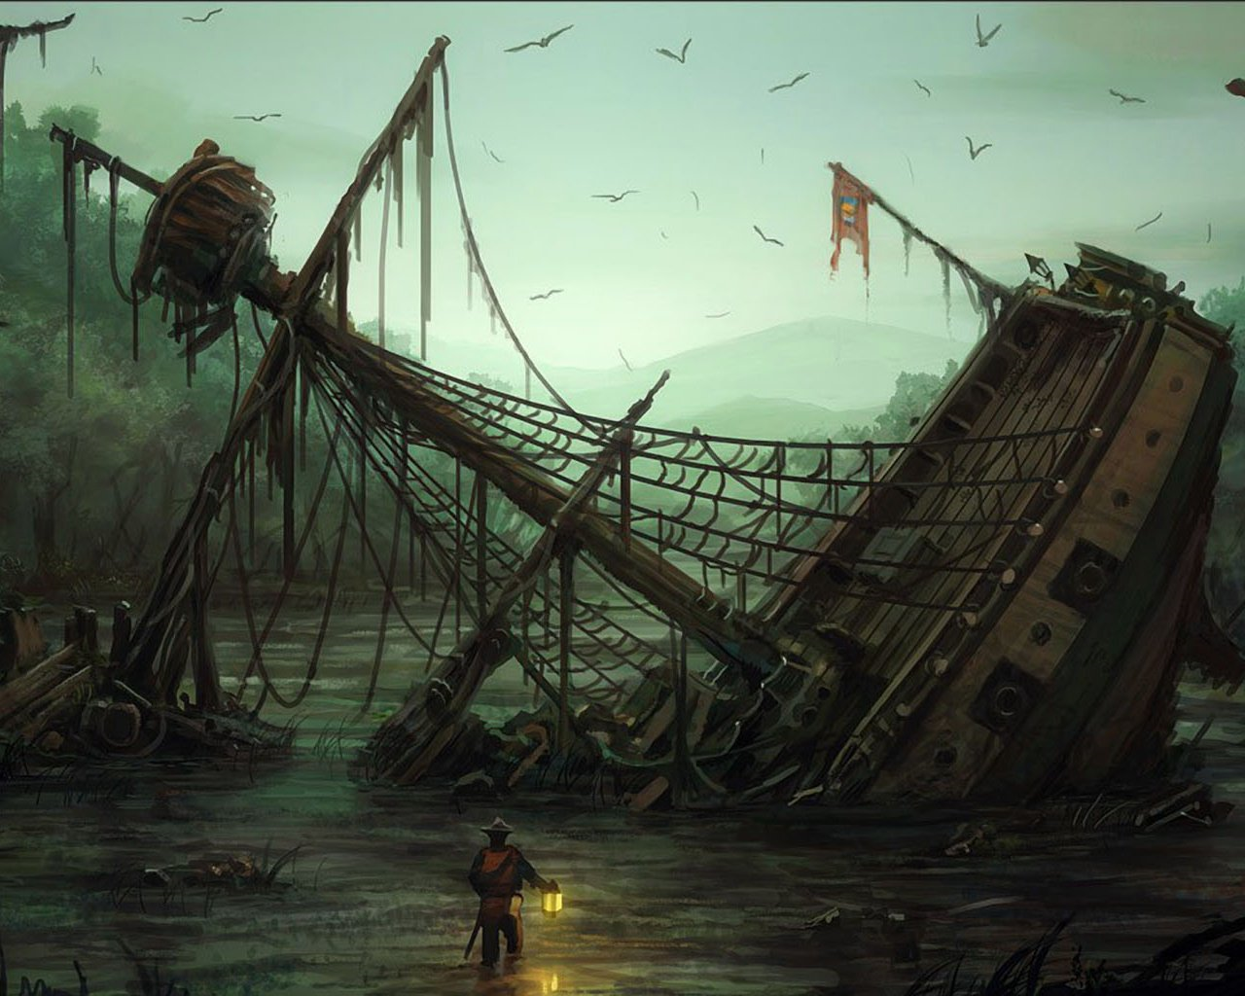

Slide 12
Project work

Slide 13
Answer the questions
1 группа
a) How many continents are there?
There are …. continents!
b) Where is North America situated?
North America is situated between…. ocean and….. ocean
2 группа
a) How many oceans are there?
There are… oceans!
b) Where is the Indian Ocean situated?
Indian Ocean is situated between… and …
3 группа
4. Where is Africa situated?
Africa is situated between … Ocean and … Ocean
5. What animals live in Australia?
They are….
6.What animals live in Antarctica?
Australia situated between … Ocean and…. Ocean

Slide 14
Complete the sentence
Today we learnt___________________
Сегодня мы узнали, что____________

