Slide 1
Модальный глагол «CAN»
Муниципальное образовательное учреждение
Дополнительного образования
«Центр внешкольной работы «Юность»
г.Комсомольск-на-Амуре
2025г.
Автор: Анисимова Вера Константиновна,
Педагог дополнительного образования

Slide 2

CAN
Означает «уметь», «мочь».

Slide 3



+
-
I | can | I |  |  | I
you |  | you |  |  | you
he |  | he |  |  | he
she |  | she |  |  | she
it |  | it |  |  | it
we |  | we |  |  | we
you |  | you |  |  | you
they |  | they |  |  | they
?
can’t
can
(cannot)

Slide 4
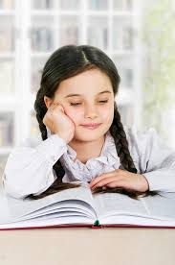
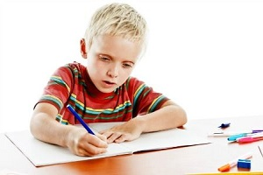
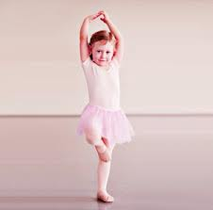
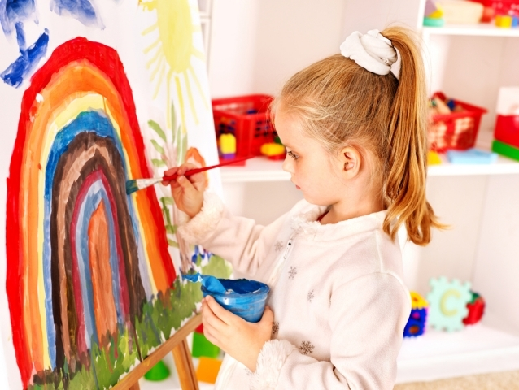
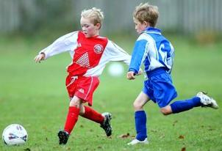
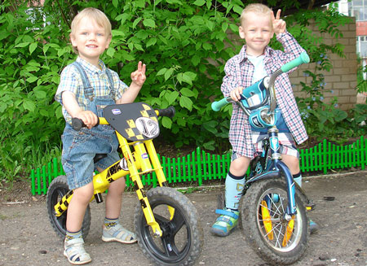
I can read.
I can write.
I can dance.
I can draw.
I can play football.
I can ride a bike.

Slide 5
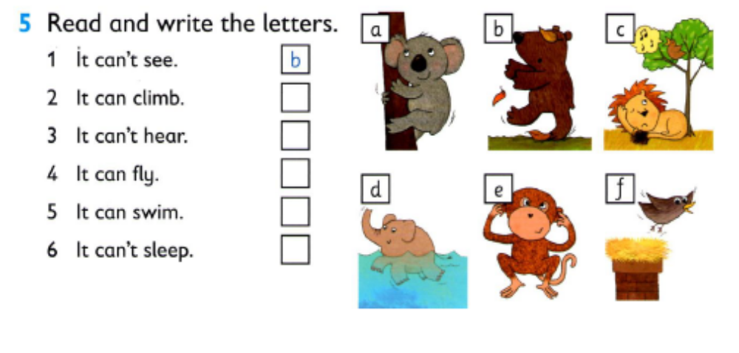
Read and write the letters.
It can’t see.
It can climb.
It can’t hear.
It can fly.
It can swim.
It can’t sleep.

Slide 6
Choose and complete the sentences
walk/swim
A fish can swim. It can’t __________.
2. run/see
A snake can’t________. It can_________.
3. talk/climb
A monkey can_______. It can’t_________.
4. fly/walk
A zebra can_________. It can’t _________.

Slide 7

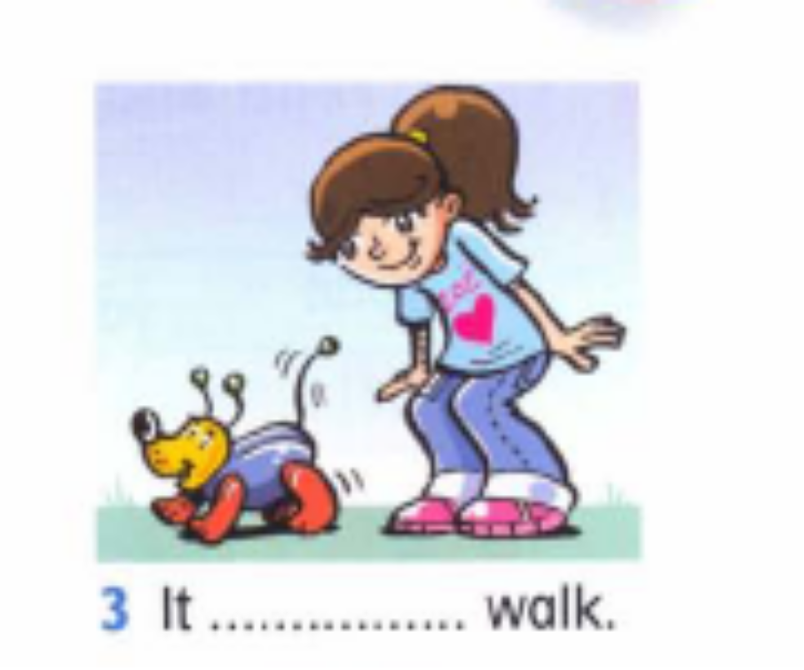
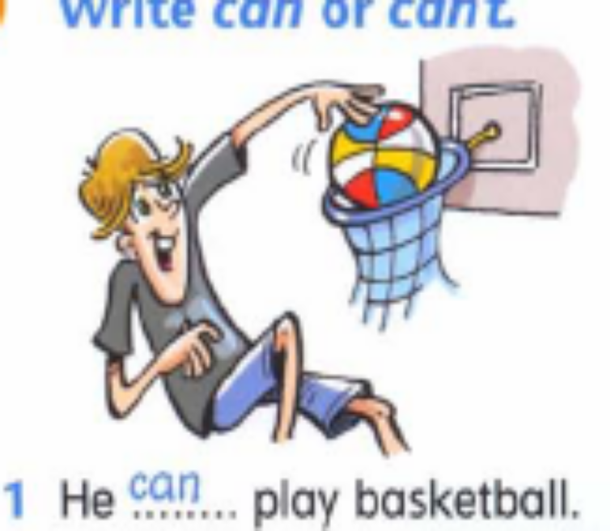
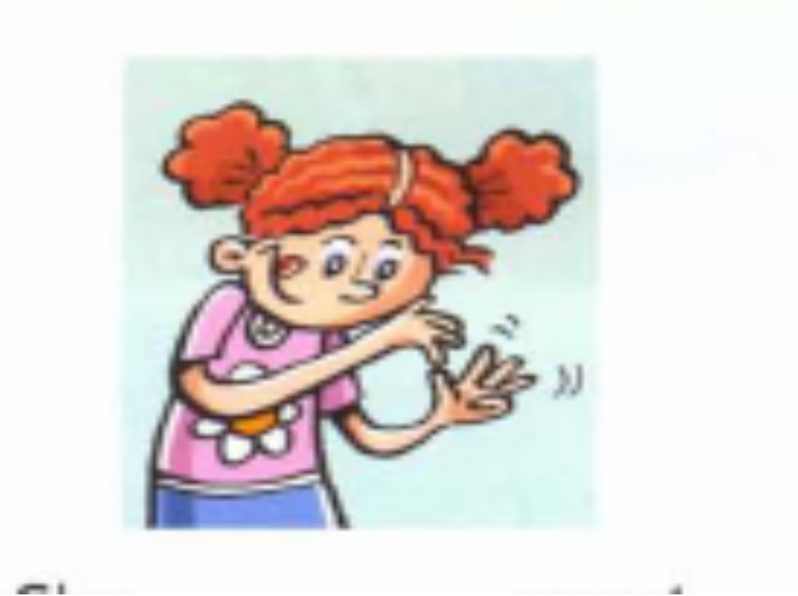
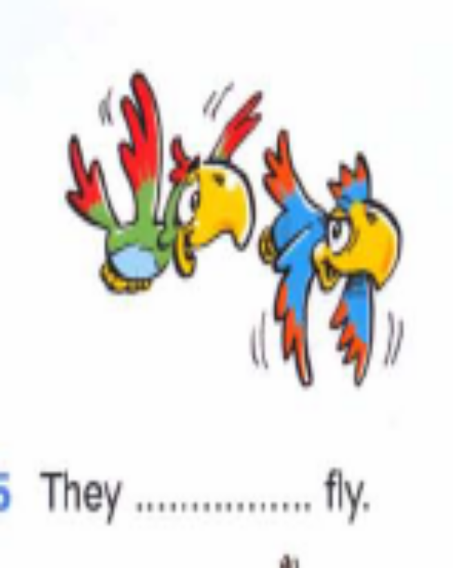
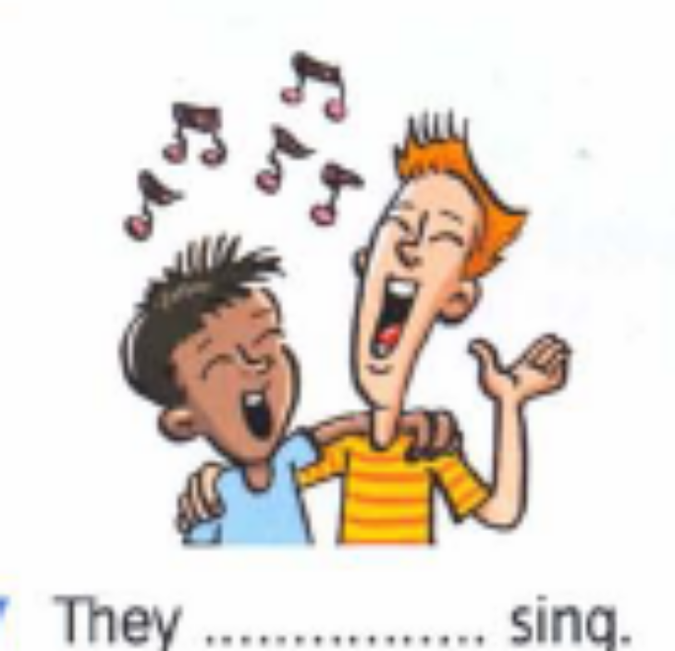
Write can or can’t

Slide 8
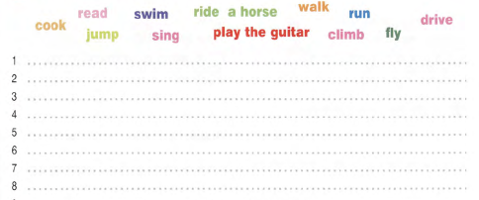
What can/can’t you do? Write sentences.

Slide 9
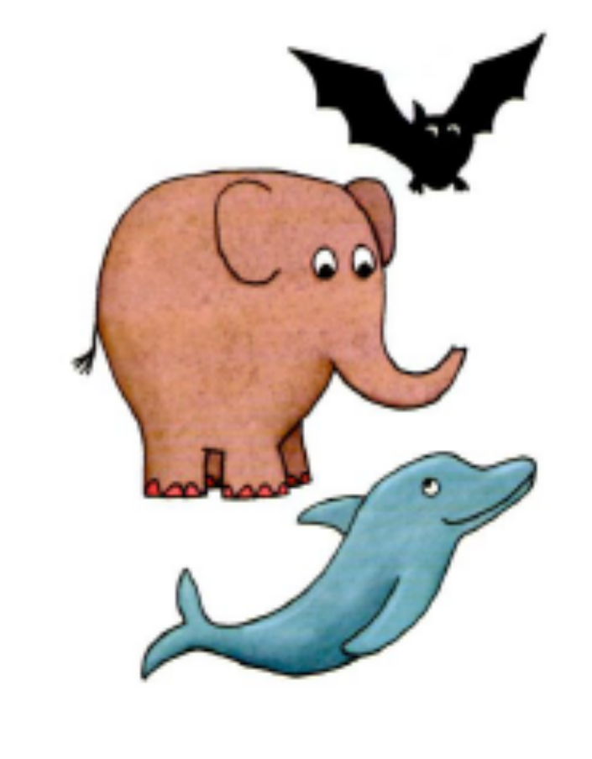
Read and write Yes, it can. Or No, it can’t.
Can the bat see at night?
Сan the dolphin fly?
Can the elephant jump?
Can the bat hear very well?
Can the elephant swim?
Сan the dolphin run?

Slide 10
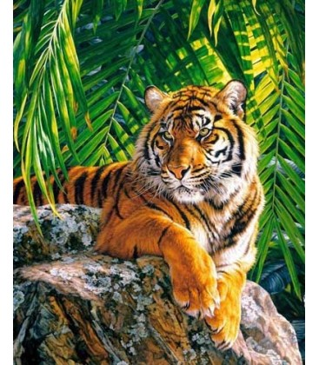
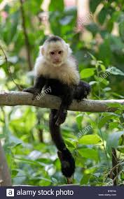
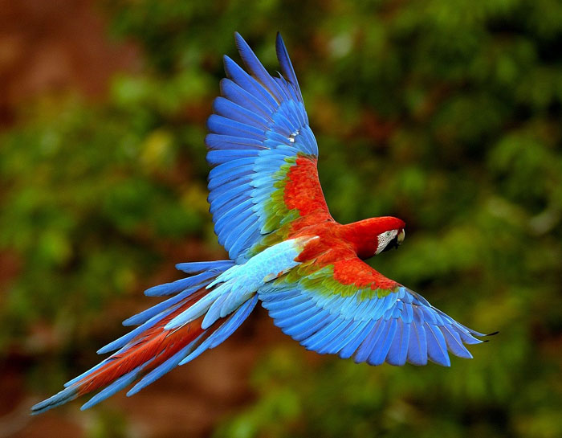
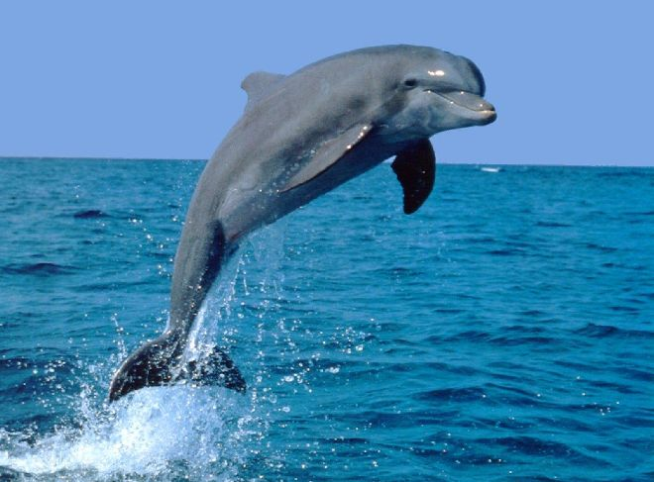
Read the poem
Tiger can run in the jungle.
Monkey can climb in the trees.
Parrot can fly in the blue sky.
Dolphin can swim in the sea.

Slide 11
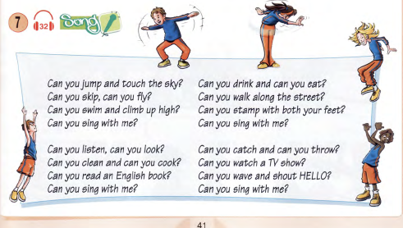


Slide 12


Slide 13
Список использованной литературы:
Virginia Evans, Jenny Dooley «New round-up. Students’ book 1»//Pearson Education Limited, England,2010.
Sandy Jervis «New Grammar Time 1»// Pearson Education Limited, England,2008.
Tamzin Thompson «Oxford Primary Skills. Reading and writing»//Oxford University Press, New York,2009.

Slide 14
Список использованных интернет-ресурсов:
https://encrypted-tbn0.gstatic.com/images?q=tbn:ANd9GcRHzqvtB0sZ8cLcq9qFK5BPQHR0Re33i7JLHyYi9ivHP_X3Gksc
http://laleoka.ru/upload/medialibrary/439/439f01eb2066967a4aad4763cdfad973.jpg
http://tomalogy.org/wp-content/uploads
http://vospitaniedetej.ru/uploads/posts/2012-11/deti-igraut-v-futbol.gif
http://img.7ya.ru/pub/img/19412/009_1.jpg
http://myartclub.ru/670-large_default/tigr-v-dzhunglyakh.jpg
https://pollservice.ru/images/model/Poll/kak_chasto_letaet_papugai.jpg
https://encrypted-tbn0.gstatic.com/images?q=tbn:ANd9GcTAAsjd89zpViOD8VNicSxwlwx2L14Get4AUA557M5YBE9dfmG8

